Slide 1


Conditionals
P 5
Unit 3
December, 2013
Tomašević Snežana

Slide 2
Tired Traveler
I’d take a taxi, if I didn’t spend all my money.
If somebody appeared,I would ask him for help.
If I had more money, I would stay at better hotels.

Slide 3
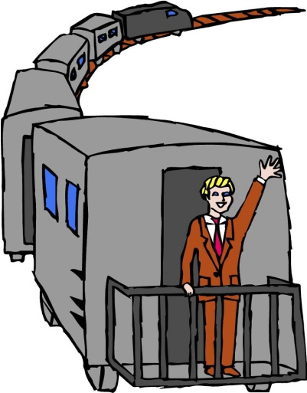

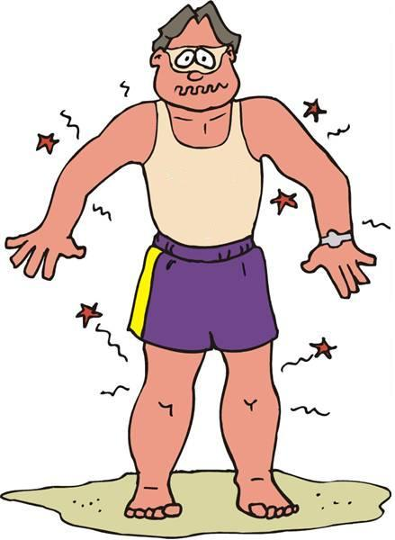



I type- Real Conditionals
Real conditionals are sentences that describe situations that occur regularly or are likely or possible in the future.
If we don’t get to the station on time, the train will leave without us.
If I don’t put sunscreen on, I’ ll get a bad sunburn.
In future-time situations, use the simple present in the if clause and the future with will in the main clause.

Slide 4
CONDITIONAL I - EXERCISES
Match the sentences on the right with those on the left
Where will we go?
Will you come?
She’ll be happy
I’ll stay at home
I’ll go to the theatre
He will win the championship
I’ll stay in bed
I won’t eat
I’ll be the happiest person in the world
We’ll go to the best restaurant
If I go out tonight
If it rains this weekend
If it’s sunny this weekend
if I have a party
If we invite her
If I’m sick
If we eat out tonight
If you cook tonight
If John plays today
If my mother lets me stay out late

Slide 5
II type-Unreal Conditionals
Unreal conditionals are sentences that describe situations that are untrue, unlikely, or impossible in the present or the past.
She doesn’t have enough money and she won’t visit Paris.
In present-time situations, use the simple past in the if clause and would, could, or might plus the base form of the verb in the main clause.
If I had enough money, I would visit Paris.

Slide 6
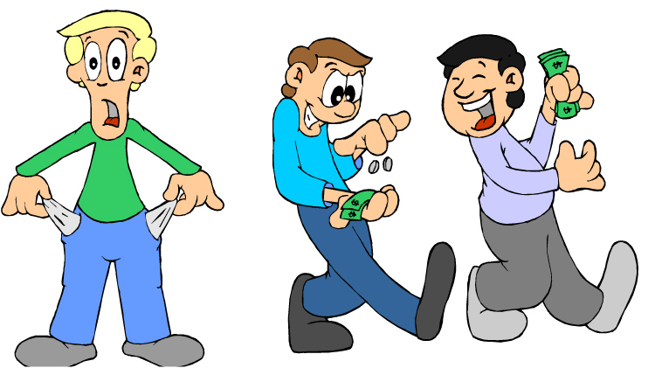

Present Unreal Conditionals
Use the simple past in the if clause. If the verb is be, use were for all persons. Use could, might, or would + base form in the result clause.
Where’s my wallet?
If I were a better planner I wouldn’t travel without a map.
If he were more careful, he would notice that his wallet was missing.
He didn’t travel with a map, so he got lost.

Slide 7
Practice 1
Look at the chart and complete the conditionals with your own ideas.
Type 1-Real | Type 2-Unreal
If + simple present AND will + base form verb | If + simple past AND would/could/might + base form verb
Examples:
If I had enough money, …
If I have enough money, …
I would travel to Asia.
I will travel to Asia.

Slide 8
II Conditional
(HYPOTHETICAL)
This type of conditional clause shows a hypothetical situation. It could happen but it isn’t probable.
If +sub+ PAST SIMPLE , sub + WOULD + INFINITIVE
If clause
If clause
Main clause
Main clause
If I won the lottery , I would buy a car immediately.

Slide 9
II Conditional
(HYPOTHETICAL)
Special rule:
TO BE IS ALWAYS: WERE
If I were taller, I would be a basketball player ( In fact, I’m too short to be a basketball player).
If he were here , he would help me ( but he isn’t here, so he can’t help me).

Slide 10


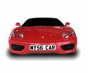


Write the sentences using the conditionals II
Practice 2
If I ……….(BE )
,I …………(BUY) a
If Alonso ……… (HAVE) a faster
, he ………..(WIN) the race.
If it …………( NOT/RAIN)
, we ………….(GO) for a walk in the
CHECK YOUR ANSWERS
If i were rich, I would buy a big house
If Alonso had a faster car, he would win the race
If it didn’t rain cats and dogs, we would go for a walk in the park.

Slide 11




Practice 3
I would feel disappointed if Dave ___________ me to his birthday party.
didn’t invite

Slide 12



Practice 3
What ___________ if she fails the university entrance examination?
will Jane do

Slide 13



Practice 3
If my team ___________ the match, we will fall to the second division.
loses

Slide 14



Practice 3
If Helen’s parents ___________ Spanish, they could help her with her project.
knew

Slide 15



Practice 3
James ___________ his wife a BMW if he were richer.
would buy

Slide 16



Practice 3
are
If you _________ cold, you can put on warm socks and a bathrobe.

Slide 17



Practice 3
If I knew Linda’s address, I ___________ her a valentine card.
would send

Slide 18



Practice 3
If Mary ___________ better tomorrow, she should see a doctor.
doesn’t feel

Slide 19



Practice 3
What would you do if you ___________ lost in a forest at night?
got

Slide 20
Let’s make the
II the conditionals sentences
Practice 4
DRINK BLEACH/ DIE
BE DOCTOR/CURE YOU
EAT A LOT/ GET FAT
BE ALPINIST/ GET TO THE TOP OF THE WORLD
HAVE A FASTER CAR/ ARRIVE EARLIER
BE YOUR FATHER/ PUNISH YOU
NOT EAT WELL/ GET ILL
BE YOU/ NOT DO THIS
SPEAK FRENCH/ UNDERSTAND

Slide 21
Complete the
II conditionals sentences
Practice 4
1.If they……..(HAVE) enough money, they …….(BUY) a new car.
2. If he ……..(BE) my friend, I ………..(INVITE) him.
3. The Smiths ……….(GO) on holiday if they ………..(HAVE) time.
4. If Susan ………..(STUDY) harder, she ………(BE) better at school.
5. We ……….(CALL) the police if we ……….(SEE) a burglar.
6. If the pupils ……….(HAVE) no school, they ………(PLAY) football.
7. If I …………(COME) home early, my father ……(NOT BE) angry.
8. If I………… (BE) you, I………….. (NOT GO) to the party.
If they HAD enough money, they WOULD BUY a new car.
If he WERE my friend, I WOULD INVITE him.
The Smiths ……….WOULD GO on holiday if they HAD time.
If Susan STUDIED harder, she WOULD BE better at school.
We WOULD CALL the police if we SAW a burglar.
If the pupils HAD no school, they WOULD PLAY football.
If I CAME home early, my father WOULD NOT BE angry.
If WERE you, I WOULDN’T GO to the party.

Slide 22


