Slide 1
Phrasal verbs
Tomašević Snežana
November, 2013

Slide 2
PHRASAL VERBS
FORM:
VERB + PARTICLE (PREPOSITION OR ADVERB)
Examples:
Wake up
Turn on
Look like

Slide 3
Get in trouble

Slide 4
Give away

Slide 5
Go out

Slide 6
Hand in

Slide 7
Hand out

Slide 8
Grow up

Slide 9
Hang out

Slide 10
Laugh at

Slide 11
Put out

Slide 12
Put up

Slide 13
Take down

Slide 14
Take off

Slide 15
Break up

Slide 16
Look at

Slide 17
Turn on

Slide 18
Turn off

Slide 19
Come in

Slide 20
Get in

Slide 21
Get out

Slide 22
Run away

Slide 23
Put on

Slide 24
Turn over

Slide 25
Wake up

Slide 26
Look for

Slide 27
Throw away

Slide 28
Pick up

Slide 29
Put down

Slide 30
Take out

Slide 31
Put in

Slide 32
Come out

Slide 33
Turn over

Slide 34
Sit down

Slide 35
Stand up

Slide 36
Go to bed

Slide 37
exercises
PHRASAL VERBS WITH GET

Slide 38
exercises
Choose the best option:
He’s not very good at getting his ideas ___________.
Over
Through
Across

Slide 39
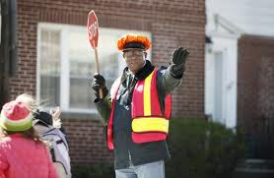
Get Across:
Communicate (specially details)

Slide 40
exercises
Choose the best option:
2. He doesn’t get _______ well with his mother-in-law.
In
Along
Across

Slide 41

Get along (with):
Have a good relationship

Slide 42
exercises
Choose the best option:
3. The news of his arrest got _______ quickly.
On
By
Around

Slide 43

Get around:
Spread / circulate

Slide 44
exercises
3. This weather is getting me _____.
Down
Through
Over

Slide 45

Get down:
Cause someone to be depressed.

Slide 46
exercises
4. I thought he would never get ______ his illness.
Down
Through
Over

Slide 47
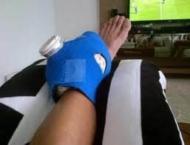
Get over:
Recover from something.

Slide 48
exercises
5. Paul got ______ the bus to go to the store.
Up
On
At

Slide 49
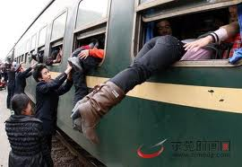
Get on:
Enter

Slide 50
exercises
6. Let’s get ________ tomorrow at 9?
Together
Through
Across

Slide 51
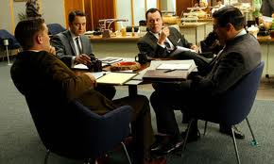
Get together:
Meet

Slide 52
exercises
OTHER PHRASAL VERBS
Choose the correct Phrasal Verb
Notes:
dddd

Slide 53
exercises
Someone _______ last night and stole our TV.
Broke in
Broke into
Broke at

Slide 54
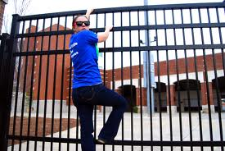
Break in:
Force entry to a building

Slide 55
exercises
They ________ last night, after 3 years dating.
Broke in
Brought in
Broke up

Slide 56

Break up:
End a relationship

Slide 57
exercises
Jason ______ the wedding_______ because he wasn't in love with his fiancé.
Brought in
Got off
Called off

Slide 58
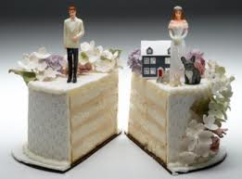
Call off:
Cancel

Slide 59
exercises
Please _______ your answers before you submit your test.
Go by
Go over
Go along

Slide 60

Go over:
Review

Slide 61
exercises
Please ______ while I transfer you to the Sales Department.
Go on
Hold on
Try on

Slide 62

Hold on:
Wait a short time

Slide 63
exercises
We ______of shampoo so I had to wash my hair with soap.
Ran out
Ran off
Ran over

Slide 64
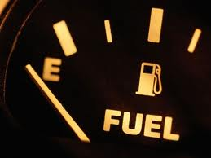
Run out:
Have none left

Slide 65

Any questions?

Slide 66

THANK YOU FOR YOUR ATTENTION
Now, practice in your book.

