Slide 1
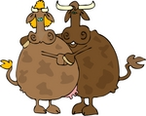
WHAT ARE THE COWS DOING?
DANCE
SHOP
RIDE
HOOVER
READ

Slide 2
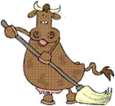
What’s the cow doing?
cleaning
✗
running
dancing
The cow is____________ the floor.
cleaning

Slide 3
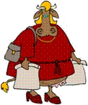
What’s the cow doing?
dancing
✗
cooking
shopping
The cow is____________.
shopping

Slide 4
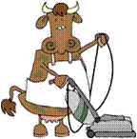
What’s the cow doing?
fishing
✗
washing
vacuuming
The cow is ____________ the floor.
vacuuming

Slide 5
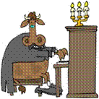
What’s the cow doing?
surfing
✗
playing the piano
surfing the internet
The cow is ___________________.
playing the piano

Slide 6
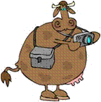
What’s the cow doing?
taking photographs
✗
watching a video
playing video games
The cow is ____________________ .
taking photographs

Slide 7
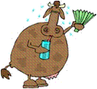
What’s the cow doing?
cooking
✗
eating a hot dog
drinking juice
The cow is________________.
drinking juice

Slide 8
What’s the cow doing?
riding a motorbike
✗
riding a horse
driving a car
The cow is___________________.
riding a motorbike

Slide 9
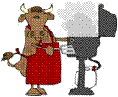
What’s the cow doing?
drinking
✗
eating
cooking
The cow is__________.
cooking

Slide 10
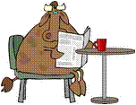
What’s the cow doing?
writing a letter
✗
reading the newspaper
riding a bike
The cow is______________________.
reading the newspaper

