Slide 1


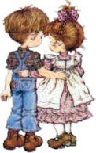

The
PRESENT CONTINUOUS

Slide 2
Present Continuous
What are they doing now?
eat // ice-cream
dance
have // a shower
She is eating an ice-cream
They are dancing.
He is having a shower.

Slide 3
cry
cook // pancakes
play // the violin
Is the boy crying?
Is the man cooking pancakes?
Yes, he is.
The boy is crying.
No, he isn’t.
The man is playing the violin.
read // the newspaper
Is she reading the newspaper?
Yes, she is.
She is reading the newspaper.

Slide 4
The Present Continuous
Verb/ Glagol: Dance
AFFIRMATIVE/ potvrdan oblik
FORMA-GRAĐENJE:
glagol TO BE (simple present: AM/ IS/ ARE)
+
GLAVNI GLAGOL +nastavak –ING
PRESENT PARTICIPLE
I am dancing
You are dancing
He / She / It is dancing
We are dancing
You are dancing
They are dancing
UPOTREBA:
 Da govorimo o radnjama koje se dešavaju sada tj u trenutku kada o njima pričamo.

Slide 5
The Present Continuous
Verb: Dance
NEGATIVE
INTERROGATIVE
I am not dancing
You are not dancing
He / She / It is not dancing
We are not dancing
you are not dancing
They are not dancing
Am I dancing ?
Are you dancing?
Is he / she / it dancing?
Are we dancing?
Are you dancing?
Are they dancing?

Slide 6
THE PRESENT CONTINUOUS TENSE affirmative sentences
Verb/ Glagol: Play
I | am ‘m | playing
You | are ‘re
He She It | is ‘s
You We They | are ‘re

Slide 7
THE PRESENT CONTINUOUS TENSE negative sentences
Verb/ Glagol: Play
I | am not ‘m not | playing
You | are not aren’t
He She It | is not isn’t
You We They | are not aren’t

Slide 8
THE PRESENT CONTINUOUS TENSE interrogative sentences
Verb/ Glagol: Play
Am | I | playing?
Are | you
Is | he she it
Are | you we they

Slide 9
Make –ing forms of each verb given.
go
start
listen
stop
swim
study
happen
get
use
fly
try
clean
come
eat

Slide 10
SPELLING RULES / PRAVILA PISANJA
write ⇨ writing take ⇨ taking
but see ⇨ seeing
Glagoli koji se završavaju na –e gube to –e pa im se dodaje nastavak –ing
sit ⇨ sitting
swim ⇨ swimming
Glagoli koji se završavaju jednim naglašenim samoglasnikom između dva suglasnika,
poduplavaju taj poslednji suglasnik pa im se dodaje nastavak –ing
Glagoli koji se završavaju sa –l, poduplavaju to –l pa im se dodaje nastavak –ing
travel ⇨ travelling
lie ⇨lying
die ⇨ dying
Glagoli koji se završavaju sa –ie, gube to –ie dobijaju –y pa im se dodaje nastavak –ing

Slide 11
TIME EXPRESSIONS/
VREMENSKI IZRAZI
Vremenski izrazi koji se koriste uz PRESENT CONTINUOUS su:
at present
at the moment
now
these days

Slide 12
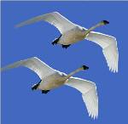
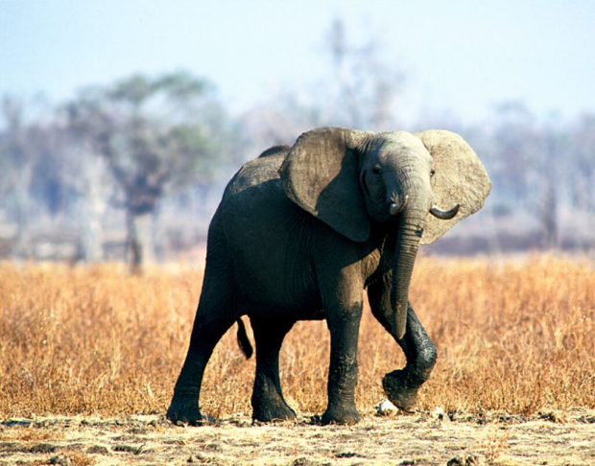
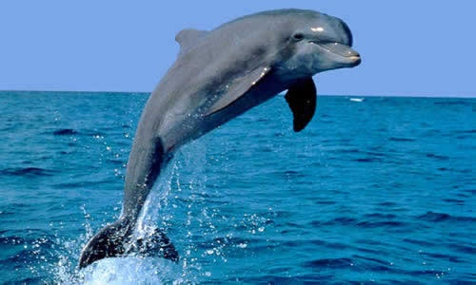
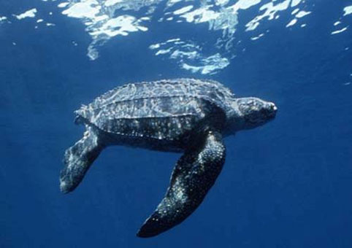
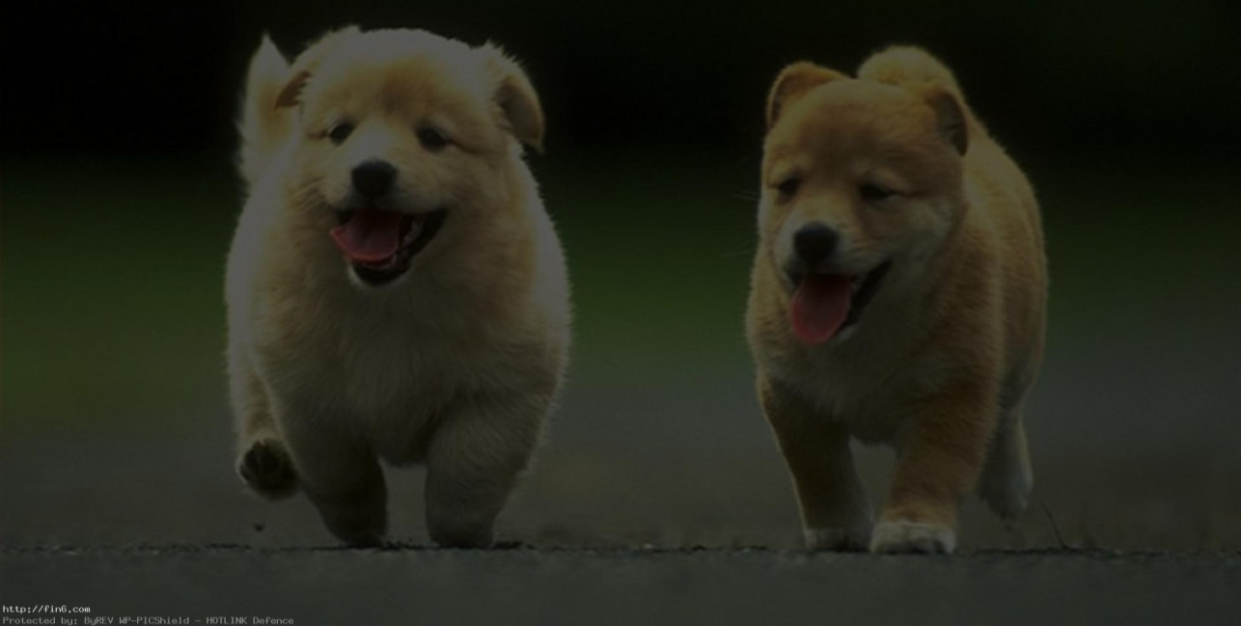
What are they doing?
The birds are flying.
The elephant is walking.
The dolphin is jumping.
The turtle is swimming.
The dogs are running.

Slide 13
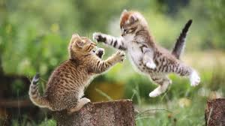

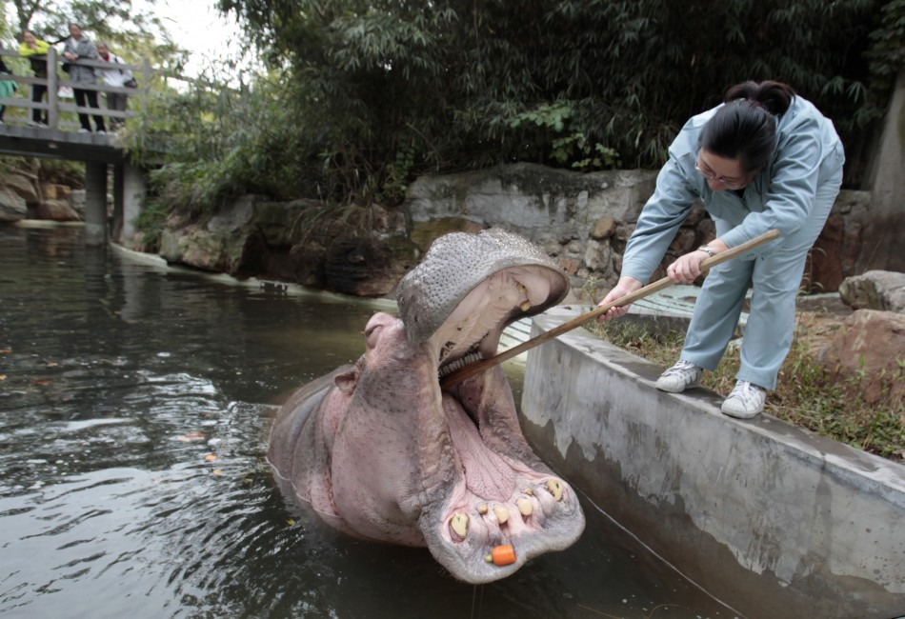
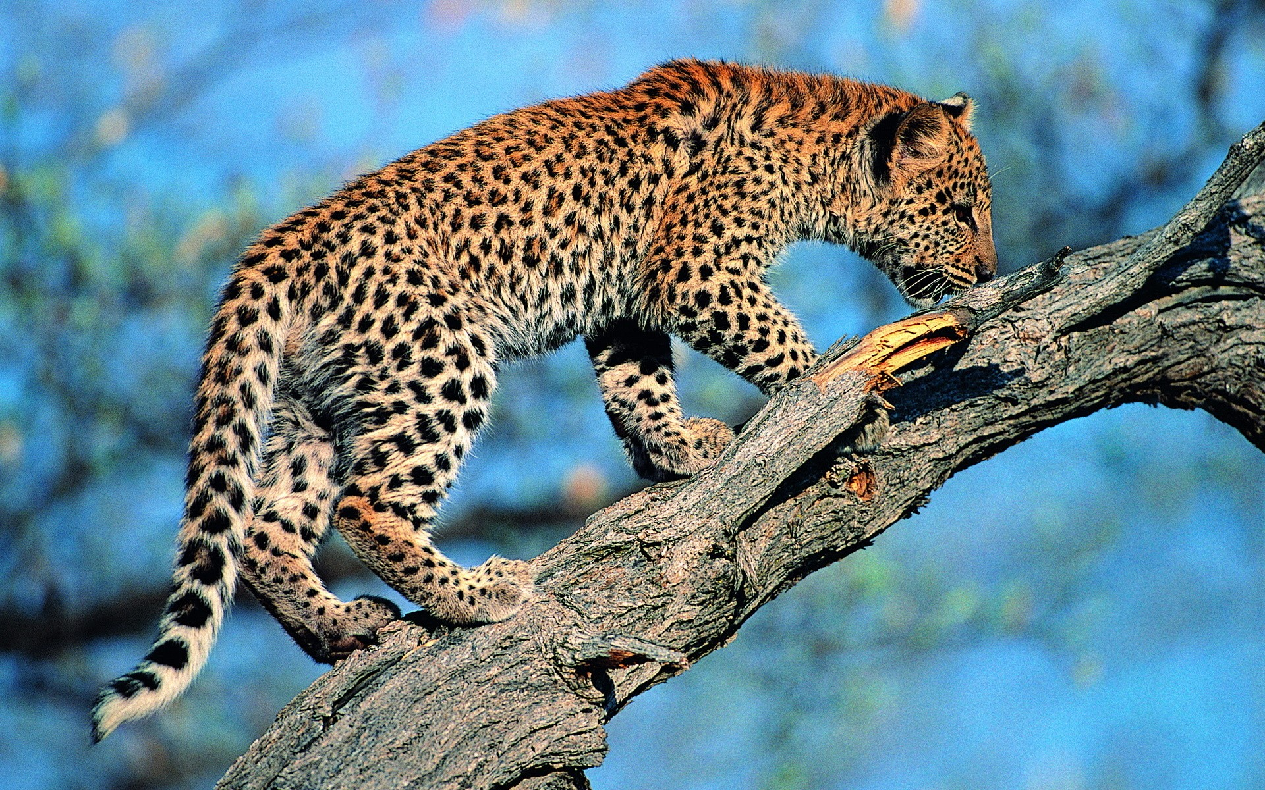
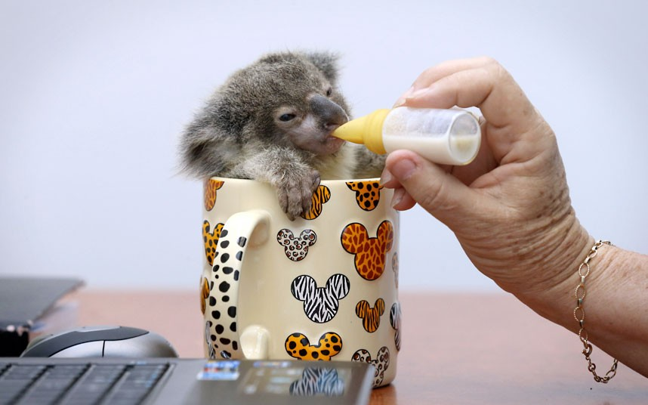
What are they doing?
The cats are playing.
The penguins are standing.
The keeper is cleaning hippo’s teeth.
The koala is drinking milk.
The cheetah is climbing a tree.

Slide 14
The Present Continuous
Complete the sentences.
is watching
1 She ____________(watch) TV.
2 We ____________(learn) English.
3 Jack ____________(do) his homework.
4 I ____________(sit) on the bench.
5 Kate and Ben ____________(play) tennis.
6 Mr. Grey ____________(watch) birds in the zoo.
7 Monkeys ____________(hide) in the trees.
6 The crocodile ____________(swim).
7 Birds ____________(fly).
8 My dog ____________(jump) around me.
are learning
is doing
am sitting
are playing
are watching
are hiding
is swimming
are flying
is jumping

Slide 15






(he / swim – dive)
(he / ride a motorcycle – drive a car)
Is he swimming?
Is he riding a motorcycle?
No, he isn’t.
He is diving.
No, he isn’t.
He is driving a car.
(she / use a computer – read a book)
Is she using a computer?
No, she isn’t.
She is reading a book.

Slide 16

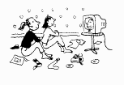



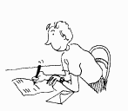
(they / tidy their room – watch TV)
(it / climb a tree – catch a ball)
Are they tidying their room?
Is it climbing a tree?
No, they aren’t.
They are watching TV.
No, it isn’t.
It is catching a ball.
(he / call his friend – write a letter)
Is he calling his friend?
No, he isn’t.
He is writing a letter.

Slide 17

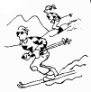
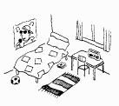
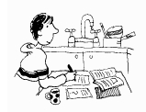
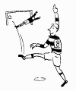

(they / skate – ski)
(he / study in his room – study in the kitchen)
Are they skating?
Is he studying in his room?
No, they aren’t.
They are skiing.
No, he isn’t.
He is studying in the kitchen.
(he / ski – play football)
Is he skiing ?
No, he isn’t.
He is playing football.

