Slide 1
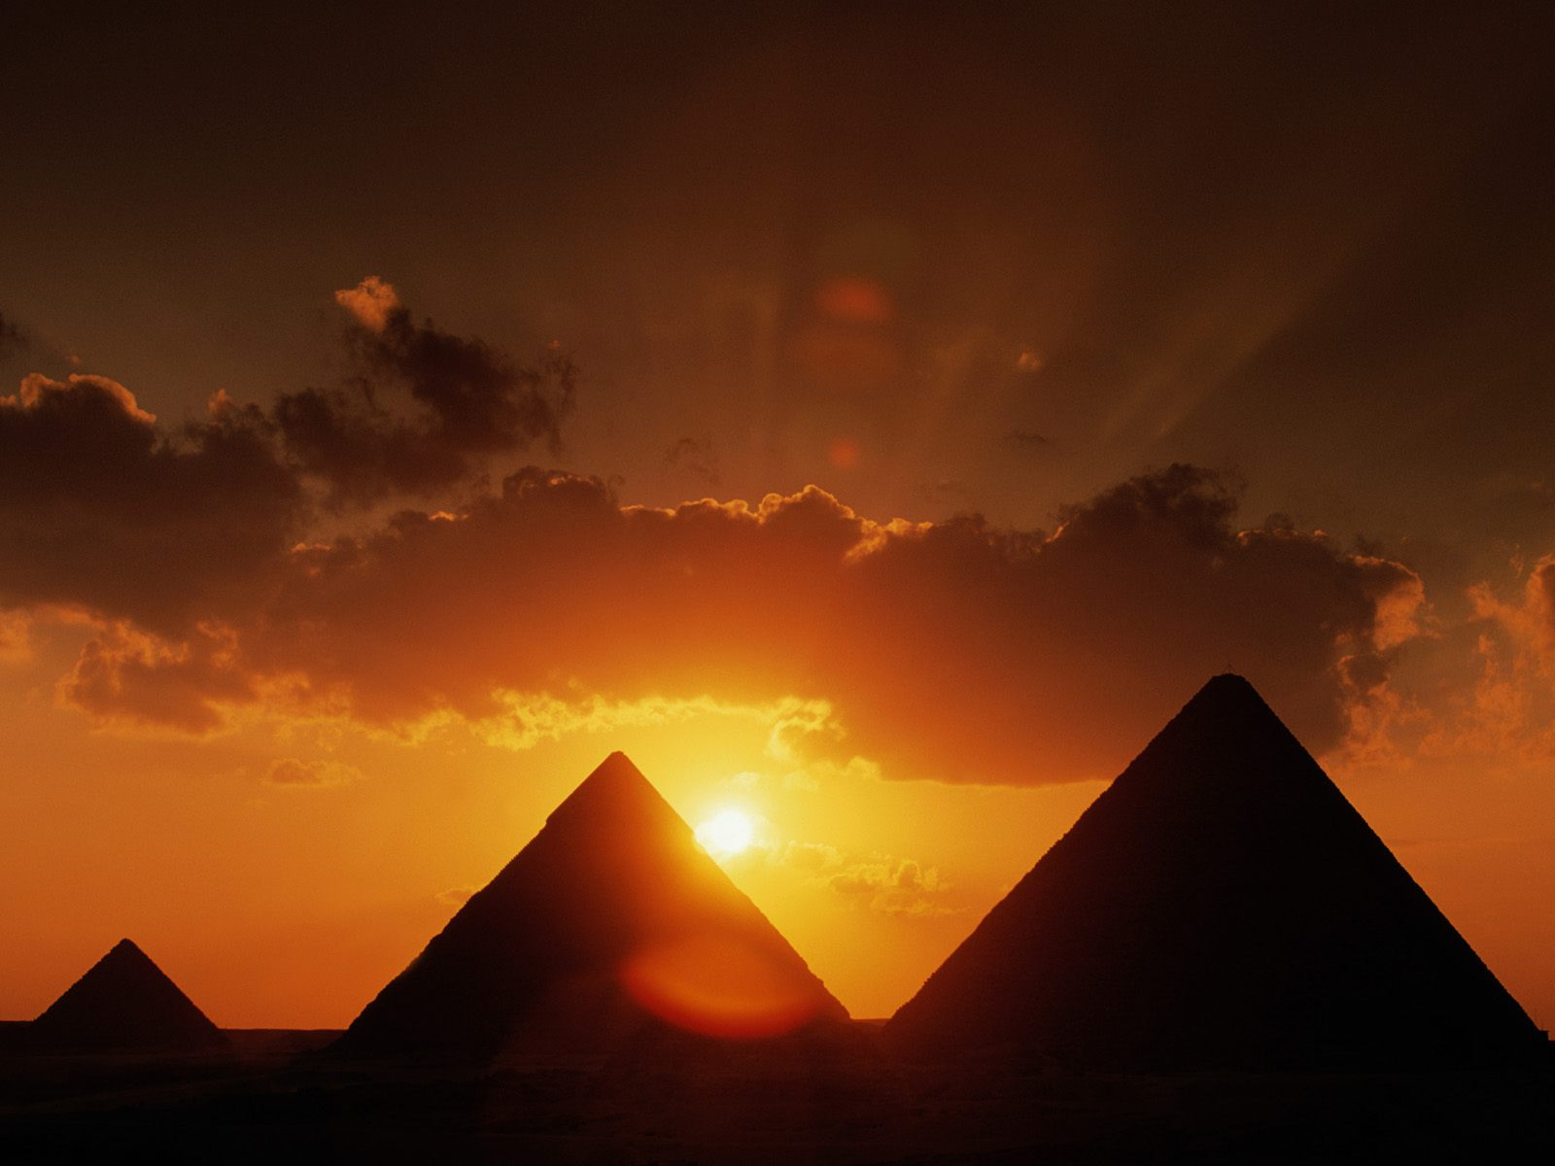
Ancient Egypt
Marta Milenković VII 1

Slide 2
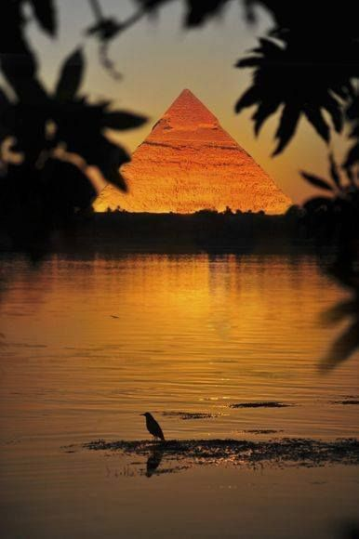
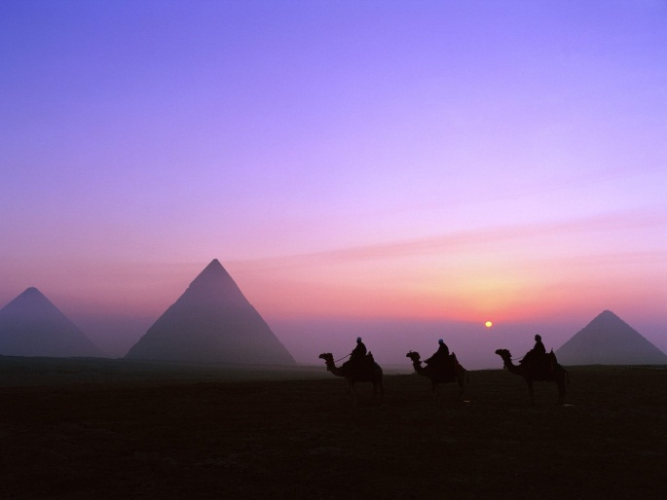
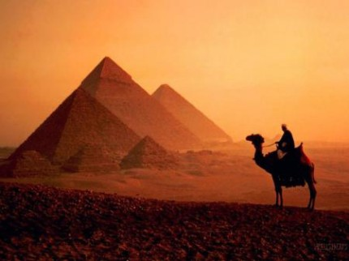
Ancient Egypt
► Ancient Egypt was a civilization that originated in the valley of the Nile , around 3.300 BC in northeast Africa. It is one of the oldest civilization in the human history. For Egypt is said to have the gift of the Nile River. Ancient Egypt is the greatest human civilization. Egyptian civilization developed specific religion , architecture, writing and art. The River Nile was important for the development of the ancient Egypt.
► Egypt is divided into: Ancient Egypt , Middle Egypt and New Egypt.

Slide 3
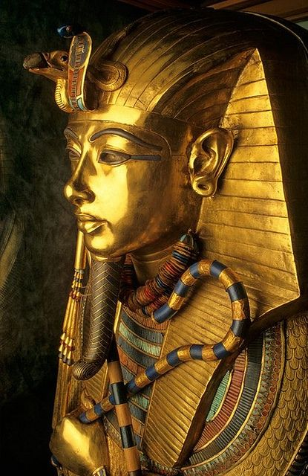
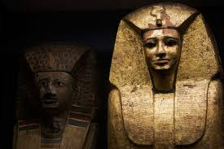
► The kingdom of Egypt was ruled by Pharaoh , who was considered a god.
► The word ‘Pharaoh’ means ‘the one in the palace’.

Slide 4
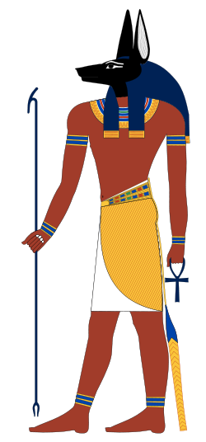
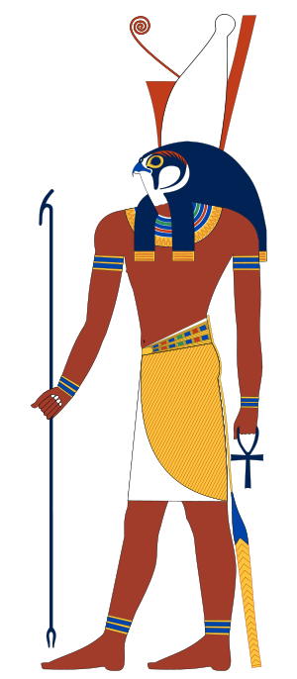
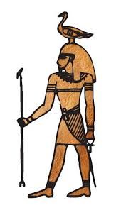
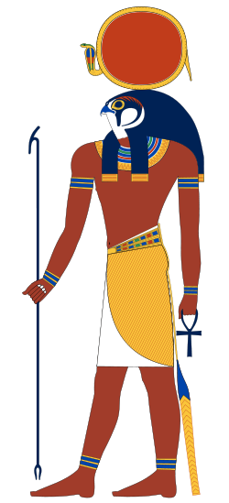
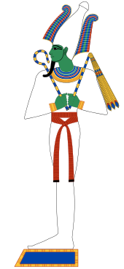
► The Egyptians believed in many gods and also in the afterlife.
► Supreme gods are:
→ Ra (god of Sun)
→ Geb (god of Earth)
→ Nut (god of Heaven)
→ Osiris
→ Anubis
→ Horus
Anubis
Geb
Horus
Ra
Osiris

Slide 5
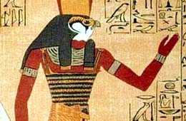
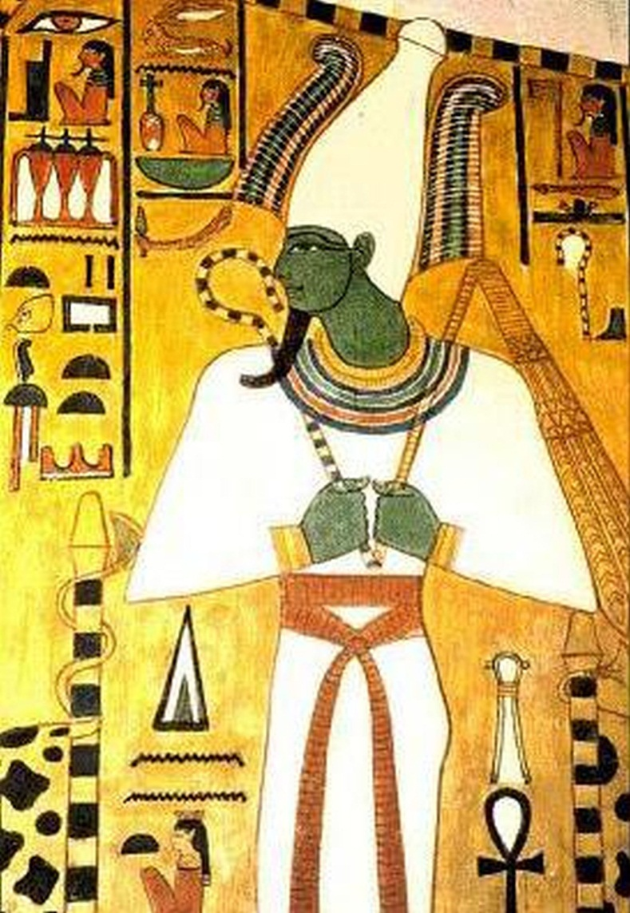
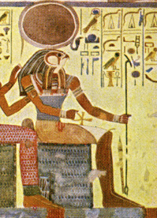
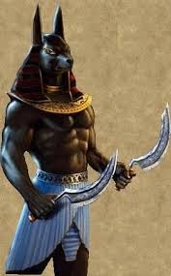
→Horus
→Ra
→Osiris
→Anubis

Slide 6
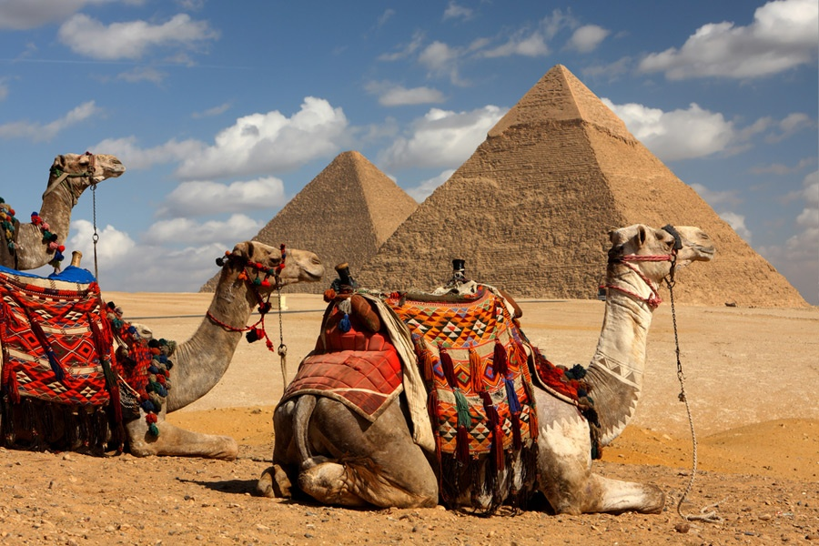
►The Egyptians built the pyramids , temples , sphinxes , etc.
►The Egyptian pyramids are the structures in the form of pyramids which were built in the ancient Egypt and considered the largest and most spectacular achievements.
►Ancient Egyptians knew mathematic, astronomy, geometry, medicine , etc. They wrote using colorful letters – hieroglyphics.
►The most famous pyramids are:
→ Great Pyramid of Giza
→ Khafre Pyramid
→ Mankauare Pyramid
→ Red Pyramid

Slide 7
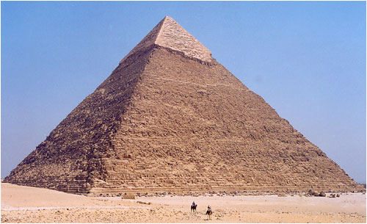
Khafre Pyramid

Slide 8
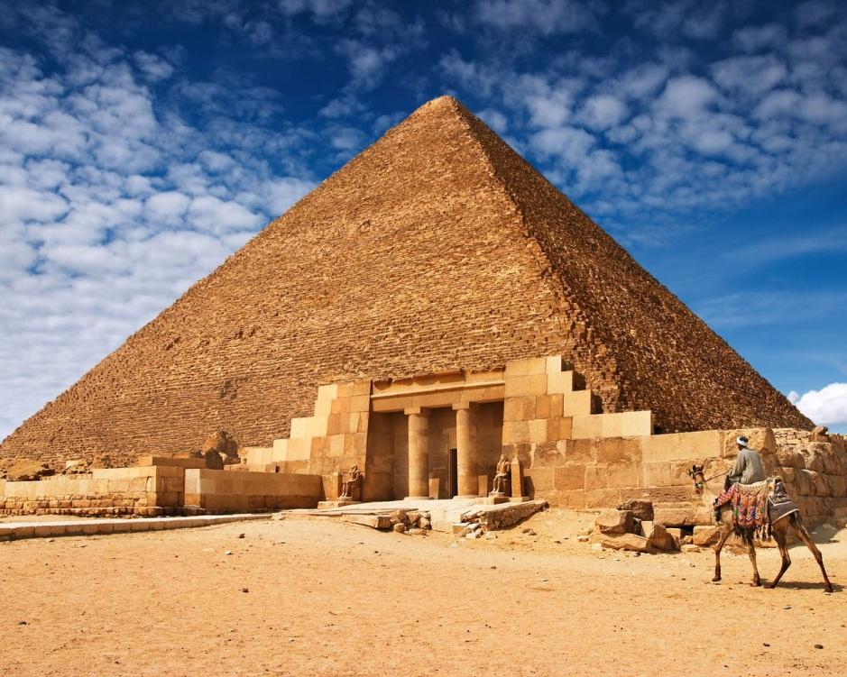
Great Pyramid of Giza

Slide 9
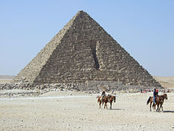
Mankaure Pyramid

Slide 10
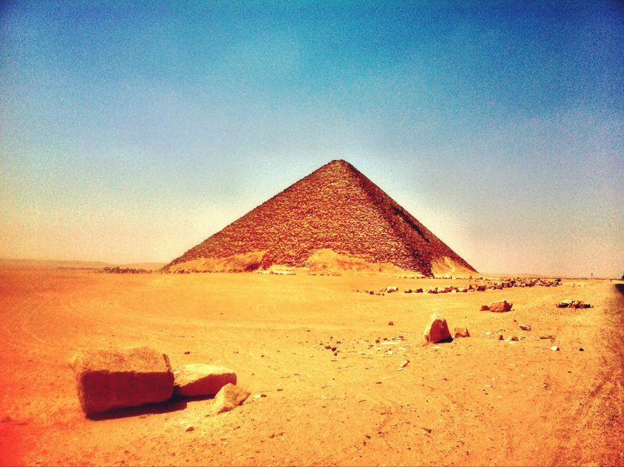
Red Pyramid

Slide 11
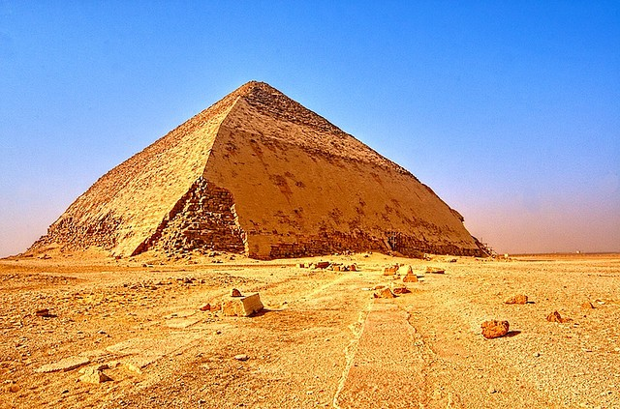
Bent Pyramid

Slide 12
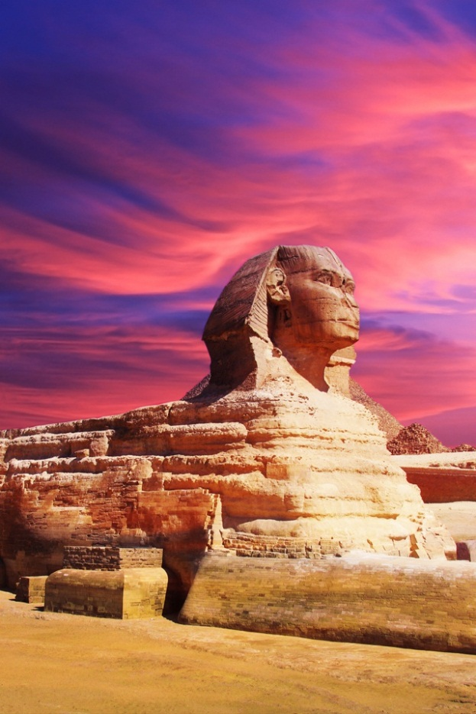
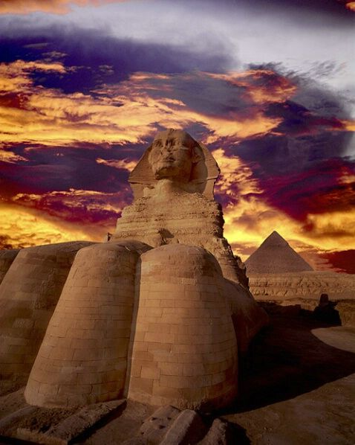
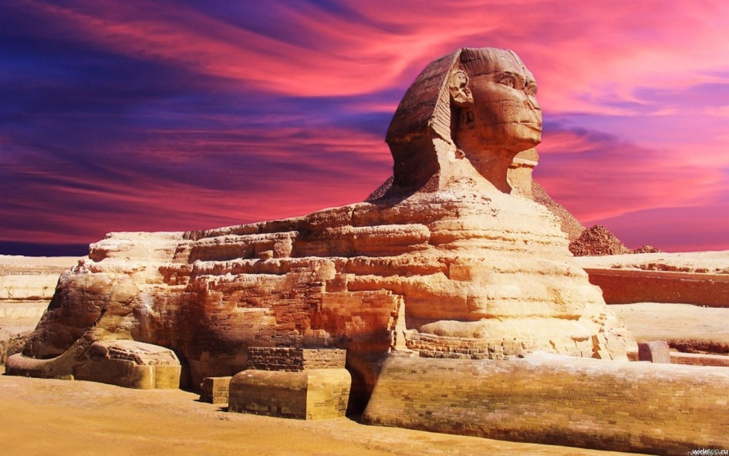
Sphinxes

Slide 13
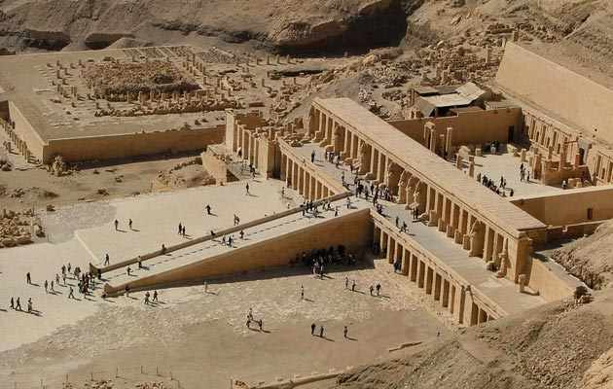
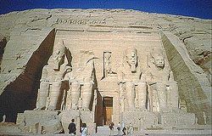
Temple of Hatshepsut

Slide 14
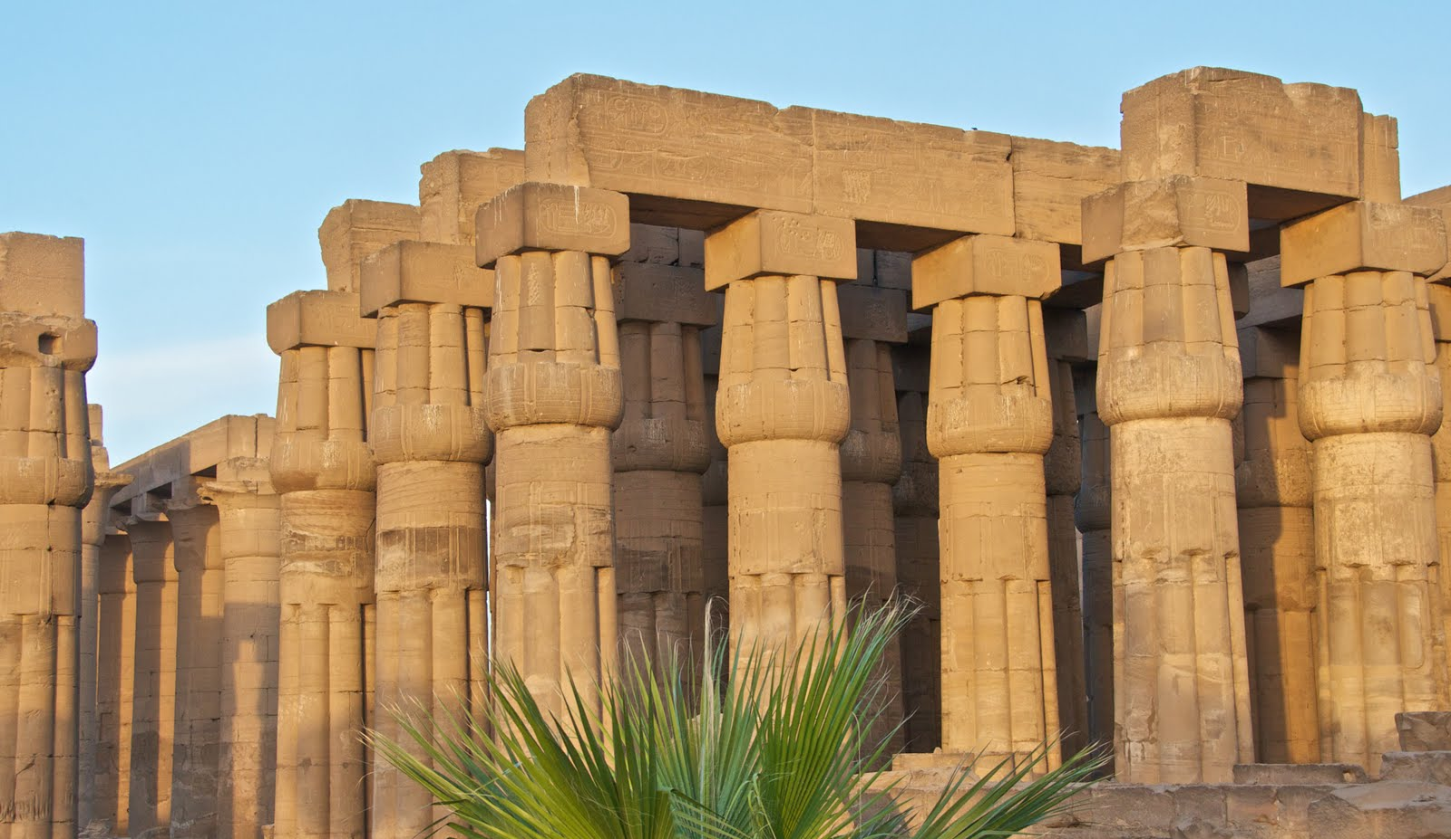
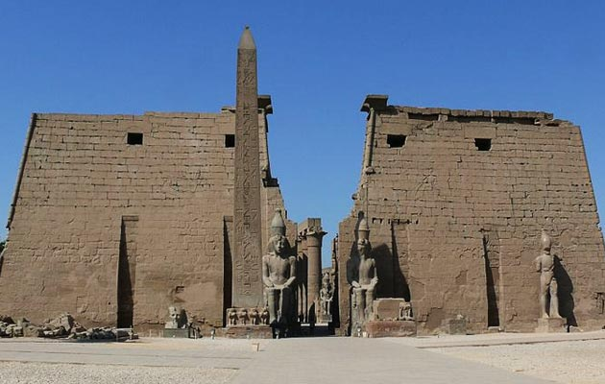
Temple of Luxor

Slide 15
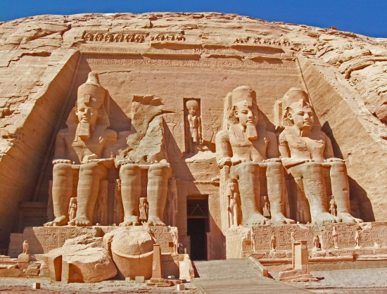
Temple of Abu Simbel

Slide 16
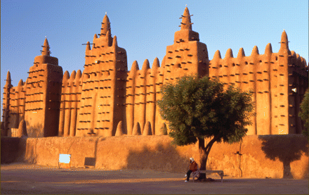
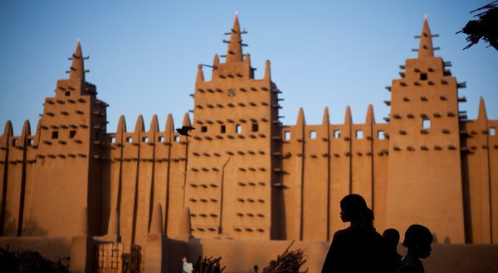
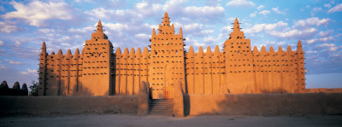
The Great Mosque of Djenné in Mali

Slide 17
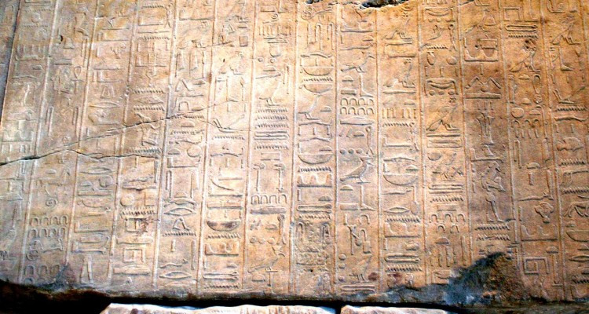
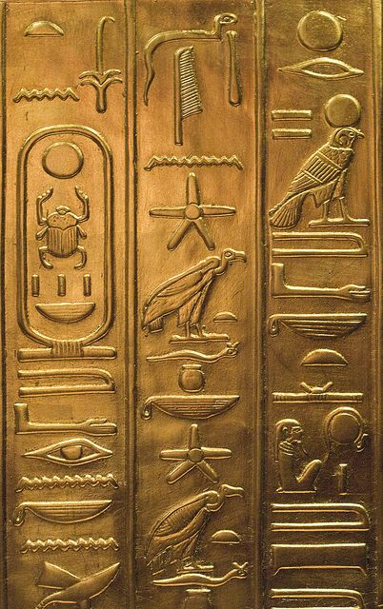
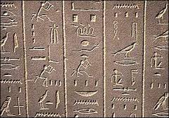
Hieroglyphics

Slide 18
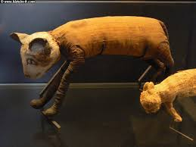
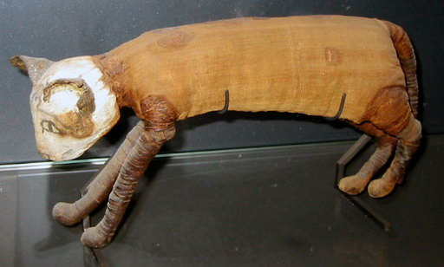
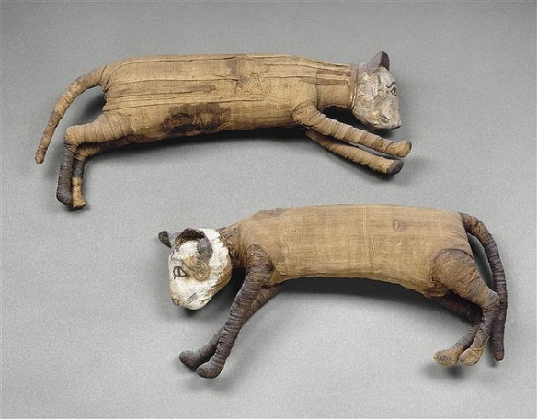
►In 1888 , an Egyptian farmer discovered a large tomb with thousands of mummified cats and kittens. This discovery at Benny Hassan had over 80 thousand cat bodies. In ancient Egypt the cat was considered a sacred animal.

Slide 19
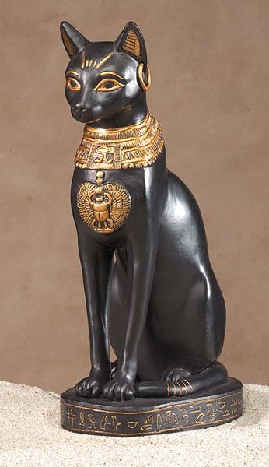
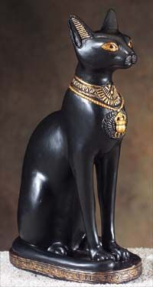
Egyptian Cat Goddess Bast

Slide 20
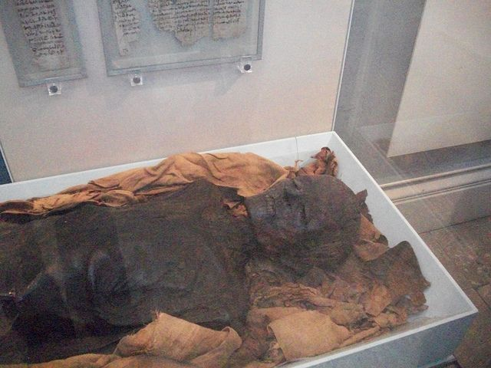
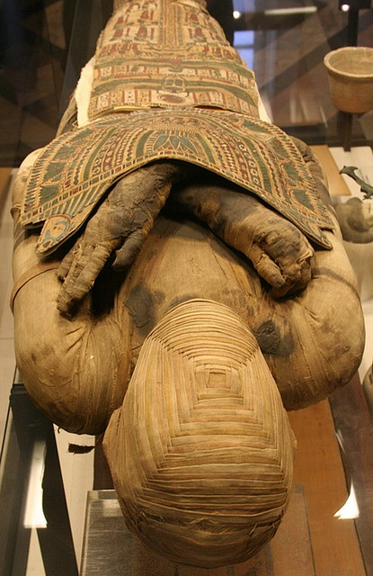
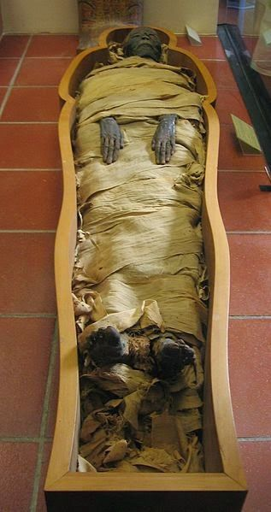
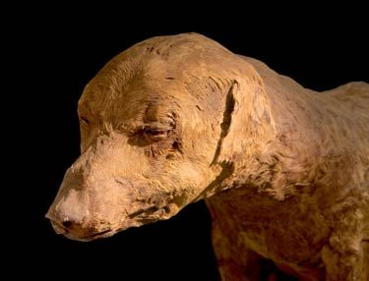
►Mummies are dead bodies which have been preserved after death.
For conservation of the bodies we use two terms: mummification and embalming.

Slide 21
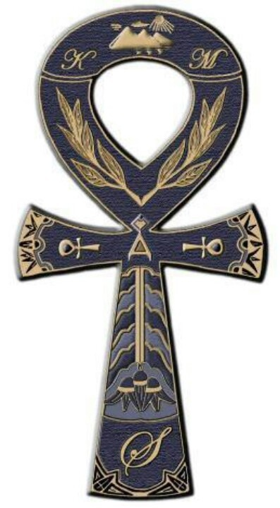
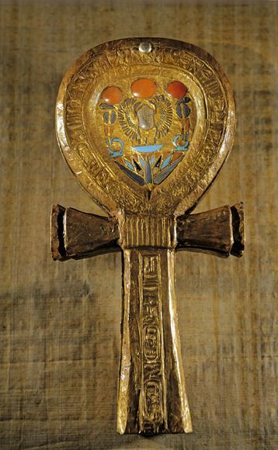
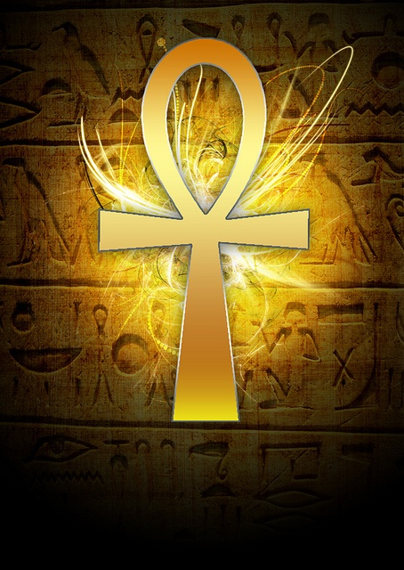
►Ankh is a symbol of life and immortality and also a hieroglyph.
►Many gods carried this sign.

Slide 22
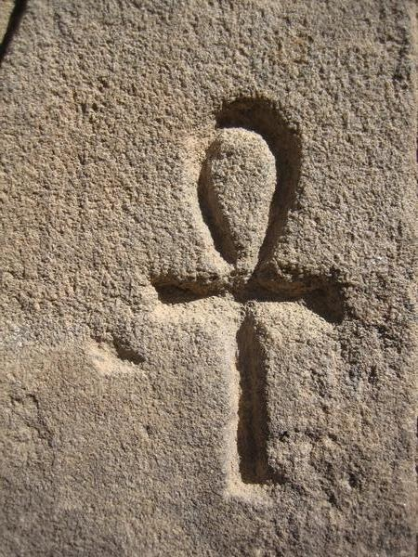
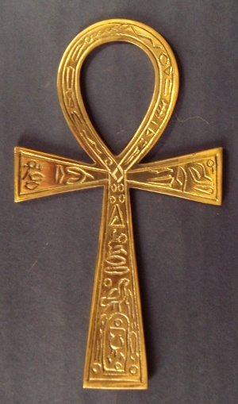
Ankh

