Slide 1
FOOTBALL
Danilo Cvijanović VIII 1

Slide 2
Football History
Football was first reported in Japan under the name as “Kick ball”, after that football has evolved through the centuries and final development happened in England.
Football is so developed that today almost every person on the planet watch it.

Slide 3
Football pitch
It is impossible to play football without a football pitch. A football pitch is 100 meters long and 50 meters wide. It has sixteen meters boxes from both sides. The middle of the pitch is marked by a long white line with the circle on its middle. The base of the classic football pitch is grass.

Slide 4
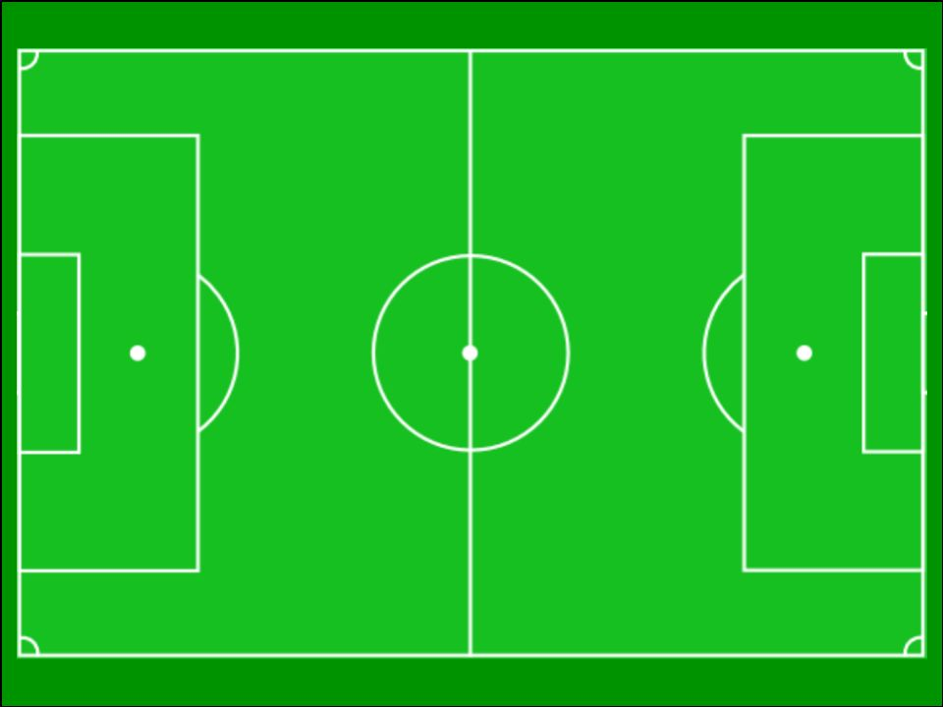

Slide 5
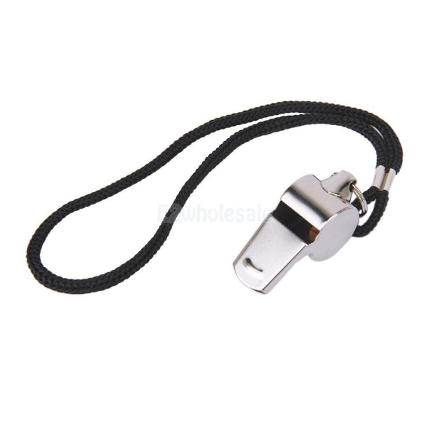
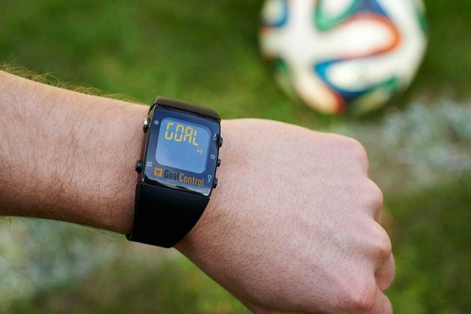
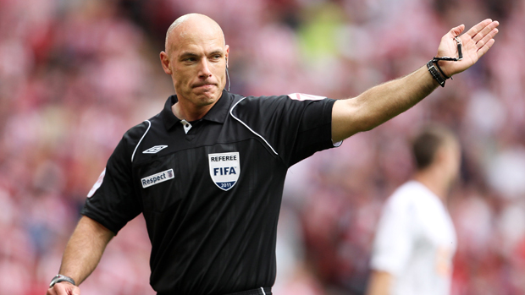
Referee
Referee is a very important person in a football match; he controls the match and judges the players. He wears a uniform and he has a whistle and a goal timer too.

Slide 6
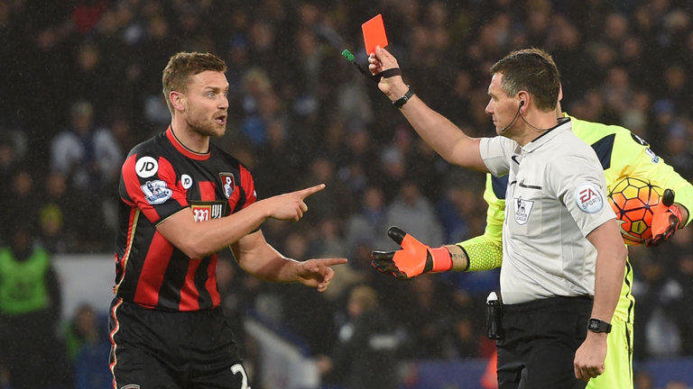
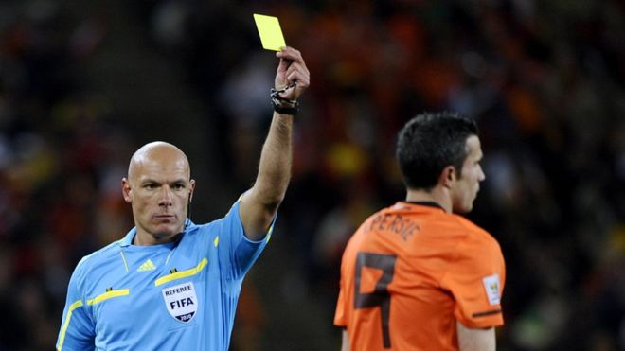
Rules: Foul
Foul- This rule is used when a player pushes or pulls other player too hard.
2. When the referee decides that a foul is too hard he can give: red or yellow card.
Yellow- means 1st warning, two yellow cards means red card. Red one means a player goes out of the game automatically.

Slide 7
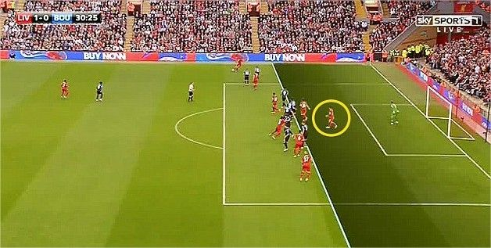
Offside
Rule named “Offside” is the rule when an attacker is behind the defensive line.
When this happens, the ball goes to the other team.
Here is an example:

Slide 8
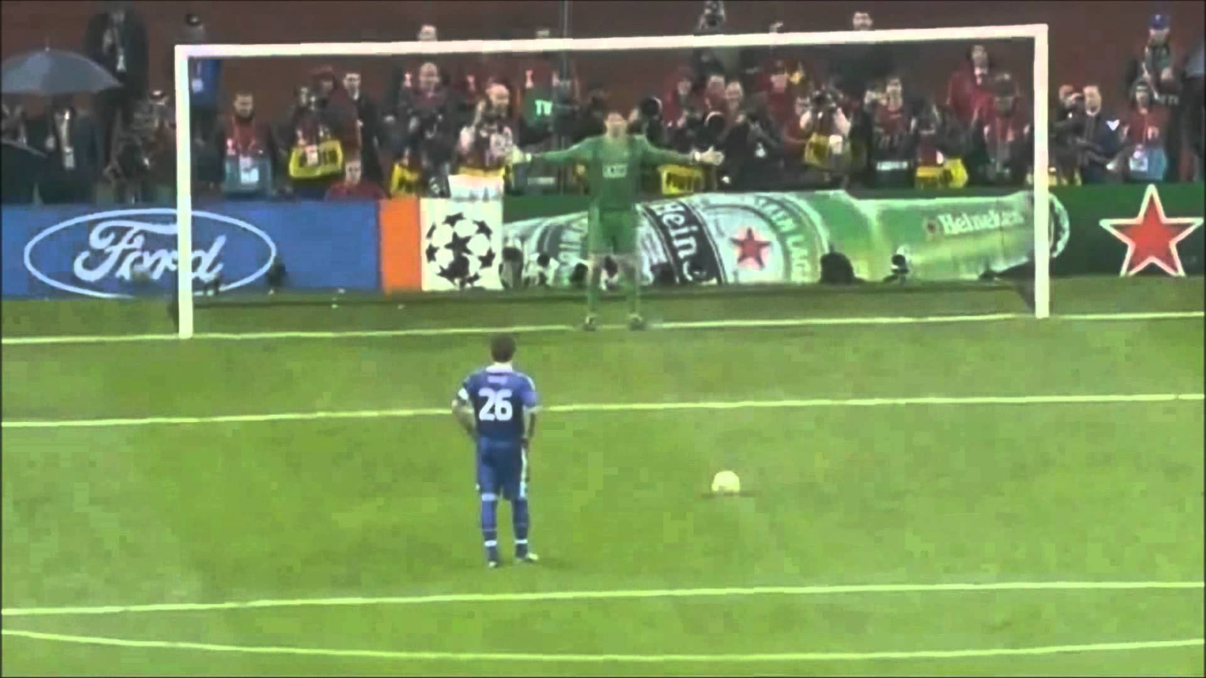
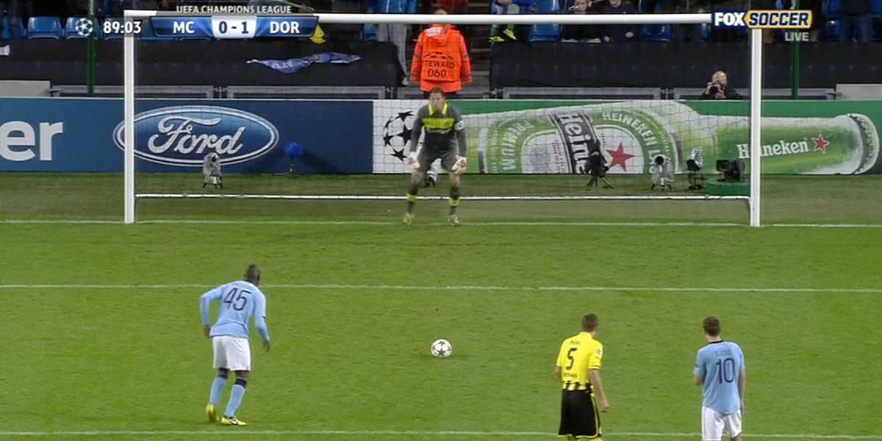
Penalty
Another important rule is a foul in the zone of sixteen meters or the expert said “ Penalty”.
Penalty is judged when a player fouls opponent player too hard in the sixteen meters in front of the goal. He shoots from white circle in the middle of the box. Here are some examples:

Slide 9
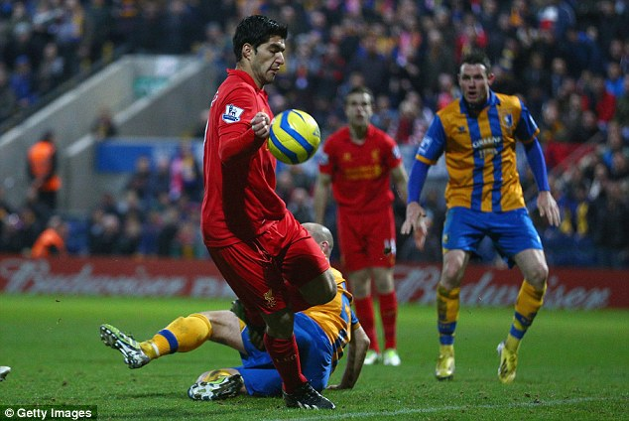
No hands, please
No hands, please is the main rule in football.
Even if you know nothing about football, you have an idea that you don’t use your hands unless you are a goalkeeper.

Slide 10
Match length
One football match is divided into two half-times. Full match lasts 90 minutes and it is divided into two halves. Length of one half-time is 45 minutes. Referee can add more time at the end of each half time.

Slide 11
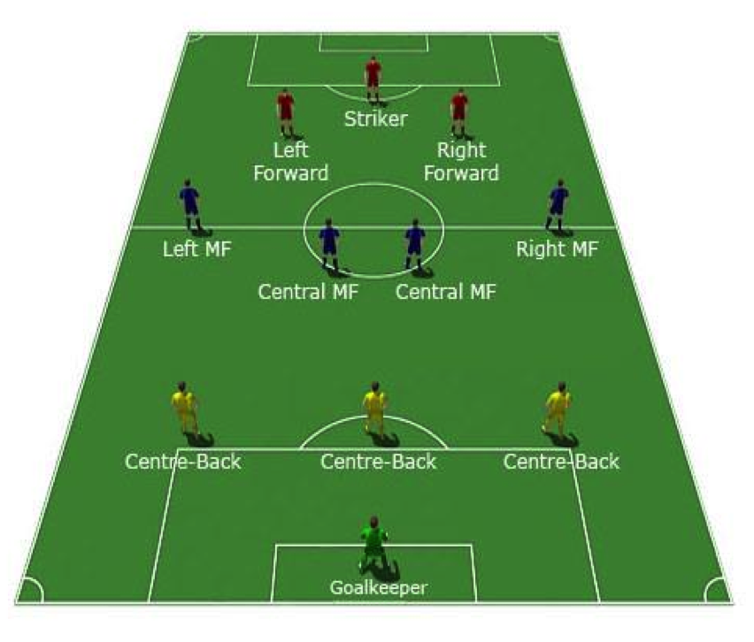
Positions
Football plays 11 players on both sides

Slide 12
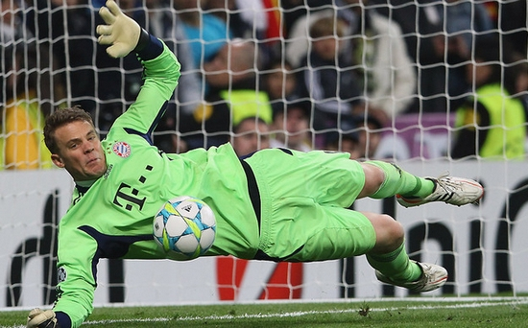
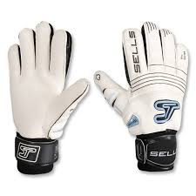
Goalkeeper
For me a goalkeeper is the main player of all 11
players. He wears gloves because they are protecting him from strong shots.

Slide 13
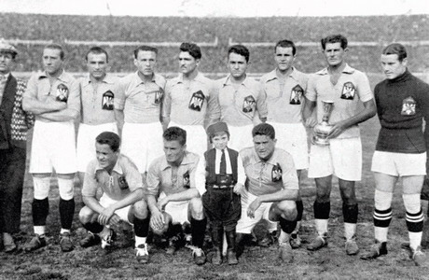
Yugoslavia success
Yugoslavia football team made an amazing act when they almost won World Cup in Uruguay because they were outsiders. Yugoslavia was second, but that was unfair because the referee was on Uruguay side.

Slide 14
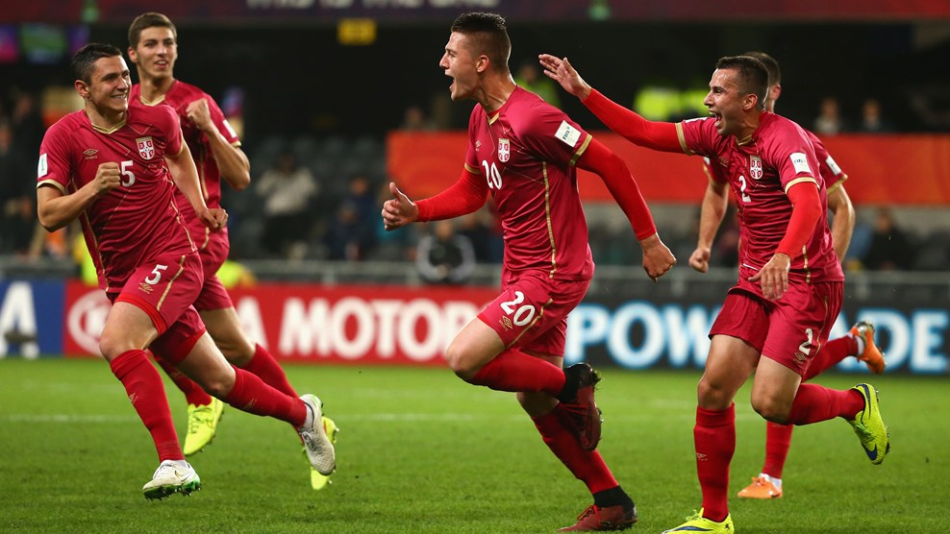
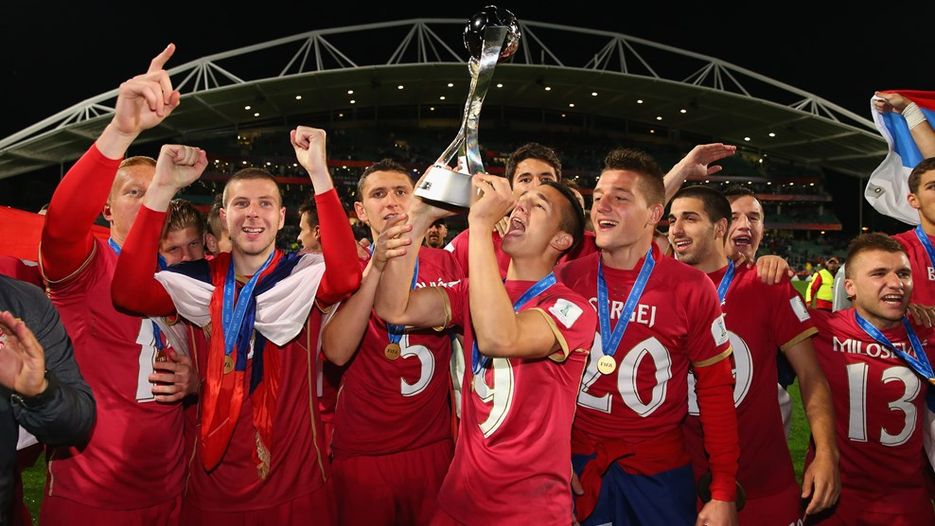
Happiest moments in Serbian football
Out country is well known in world because of football. We had some good and bad moments, but very recently we won a U20 World Cup in New Zealand. Someone would say “History is getting rewritten”.

Slide 15
Best Serbian footballers
For now, Serbia does not have many too famous football players, except Nemanja Matić, but if we look in the past our teams were the best in whole Europe. Then, best players were:
Dragan Stojković “Piksi”, Dejan Savićević, Siniša Mihajlović and others.

Slide 16
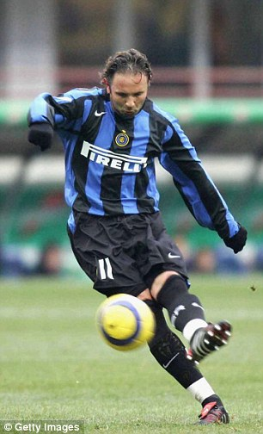
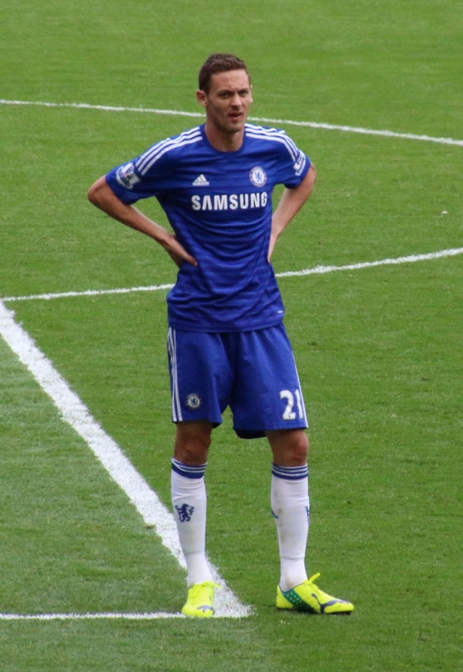
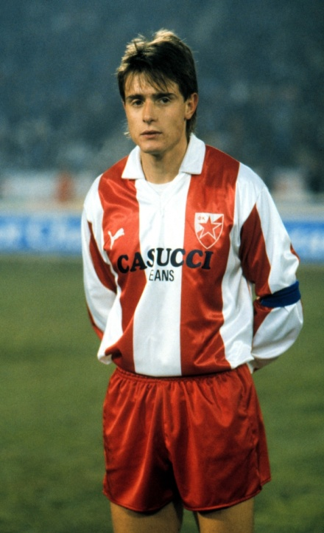
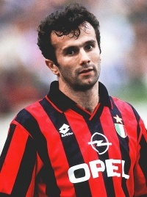
Siniša
Mihajlović Nemanja
Matić
Dejan
Savićević
“Piksi”

Slide 17
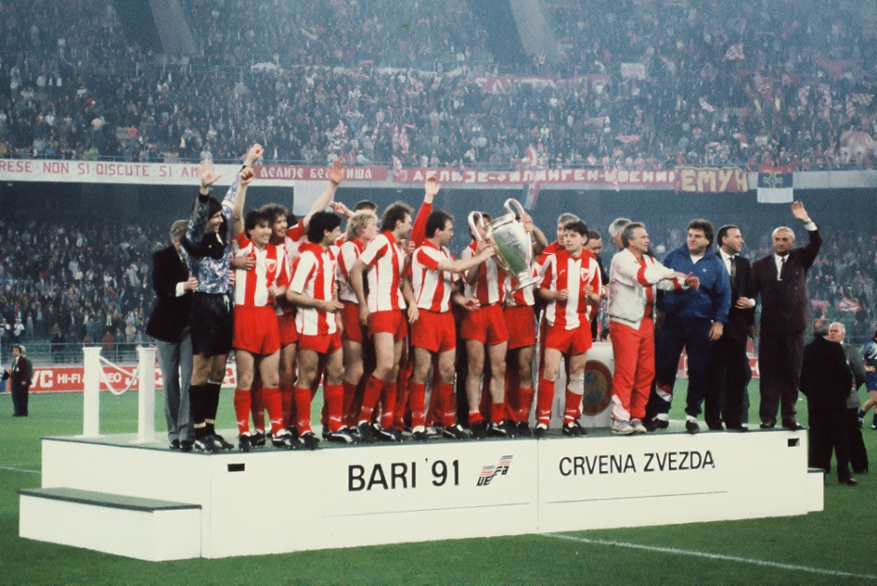
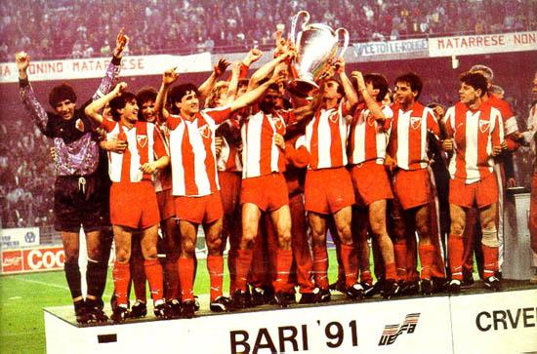
Best Serbian team
The best and most famous Serbian football team is Red Star. They won League of Champions or expert said “UCL”. They beat Olympique de Marseille after penalties 5:3. One of the conquerors is my football coach now.

Slide 18
Thanks for your patience

