Slide 1
ITALY
Filip Mihajlović VI 1
April, 2015

Slide 2
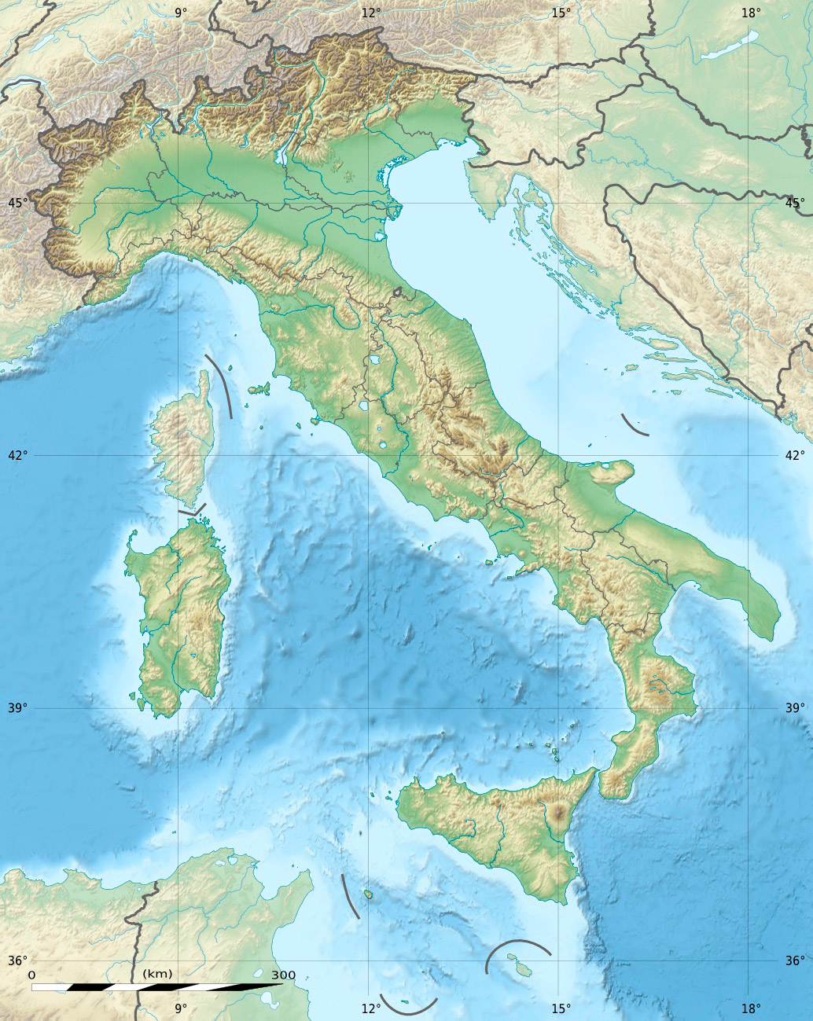
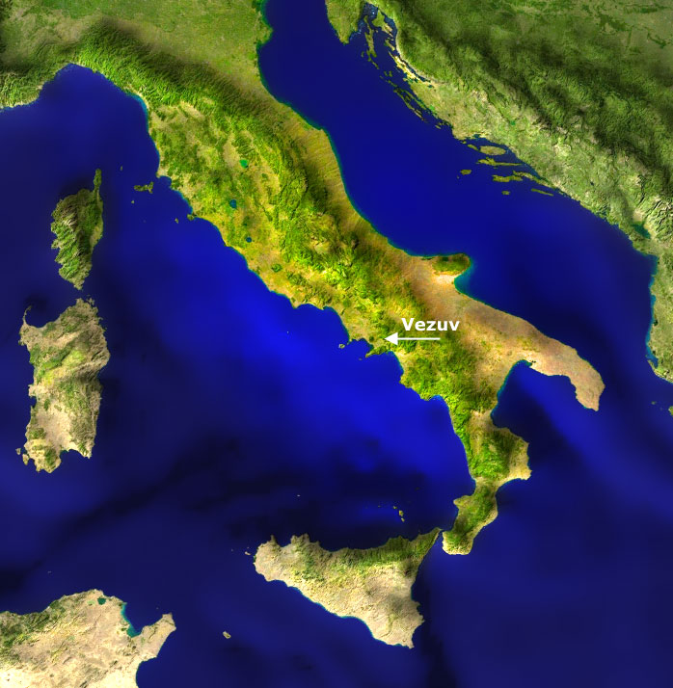
ITALY
Italy is located in the Apennine peninsula
between the Adriatic ,the Ionian Sea and the Mediterranean Sea and the Alps in the north.

Slide 3
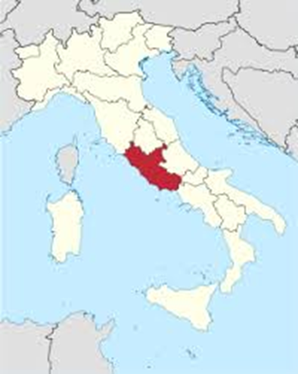
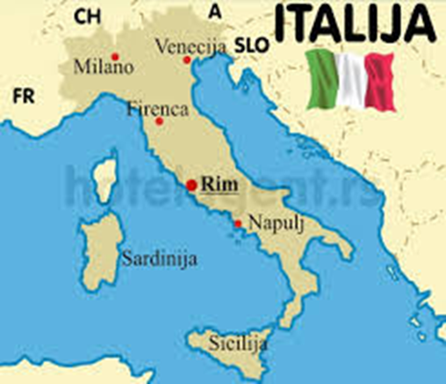
ROME
Rome is the capital city of Italy and also the largest and most numerous city in Italy, with about 2.8 million people.
It is the fourth largest city in the European Union.
"Rome is the eternal city"

Slide 4
CLIMATE
Rome has a typical Mediterranean climate which characterizes the Mediterranean, the coast of Italy.

Slide 5
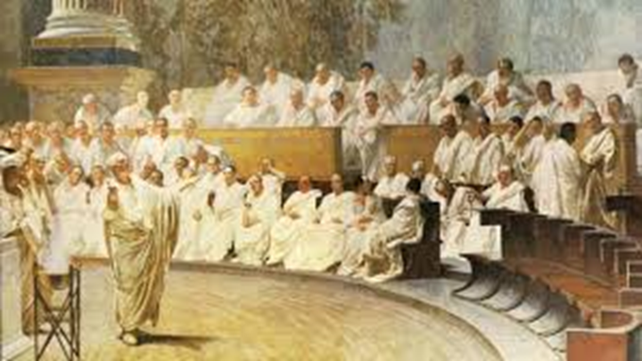
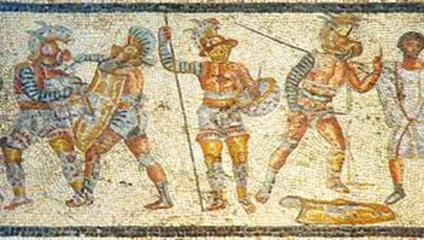
POPULATION
Italy is a nationally homogeneous state.
Italians make up to 94% of the population.
Italians are descended from old Latina.
National minorities are: Austrians, Slovenians, French and others.

Slide 6
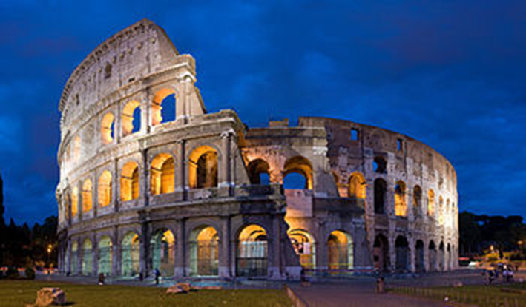
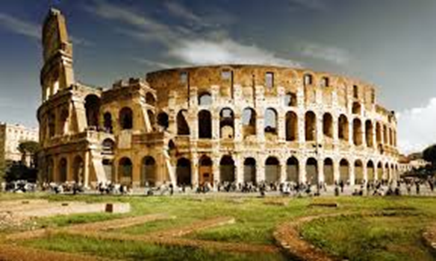
COLOSSEUM
Colosseum amphitheatre is in Rome.
Gladiatorial combats were held in it.
About 50,000 people could be placed in there
There were also fights with animals.
In case of fire, the Coliseum could be emptied in just 10 minutes.

Slide 7
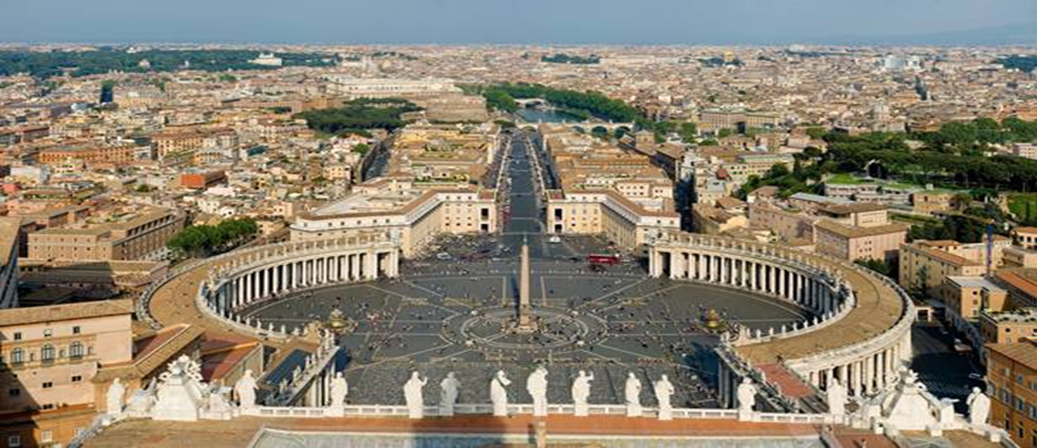
VATICAN
Vatican City (ital. Stato della Città del Vatican) is the smallest independent country in the world according to its area and its population.
It is located in the centre of Rome and its area is only 44 acres.

Slide 8
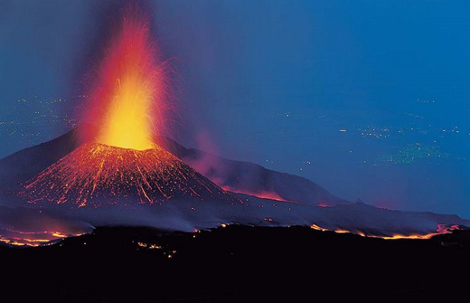
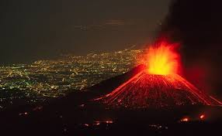
ETNA
In the south of Italy, there is a zone of active volcanoes.
The active and largest volcano in Italy is Etna
It is located on the island of Sicily .

Slide 9
Thanks for your attention

