Slide 1
Mario Casas anĐela Pejdo VII 1 ć

Slide 2
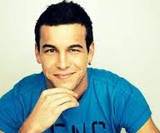
Mario Casas is an the actor. He was born on 12th June, 1986 in California.
The first time when he appeared on TV was in an advertisement.

Slide 3
Then he realized that he wanted to become an actor and he become a student at the school of interpretation of Cristina Rota.
He has acted in several series:
El barco
SMS
Mujeres
Obsesion

Slide 4
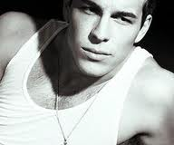
His first film in the cinema was Path an Englishman.
He has acted in many famous film:
Groups 7
La Mula
El camino de los ingleses
Paco
Except on TV Mario acts in cinemas

Slide 5
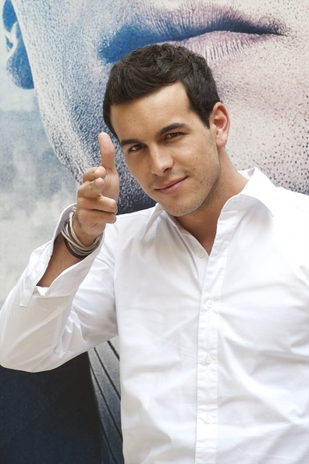
Mario on the film premiere GROUP 7

Slide 6
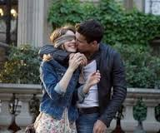
Mario is best remembered for his role Uga Librela- Aćеа in the film THREE STEPS ABOVE HEAVEN. Is this film he plays the leading role along with actress Mariom Valverde. The film is a love story which many were opposed to. Despite the begining when they loved at the end they parted.
AĆE AND BABY

Slide 7
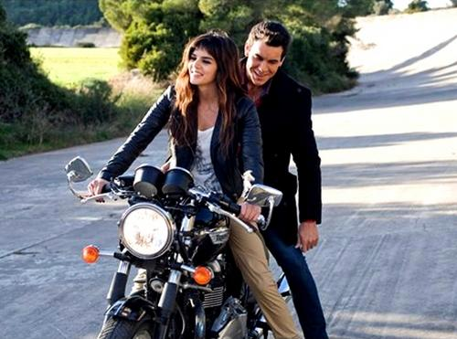
Continuation of the film is the second part entitled WANT YOU. In addition to his act and Clara Lago.
CLARA AND MARIO

Slide 8
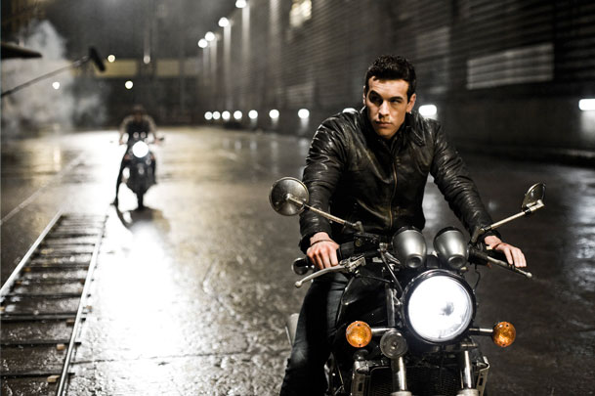
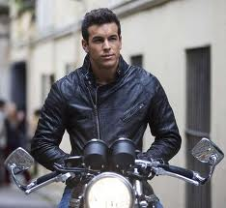
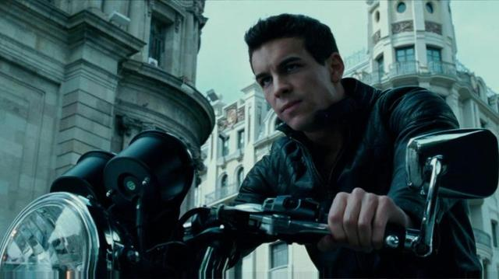

Slide 9
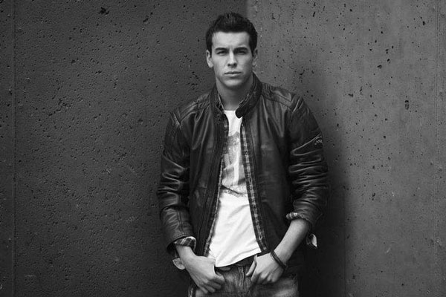
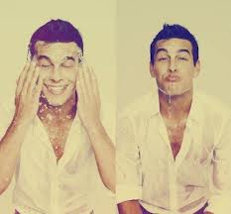
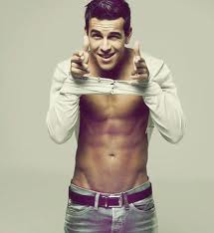
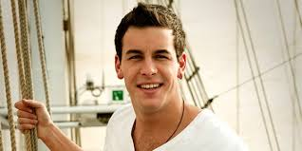

Slide 10
Thank you for listening! ☺

