Slide 1
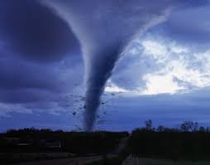
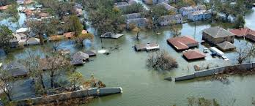
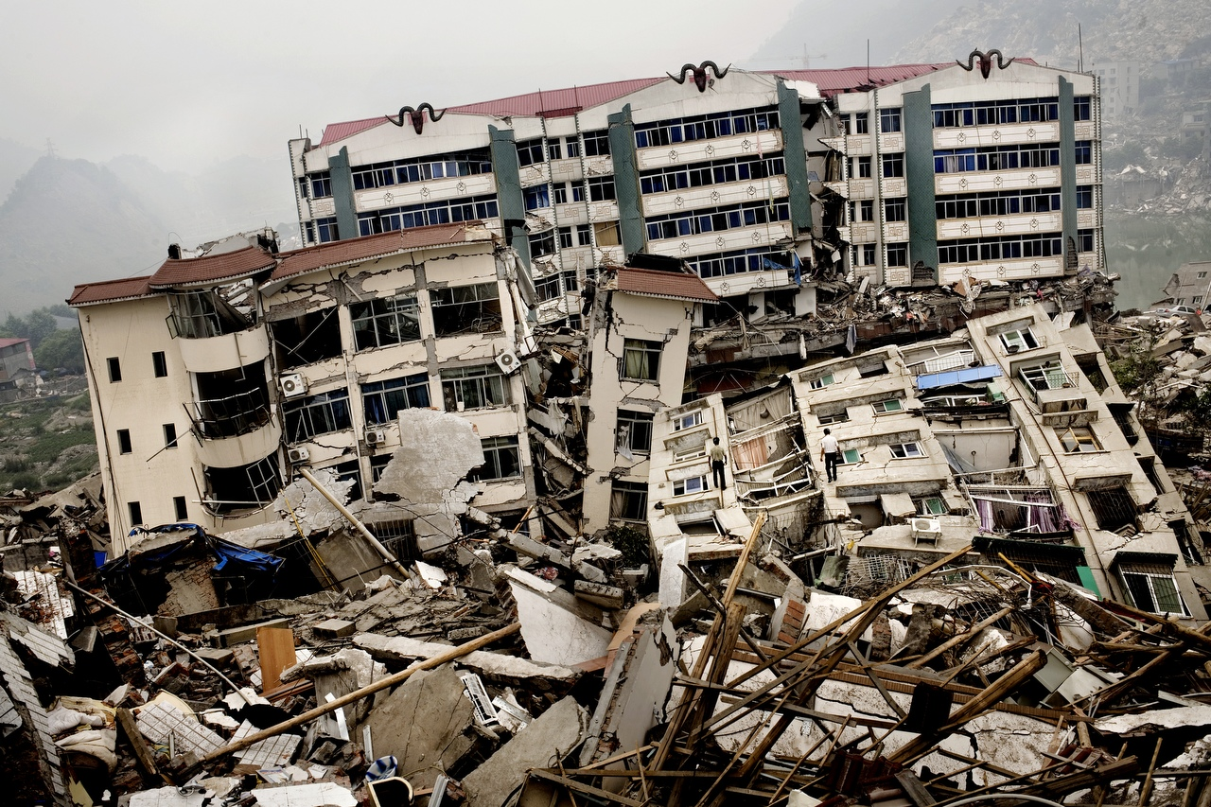
Natural Disasters
Marta Milenkovic VII1

Slide 2
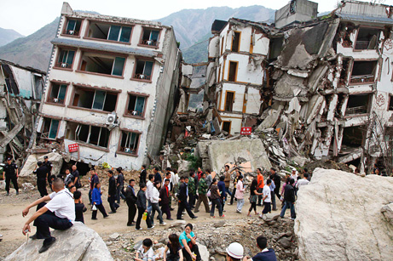
Earthquake
An earthquake is caused by moving tectonic plates. They happen very often, but the bigger number of them is intensity. Sometimes, they can cause a tsunami. Earthquakes are among the most horrifying natural disaster that happen on the Earth.

Slide 3
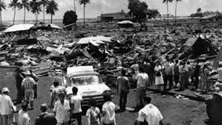
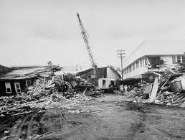
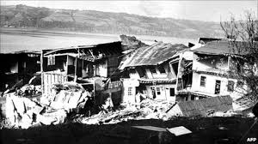
Earthquake in Valdivia
The earthquake in Valdivia or Great Chilean earthquake happened on 22nd May, 1960. It is the most powerful recorded earthquake on Earth. The strength of the earthquake was 9.5 on the Richter scale. The material damages are not exactly confirmed, but it is believed it has killed about 6.000 people.

Slide 4
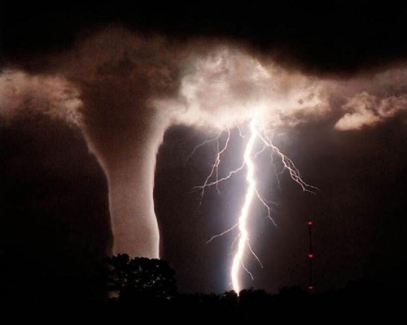
Tornado
Tornado is a violent storm characterized by reversing the clouds in the shape of a funnel. Tornadoes are formed in the storms around the world, but mostly along the coast of America.

Slide 5
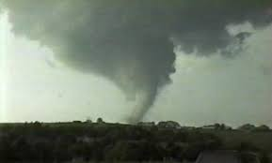
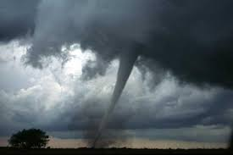
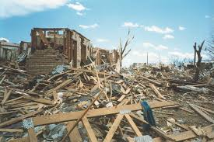
Tornado in Oklahoma
City of Moore in Oklahoma, was hit by a tornado that was 27 km long, 2 km wide and 600 times more powerful that an atomic bomb. This tornado in 1999 almost destroyed the entire city from the ground. This tornado has killed about 50 people.

Slide 6
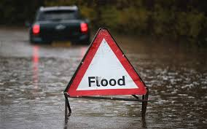
Flood
Flood is natural disaster that makes the high water levels in rivers and lakes because the water flow over the coast.

Slide 7
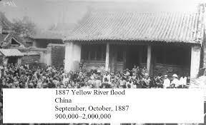
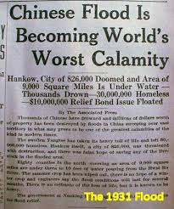
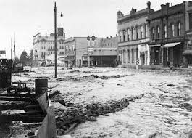
Flood in China
The flood have washed away a lot of lives in China. The flood in 1887 nearly destroyed the area and killed between 900.000 and 2 million people. The Yellow River is also considered the deadliest natural disaster. Because of that this river is called Chinese sadness.

Slide 8
THE END
»Thank you for listening and I hope you like my project!
Marta Milenkovic VII

