Slide 1
Passive voice
Tomašević Snežana

Slide 2
Part 1
PASSIVE VOICE WITH MODALS

Slide 3
Subject
Object
You can design your clothes.
Your clothes
can be designed
by you.
Agent
Subject

Slide 4
ACTIVE
PASSIVE
can design
can be designed
modal verb
modal verb
be
past participle
auxiliary
main verb

Slide 5
ACTIVE
PASSIVE
CAN | can adopt
COULD |  | could be broken
MAY | may dress
MIGHT | might go
MUST |  | must be read
SHOULD | should tell
can be adopted
could break
may be dressed
might be gone
must read
should be told

Slide 6
Now Practise!

Slide 7
Complete with the correct verb form.
1. Guidelines on dressing codes ____________ at school.
2. You __________ in fashionable clothes but your character is what truly matters.
3. Parents ___________________ (not) their children’s lifestyle.
4. The new teen collection ______________ before the next season.
5. Teens _____________ that they aren’t allowed to wear outrageous clothes in school.
must be read
PASSIVE
may dress
ACTIVE
might not understand
ACTIVE
can be adopted
PASSIVE
should be told
PASSIVE

Slide 8
Rewrite these sentences in the passive voice.
1. People might judge you by the clothes you wear.
You might be judged by the clothes you wear.
2. Your clothes can show your originality and creativity.
Your originality and creativity can be shown by your clothes.
3. This shop should sell more trendy clothing.
More trendy clothing should be sold by this shop.

Slide 9
4. Some teens must wear uniforms in school.
Uniforms must be worn by some teens in school.
5. You could choose your T-shirt from that catalogue.
Your T-shirt could be chosen from that catalogue.
6. People may not laugh at you because of your style.
You may not be laughed at because of your style.

Slide 10
Easy passive voice quiz
Part 2

Slide 11
Choose the most appropriate answer
Good Luck
Notes:
No more Comment!

Slide 12
Someone is doing this quiz right now.
1.
Active
a. This quiz is done right now by someone
b. This quiz is being done by someone right now
c. This quiz is being done right now.
Passive?
Notes:
*

Slide 13
Ooops!!!

Slide 14
Good Job

Slide 15
She is used to cleaning the floor everyday.
2.
a. The floor is used to clean by she everyday.
b. The floor is used to being cleaned everyday.
c. The floor is used to be clean everyday.

Slide 16
Ooops!!!

Slide 17
Right!

Slide 18
They will offer her the award soon.
3.
a. She will be offered the award soon.
b. The award will be offered to her soon.
c. She will be offered them the award soon

Slide 19
Sorry! Try again!

Slide 20
Well Done

Slide 21
People can use this device easily.
4.
a. This device can to be used easily
b. This device can to be easily used.
c. This device can be used easily.

Slide 22
Sorry! Try again!

Slide 23
Good

Slide 24
They should reconsider the decision.
5.
a. The decision should to be reconsidered.
b. The decision should be reconsidered.
c. The decision should be reconsider by they.

Slide 25
Sorry! Try again!

Slide 26
Excellent

Slide 27
Someone will speak to the manager.
6.
a. The manager will be spoken to.
b. The manager will to be spoken to.
c. The manager will be spoken.

Slide 28
Ooops! Try again!

Slide 29
Very Good

Slide 30
They haven't brought the book back yet.
7.
a. The book haven't been brought back yet.
b. The book haven't been brought yet back.
c. The book hasn't been brought back yet.

Slide 31
Sorry! Try again!

Slide 32
Carry on!

Slide 33
They are going to buy the ship.
8.
a. The ship is being gone to be bought.
b. The ship is going to buy.
c. The ship is going to be bought.

Slide 34
Sorry! Try again!

Slide 35
Continue

Slide 36
They don't use machines there.
9.
a. Machines there are not used.
b. Machines are not used there.
c. Machines don't be used there.

Slide 37
Sorry! Try again!

Slide 38
Bravo!

Slide 39
We made mistakes.
10.
a. Mistakes are made.
b. Mistakes were made.
c. Mistakes had been made.

Slide 40
Sorry! Try again!

Slide 41
CONGRATULATIONS
Yes, you did it.

Slide 42
Twenty Questions
Part 3

Slide 43
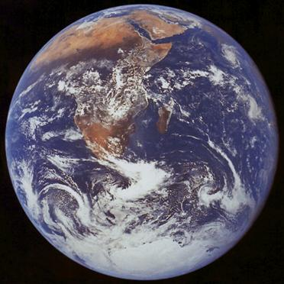
1) 70% of the Earth’s surface is covered by A) Ice. B) Water. C) Forest.

Slide 44
2) A) 25% B) 15% C) 6% of the Earth’s surface is covered by rain forest

Slide 45
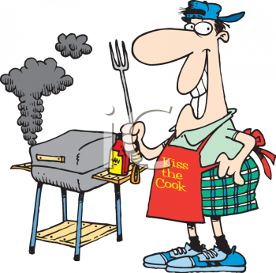
3) a) Electricity b) Wood c) Coal is used by half the world's population for cooking and heating.

Slide 46
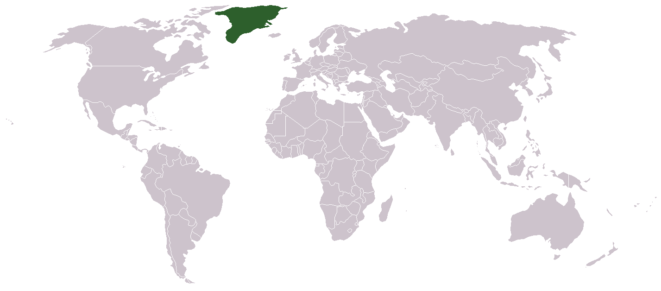
4) a) 85% b) 0% c) 25% of Greenland is covered by ice.

Slide 47
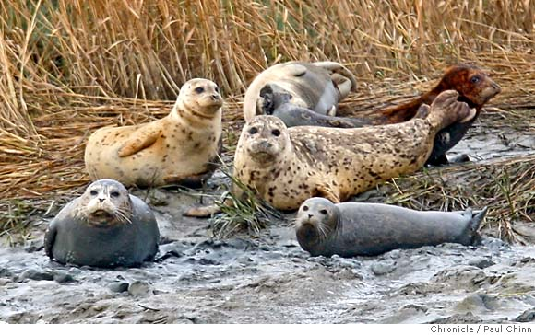
5) Seals are caught and eaten by a) penguins. b) crocodiles. c) polar bears.

Slide 48
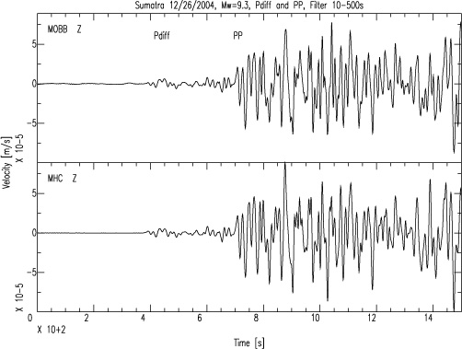
6) a) A volcano b) An earthquake c) A tornado is measured on the Richter scale.

Slide 49
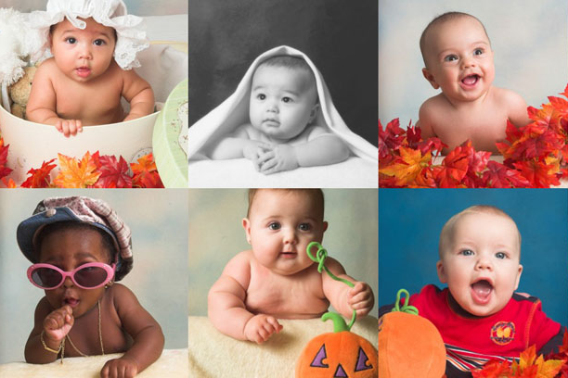
7) No babies are born a) at The North Pole. b) in the Sahara Desert. c) in the Vatican City.

Slide 50
8) a) 2000 b) 200 c) 20 babies are born every minute all over the world.

Slide 51
9) 3,000 million flowers are grown each year by a) Holland. b) Madeira. c) Hawaii.

Slide 52
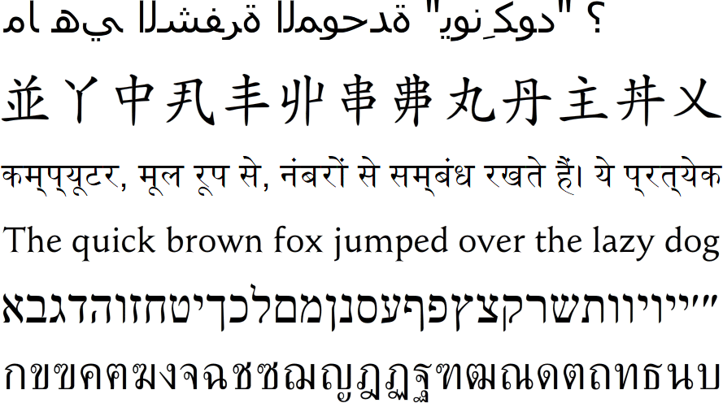
1o) a) 250 b) 460 c) 65 different alphabets are used in the world today.

Slide 53
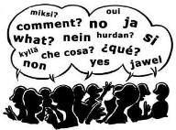
11) a) English b) Mandarin Chinese c) Spanish is spoken as a first language by the largest number of people in the world.

Slide 54
12) A) Italy b) Greece c) Spain is visited by more tourists than any other country in the world.

Slide 55
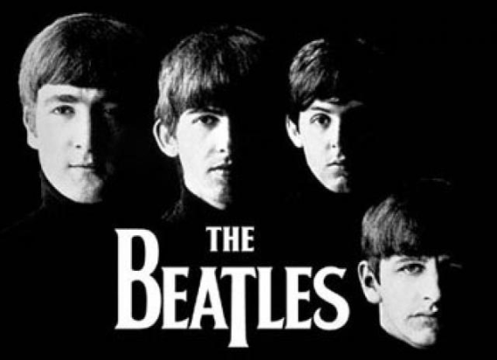
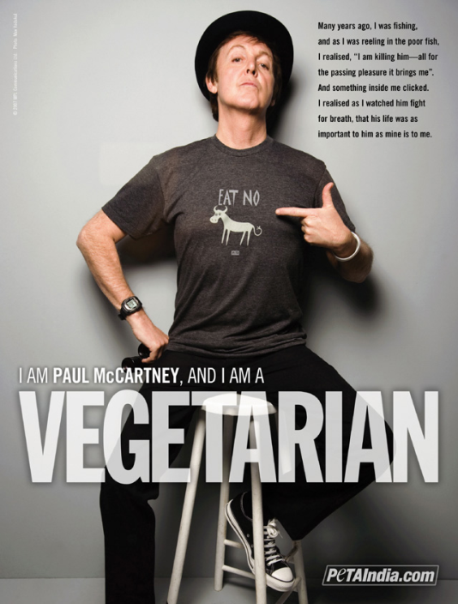
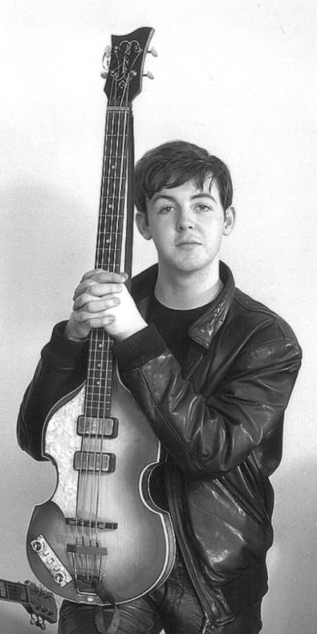
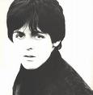
13) A) £45 a minute b) £45 a day c) £45 a second is earned by Paul McCartney

Slide 56
14) Diamonds are used for drilling by a) oil prospectors. b) builders. c) dentists.

Slide 57
15) a) 5% b) 15% c) 33% of the world's electricity is used by the USA.

Slide 58
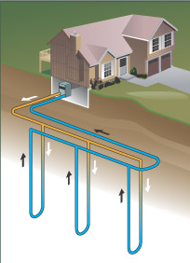
16) Houses are heated by hot water from under the ground in: a) Iceland. b) Sweden. c) Canada.

Slide 59
17) The Church of England is led by a) the Pope. b) the Queen. c) the Dalai Lama.

Slide 60
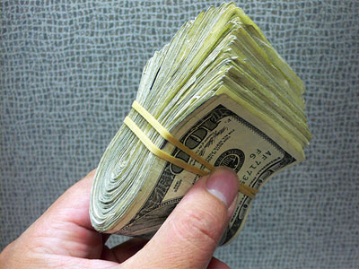
18) The word 'cash' is taken from the Indian word for a) salt. b) tea. c) bead.

Slide 61
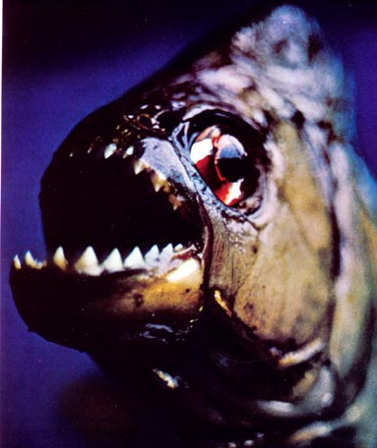
19) Piranhas are used by Amazonian Indians as a) money. b) food. c) scissors.

Slide 62
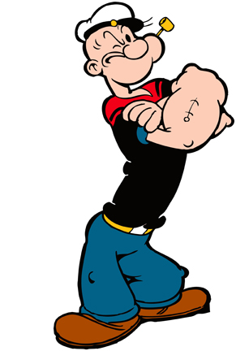
20. An anchor tatooes / is tatooed on Popeye's arm.

Slide 63
ENTERTAINMENT QUIZ
Part 4

Slide 64
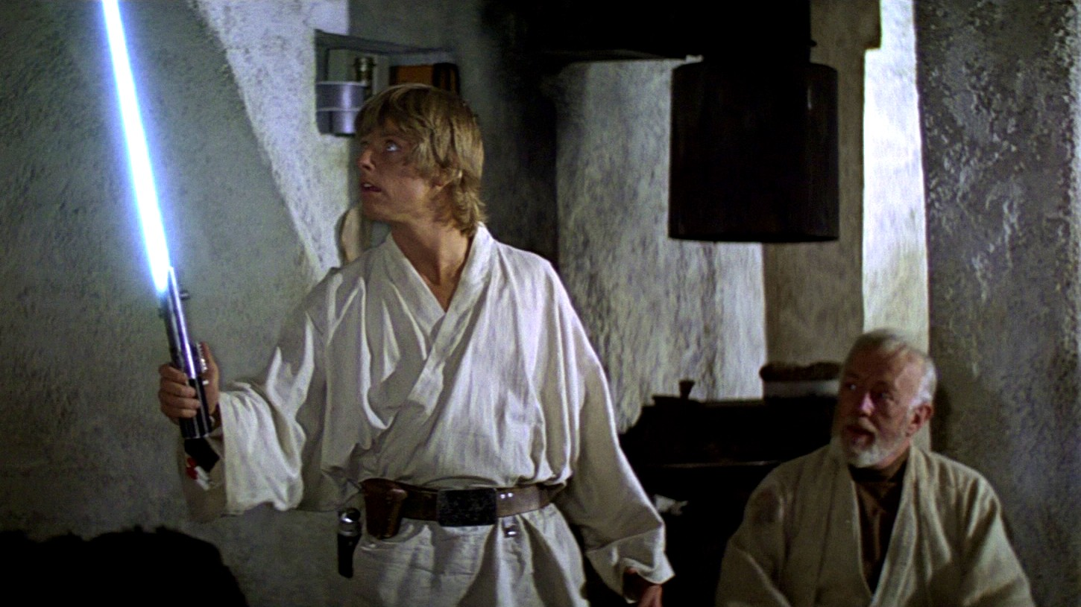
Luke Skywalker's last name changed / was changed at the last minute from Starkiller in order to make it less violent.

Slide 65
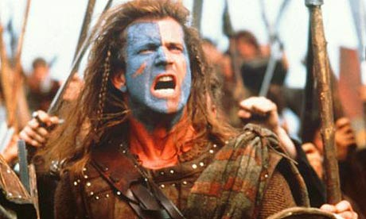
The movie Braveheart filmed / was filmed mainly in ireland.

Slide 66
Because metal was scarce, the Oscars given out during World War II was made / were made of wood.

Slide 67
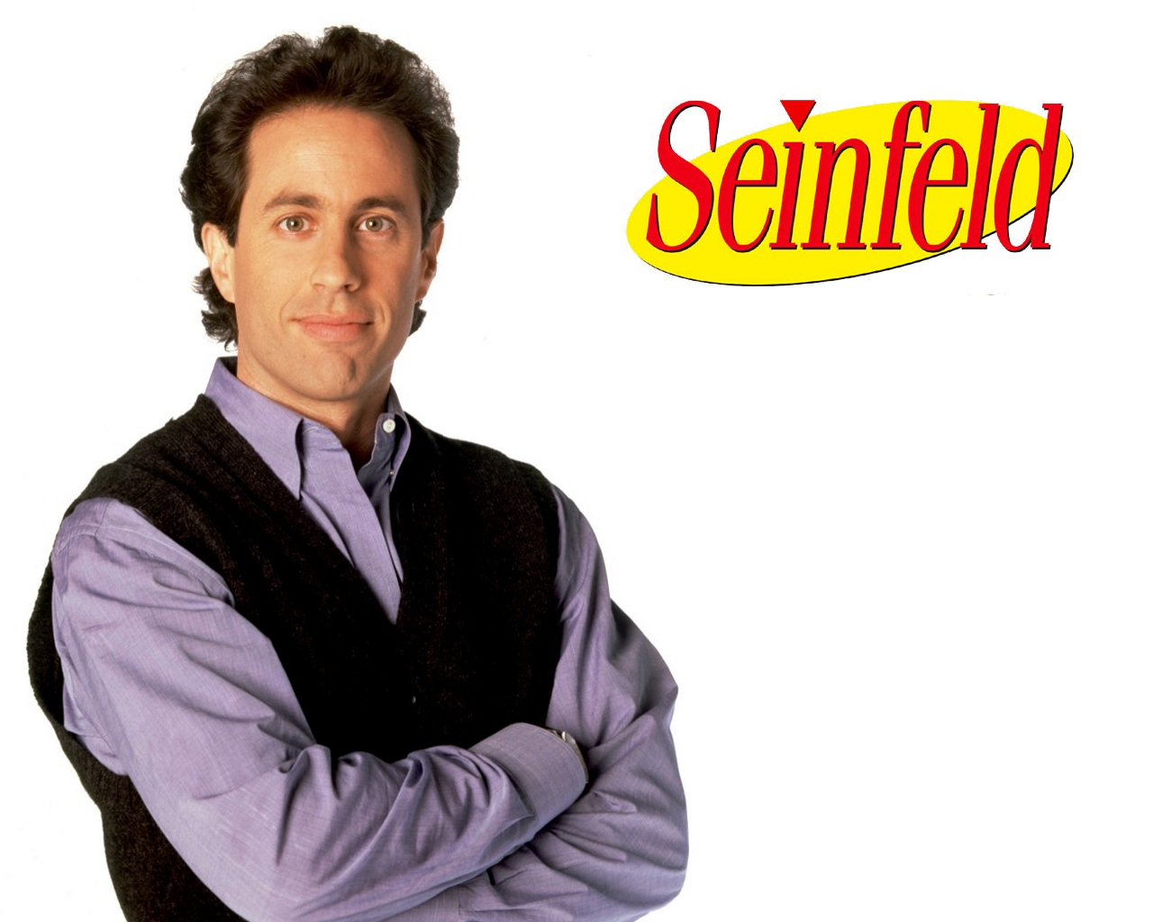
In every episode of Seinfeld a surerman can see / can be seen somewhere.

Slide 68
Since its introduction in February 1935, more than 250 million Monopoly boardgames have sold / have been sold worldwide.

Slide 69
I Write the verbs in brackets into the appropriate form.
Chinese __________________________ (speak) in Singapore.
The Taj Mahal _________________________ (build) around 164
The new hospital ________________________ (open) next year.
She __________________________________ (interview) now.
___________________________ (you invite) to Andy's party?
A Roman pavement ______________________ (just find) under Oxford Street.
These computers _______________________ (make) in Korea.
Passengers __________________ (ask) not to speak to the driver.
Sorry about the noise! -the road ___________________ (mend).
The village church ____________________ (burn down) last year.
is spoken
was built
will be opened
is being interviewed
Have you been invited
has just been found
are made
are asked
is being mended
was burnt down

Slide 70
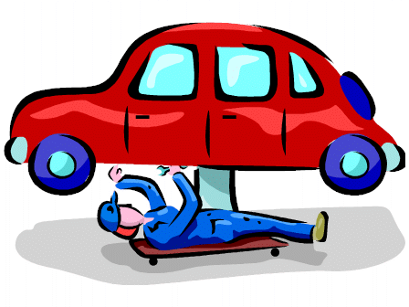
II Make the sentences passive. Include the agent only when necessary.
Shakespeare wrote 'Hamlet'.
‘Hamlet’ was written by Shakespeare.
b) They have arrested her for shoplifting.
She has been arrested for shoplifting.
They are repairing your car now.
Your car is being repaired now.
d) People in Chile speak Spanish.
Spanish is spoken in Chile.
Has anybody asked Peter?
Has Peter been asked?
My mother made this ring.
This ring was made by my mother.
Somebody will tell you where to go.
You will be told where to go.

Slide 71
h) A drunken motorist knocked her down.
She was knocked down by a drunken motorist.
i) Liverpool beat Manchester 3-0 yesterday.
Manchester was beaten 3-0 by Liverpool yesterday.
j) The Chinese invented paper.
Paper was invented by the Chinese.
k) They don't sell stamps in bookshops.
Stamps aren’t sold in bookshops.
l) The directors are still considering your application.
Your application is still being considered by the directors.

Slide 72
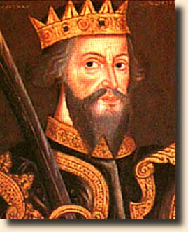
3.- Rewrite the sentences into the passive voice.
People ate most of the food at the party.
Most of the food at the party was eaten.
b) Jane won the poetry competition
The poetry competition was won by Jane.
c) One of our visitors lost this cigarette lighter.
This cigarette lighter was lost by one of our visitors.
d) They haven't decided the exact time of the match yet.
The exact time of the match hasn’t been decided yet.
e) Last Thursday we appointed a new marketing manager.
A new marketing manager was appointed last Thursday.
f) Smith Ltd are supplying our company with new office furniture.
Our company is being supplied with new office furniture by Smith Ltd.
William the Conqueror built the castle in the 11th century.
The castle was built in the 11th century by William the Conqueror.

Slide 73
h) The police were following the suspects.
The suspects were being followed by the police.
i) No one has seen Peter since the day of the party.
Peter hasn’t been seen since the day of the party.
j) We put up a notice about the trip on the notice board yesterday.
A notice about the trip was put up on the notice board yesterday.
k) Someone has stolen my bike.
My bike has been stolen.
l) They sent me the letter.
The letter was sent to me. / I was sent the letter.
m) We appointed Mr Evans secretary.
Mr Evans was appointed secretary.
n) The villagers called her a witch.
She was called a witch by the villagers.
o) Everybody considered her strange.
She was considered strange.

Slide 74
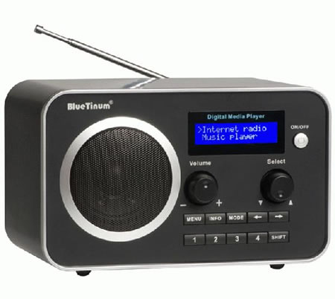
p) They are going to build a new hospital.
A new hospital is going to be built.
q) Someone will clean the room.
The room will be cleaned.
r) They didn’t ask me for my address.
I wasn’t asked for my address.
s) They pay me my salary every month.
I am paid my salary every month. /My salary is paid to me every month.
t) They showed Sue some photos.
Sue was shown some photos. / Some photos were shown to Sue.
u) Marconi didn’t invent the radio.
The radio wasn’t invented by Marconi.
v) The strong winds blew down a number of trees.
A number of trees were blown down by the strong winds.
w) They sent me a telegram
I was sent a telegram. / A telegram was sent to me.

Slide 75
4.- Change the structure into active.
a) Nothing was sent to me.
They sent me nothing.
b) Papers were sent to us to sign.
They sent us papers to sign.
c) A clock was given to Henry when he retired.
They gave Henry a clock when he retired.
d) Stories were read to the children.
They read the children stories.
e) 5000 € is owed to me.
Someone owes me 5000 €.
f) A new job has been offered to me.
They have offered me a new job.
g) French is taught to us by Mrs Lee.
Mrs Lee teaches us French.
h) A car has been lent to me for the weekend.
Someone has lent me a car for the weekend.

