Slide 1
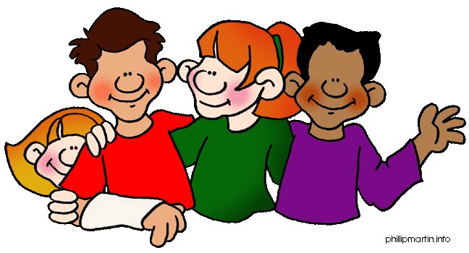
Personal Pronouns
Tomašević Snežana,
November, 2013

Slide 2
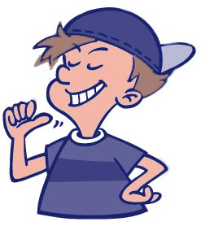
Examples
I I am Jack.

Slide 3
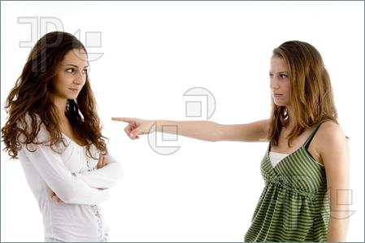
You You are my best friend!

Slide 4
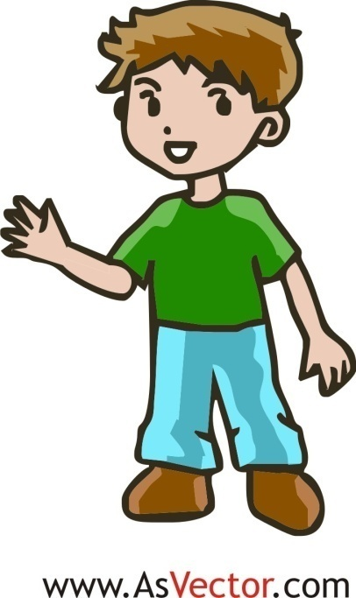
He He is Adam.

Slide 5
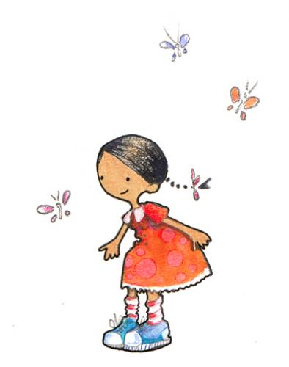
She She is beautiful.

Slide 6
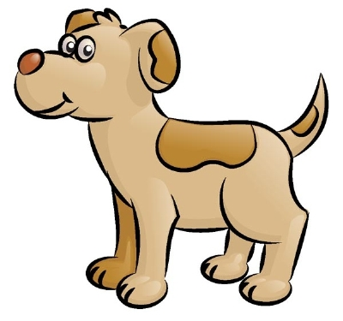
IT It is a dog.
.

Slide 7
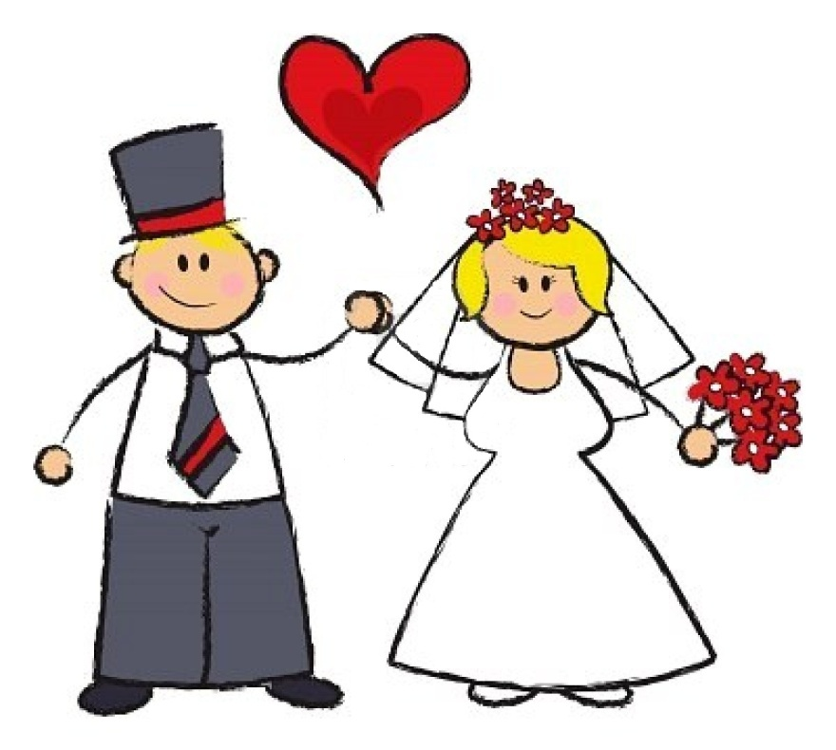
We We are married.

Slide 8
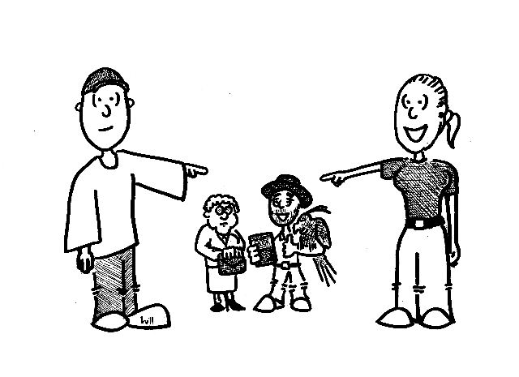
They They are happy.

Slide 9
Personal Pronouns
There are two types of Personal Pronouns:
Subject
Object

Slide 10
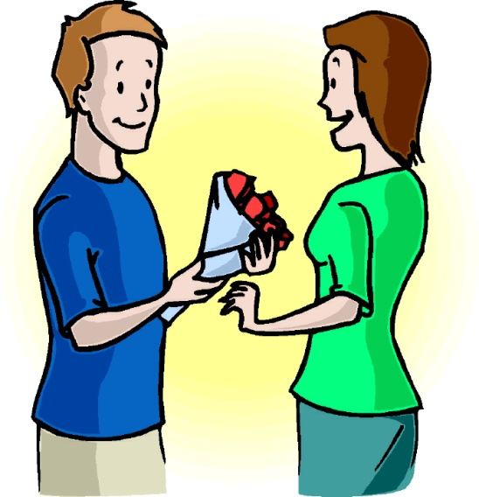
Subject Pronouns
Subjekatske zamenice (Subject pronouns) se koriste kada je zamenica subjekat u rečenici. Subjekatska zamenica zamenjuje imenicu koja vrši službu subjekta u rečenici.
Bob loves Linda.
He
S

Slide 11
Subject Pronouns
________ like/s John.
I
You
He
She
It
We
They

Slide 12
Subject Pronouns-examples
Sophie likes to play with a ball.
She likes to play with a ball.
Sophie – imenica; subjekat rečenice
She – subjekatska lična zamenica koja je zamenila imenicu Sophie.

Slide 13

Object Pronouns
Objekatska zamenica (Object pronoun) zamenjuje imenicu koja vrši službu objekta u rečenici. Objekatske zamenice se uvek nalaze posle predikata rečenice.
Bob loves Linda.
her.
O

Slide 14
Object Pronouns-examples
Diane is calling Bob.
Diane is calling him.
Bob– imenica; objekat rečenice
him– objekatska lična zamenica koja je zamenila imenicu Bob.

Slide 15
Subject and Object Pronouns
Subject Pronouns | Object Pronouns
I
you
he
she
it
we
you
they
me (mene)
you (tebe)
him (njega)
her (nju)
it
us (nas)
you (vas)
them (njih)

Slide 16
Object Pronouns
John likes ______ .
me
you
her
him
it
us
them

Slide 17
Practice 1
Example: Tom likes his baby sister.
→ He likes her.
S
O
Jennifer has two cats.
2. The cake is for Polly and me.
3. Cameron and Anna have the test.
→ She has them.
S
O
→ It is for us.
S
O
→ They have it.
S
O

Slide 18
Practice 2- Subject PRN
1. (Joe, Scott, and Bob)__________ go to school together.
2. (My Aunt Jane)_________ likes to watch scary films on television.
3. (Nick and I)_________ have a favourite restaurant in town.
4. (My fathers’s car)_________ is very old.
5. (The elephants) _________ are drinking water.
6. (Mr. Potter)_________ never washes up.
They
She
We
It
They
He

Slide 19
Practice 3- Object PRN
1. (Adam’s grandfather) I am doing a special portrait of ___________.
2. (The blue notebook) Samantha always does her homework in ___________.
3. (The pens and pencils) I have a new pencil case for __________.
4. (Uncle Peter) Sally sometimes cleans the car for __________
him
it
them
him

Slide 20
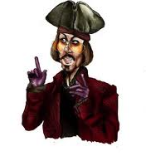
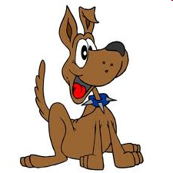

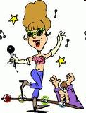
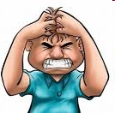
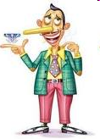
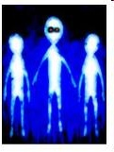
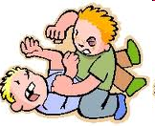
Highlight the correct pronoun
Look at HE / HIM ! HE / HIM is Johnny Depp!
That dog is very friendly. Look at HIM / IT.
These are excellent books. Take THEY / THEM.
SHE / HER an excellent singer. Listen to SHE / HER.
I / ME am nervous!! Don’t talk to I / ME !!
Oh, no! Aliens! Look at IT / THEM !!
That man is a liar! Don’t talk to HE / HIM !!
The children are shouting. Take a look at
THEY / THEM.
him
He
it
them
She
her
I
me
them
him
them

Slide 21
Circle the correct pronoun
I've got a pet rabbit. I/ Me put she / her on the grass. She /Her likes it, but my friend's dog watches she / her. He / Him wants to eat she / her, so I don't leave she / her in the garden.

Slide 22
Circle the correct pronoun
I've got a hamster. I can't keep he / him in my bedroom, because he / him makes a lot of noise at night and he / him wakes I / me up.

Slide 23
Circle the correct pronoun
There are lots of animals in the pet shop. I/ Me love to watch they / them. We / Us don't live in the town, so my mum takes I/ me to the shop. She / Her likes the pet shop, too.

Slide 24
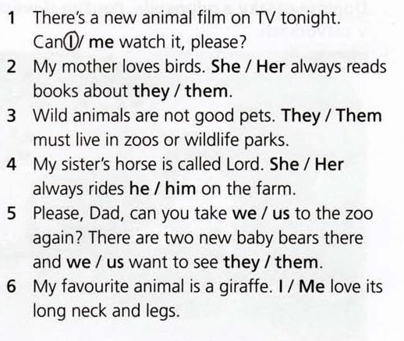
Circle the correct pronoun

Slide 25
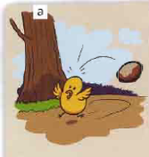
The Story of Chicken Licken
Chicken Licken is in the farmyard. Chicken Licken is eating under a tree when suddenly a nut falls on his head.
“Oh, no,” says Chicken Licken. “The sky is falling down. I must go to London to tell the King.”

Slide 26
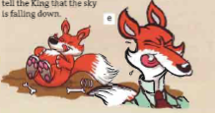
The Story of Chicken Licken
Chicken Licken, Henny Penny, Ducky Lucky and Goosey Loosey never get to London and Chicken Licken, Henny Penny, Ducky Lucky and Goosey Loosey never tell the King that the sky is falling down because Foxy Loxy eats Chicken Licken, Henny Penny, Ducky Lucky and Goosey Loosey .

Slide 27
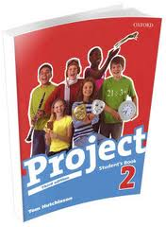
Thanks for your attention!
Now, practice in your book.
tomasevicsnezana.weebly.com/

