Slide 1
PLACES IN A TOWN Project 5- Unit 2 Vocabulary Building
November, 2013
Tomašević Snežana

Slide 2
CINEMA

Slide 3
RAILWAY STATION

Slide 4
SPORTS CENTRE

Slide 5
CINEMA

Slide 6
MARINA

Slide 7
SHOPPING MALL

Slide 8
BUS STATION

Slide 9
AIRPORT

Slide 10
RAILWAY STATION

Slide 11
BAKERY

Slide 12
MULTIPLEX CINEMA

Slide 13
PORT

Slide 14
FIRE STATION

Slide 15
RAILWAY STATION

Slide 16
MARINA

Slide 17
PORT

Slide 18
SHOPPING MALL

Slide 19
MUSEUM

Slide 20
INTERNET CAFE

Slide 21
POLICE STATION

Slide 22
ART GALLERY

Slide 23
INTERNET CAFE

Slide 24
FIRE STATION

Slide 25
SWIMMING POOL

Slide 26
CHURCH

Slide 27
PRIMARY SCHOOL

Slide 28
THEATRE

Slide 29
BUSINESS CENTRE

Slide 30
SPORTS CENTRE

Slide 31
FORTRESS

Slide 32
FACTORY

Slide 33
PARK

Slide 34
GROCERY

Slide 35
BUTCHERY

Slide 36
RESTAURANT

Slide 37
HOTEL

Slide 38
ART GALLERY

Slide 39
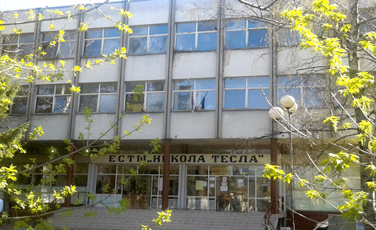
HIGH (SECONDARY) SCHOOL

Slide 40
MONUMENT

Slide 41
CAR PARK

Slide 42
SQUARE

Slide 43
FOUNTAIN

Slide 44
HOSPITAL

Slide 45
UNDERGROUND STATION

Slide 46
BRIDGE

Slide 47
TOWER

Slide 48
MONASTERY

