Slide 1
PRESENT PERFECT TENSE: FOR or SINCE NOVEMBER, 2013

Slide 2
Present Perfect Tense for
Actions - events
experiences
NO SPECIFIC TIME

Slide 3
Present Perfect Tense
S
HAVE/ HAS
inf. osnova + ED/D
III kolona glagola
played, stayed, watched,
arrived, liked,
studied, tried
come-come,
make- made, buy-bought, get-got,
go-gone, be-been, do-done

Slide 4
Present Perfect Tense
S
HAVE/ HAS
inf. osnova + ED/D
III kolona glagola
past participle
predicator

Slide 5
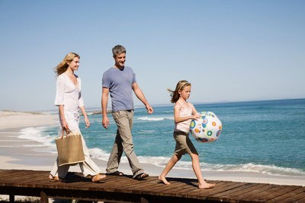
go
past
participle
have
No specific time
I _______________ to the beach twice.
have gone

Slide 6
see
past
participle
has
No specific time
Tom _____________ Titanic several times.
has seen

Slide 7
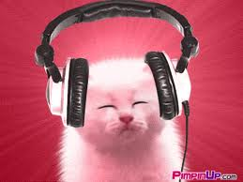
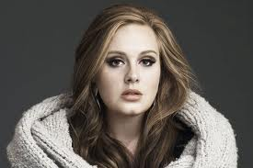
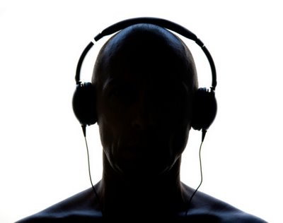
hear
Specific time
(definite time)
past
participle
have
No specific time
I _____________ Adele’s new song twice.
have heard
I ________ Adele’s new song last Friday.
heard

Slide 8
Present Perfect
Affirmative= have / has
Negative= haven’t / hasn’t
Pronoun
Aux. Verb
Main Verb
Complement
I
You
We
they
studied
played
seen
gone
English.
tennis with my friends
that movie twice.
to that concert.
have
haven’t
He
She
It
studied
cooked
worked
Japanese.
potatoes and meat.
late twice this weekend.
has
hasn’t
The verb changes in past participle.

Slide 9
YES / NO QUESTIONS (Confirmation)
You have studied English.
Yes, I have
No, I haven’t
Have
you
studied English?
I
You
We
they
studied
played
seen
gone
English?
tennis with my friends?
that movie twice?
to that concert?
Have
He
She
It
studied
cooked
worked
Japanese.
potatoes and meat.
late twice this weekend.
Has
The verb changes in past participle.

Slide 10
FOR and SINCE
We use FOR to tell a period ( of time).
I’ve been in Italy for five days.
period
We use SINCE to tell a point( of time).
I’ve been in Italy since Sunday.
point

Slide 11
Fill in SINCE or FOR.
1 _____ Easter
2 _____ last summer
3 _____ two weeks
4 _____ my birthday
5 _____ 1995
6 _____ three days
7 _____ my childhood
8 _____ a few minutes
9 _____ I was ten
10 _____ ten years
11 _____ I was young
12 _____ 1st April
since
since
for
since
since
for
since
for
since
for
since
since

Slide 12
Fill in SINCE or FOR.
for
We’ve known each other ______ two years.
She’s been sick ______ last Friday.
I’ve known Jack ______many years.
Chris hasn’t called us ______ my birthday.
They’ve been married ______ 1978.
Mr. Common has been in his office ______ one o’clock.
Mrs. Common has written a letter______ one hour.
They haven’t washed their car ______a month.
I haven’t cut my hair ______ last month.
We have been at this school ______ seven years.
We have been at this school ______ 2007.
since
for
since
since
since
for
for
since
for
since

Slide 13
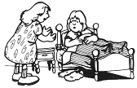
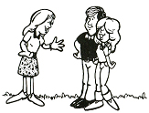
How long / Ana/ be / sick? // last Thursday
How long / you / know / each other? // two years
How long have you known each other?
How long has Ana been sick?
We’ve known each other for two years.
Ana (She) has been sick since last Thursday.
How long / Diane / have / problems / with her back? // four years
How long has Diane had problems with her back?
She has had problems with her back for four years.

Slide 14
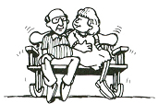
How long / Mr. and Mrs. Peterson / be / married? // 1945
How long / you / have / a headache // ten o’clock this morning
How long have you had a headache?
How long have Mr. and Mrs. Peterson been married?
I ’ve had a headache since ten o’clock this morning .
They’ve been married since 1945.
How long / he/ be / here? // five and a half years
How long has he been here?
He’s been here for five and a half years.

Slide 15
Chose suitable tense.
yesterday
a) Past Simple b) Present Perfect
today
a) Past Simple b) Present Perfect
at 6 a. m. today
a) Past Simple b) Present Perfect
in 1995
a) Past Simple b) Present Perfect
a long time ago
a) Past Simple b) Present Perfect
in my life
a) Past Simple b) Present Perfect
in Shakespeare's lifetime
a) Past Simple b) Present Perfect

Slide 16
Chose suitable tense.
last year
a) Past Simple b) Present Perfect
since 1999
a) Past Simple b) Present Perfect
two seconds ago
a) Past Simple b) Present Perfect
so far
a) Past Simple b) Present Perfect
for a year
a) Past Simple b) Present Perfect
since my birthday
a) Past Simple b) Present Perfect

Slide 17
Chose suitable tense.
ever
a) Past Simple b) Present Perfect
in 1999
a) Past Simple b) Present Perfect
for ten hours
a) Past Simple b) Present Perfect
just
a) Past Simple b) Present Perfect
ten hours ago
a) Past Simple b) Present Perfect
already
a) Past Simple b) Present Perfect

Slide 18
Now, take your books and practise!

