Slide 1


Times and Places
UNIT 3
A: What was happening?
Snežana Tomašević
December, 2013

Slide 2
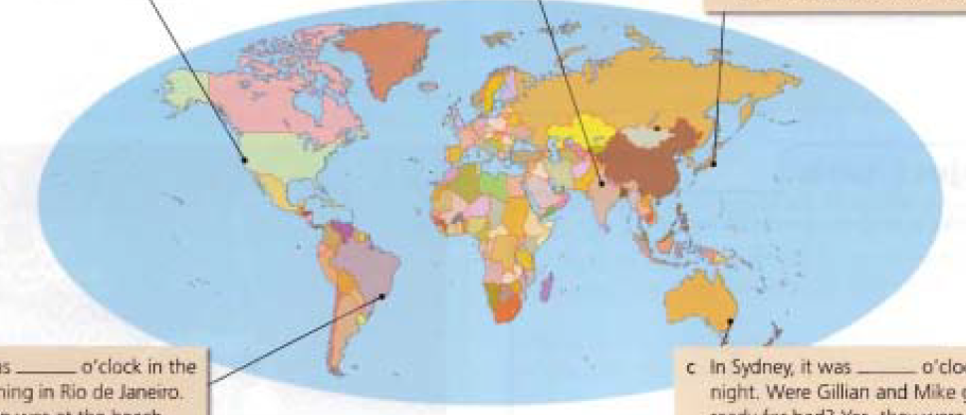
Practice 1
Name the countries and continents.
Delhi
Tokyo
San Francisco
India / Asia
Japan / Asia
the USA/ North America
Serbia
Europe
Brazil / South America
Sydney
Rio da Janeiro
Australia

Slide 3
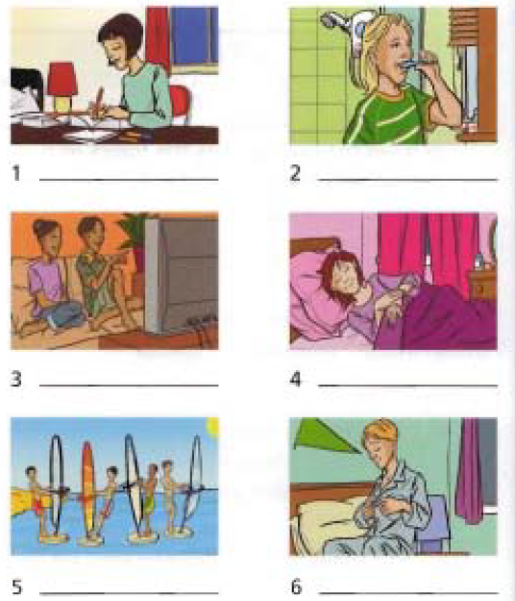
Practice 2
Write the names of the countries.
1) Japan
2)Australia
4) India
5) the USA
5) Brazil
6) Australia

Slide 4
Vocabulary- Collocations
brush
take
put on
have
send
throw
get ready
your teeth
your hair
a dog
a photograph
a shower
the bus
your pyjamas
your shoes
a hat
dinner
a drink
a shower
a break
an e-mail
a letter
a ball
for bed
for school

Slide 5
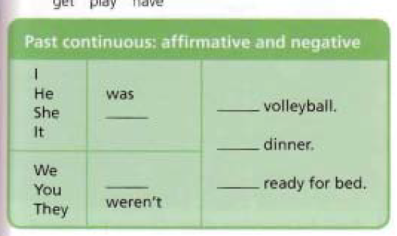
Past Continuous
get play have
playing
wasn’t
having
were
getting

Slide 6

Past Continuous Tense / FORM
S
WAS/ WERE
inf. osnova + -ING
play playing
watch watching
come + -ING coming
dance dancing
swim swimming
run running
past tense TO BE
present participle
predicator

Slide 7
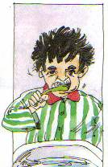
Practice
What were they doing?
At 9 o’clock last night…
He was brushing his teeth.
9 pm
now
past
future
was brushing

Slide 8
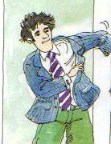
Practice
What were they doing?
At 9 o’clock last night…
He was putting on his jacket.
9 pm
now
past
future
was putting on

Slide 9
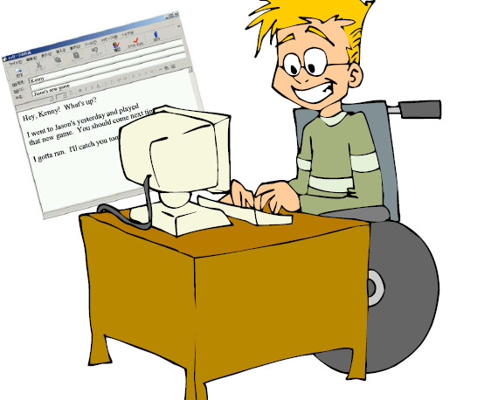
Practice
What were they doing?
At 9 o’clock last night…
He was sending an e-mail to his friend.
9 pm
now
past
future
was sending

Slide 10
Practice
What were they doing?
At 9 o’clock last night…
She was taking the bus home.
9 pm
now
past
future
was taking

Slide 11

Practice
What were they doing?
At 12 o’clock on Sunday
Martin was sitting at his computer.
Martin was sending e-mails to his friends.
12o’clock
now
past
future
was sitting
was sending

Slide 12
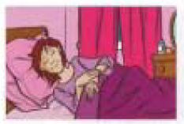
Past Continuous
At 4am
Kay was sleeping.
She was dreaming.
4 am
now
past
future
was sleeping
was dreaming

Slide 13
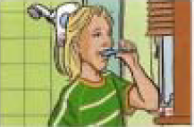
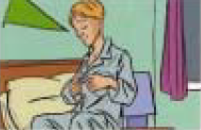
Past Continuous
At 11pm Gillian and Mike were getting ready for bed.
Gillian was brushing her teeth.
Mike was putting on his pyjamas.
11 pm
now
past
future
were getting ready
was brushing
was putting on

Slide 14
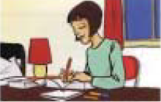
Past Continuous
At 9 pm Yoko was sitting at her desk..
She was finishing her Maths
homework .
9 pm
now
past
future
was sitting
was finishing

Slide 15
Past Continuous
At 5:30 pm Rash was watching TV
and
He was talking to his sister.
5:30 pm
now
past
future
was watching
was talking

Slide 16
Conclusion
Use the past continuous to describe an action that was in progress at a specific time in the past.
Koristi past continuous da opišeš radnju koja je trajala u nekom odrđenom trenutku u prošlosti.

