Slide 1
Clothes Ivana Dašić VII 1 November, 2013

Slide 2
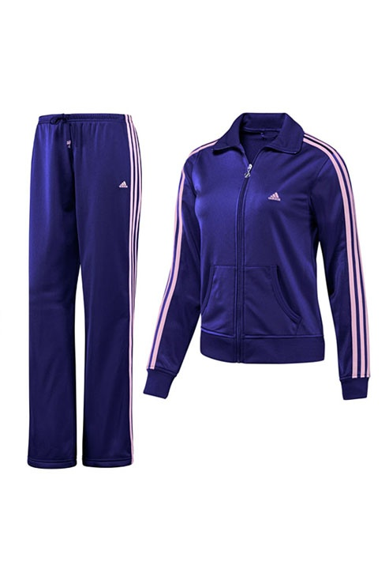
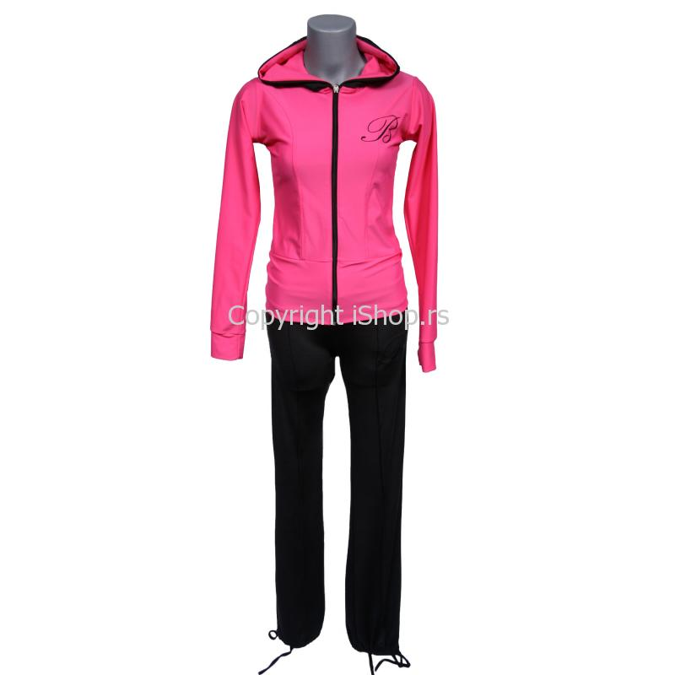
Track suits
This is a striped purple silk track suit. It is long-sleeved.
This is a pink and black silk track suit. It is long-sleeved.

Slide 3
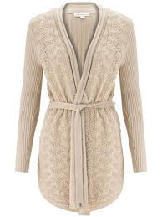
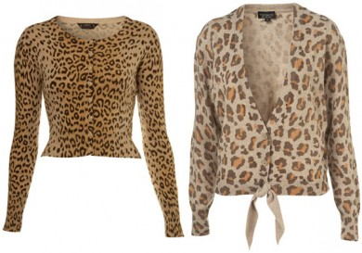
Jumpers
These are polka dot brown wollen jumpers with long-sleeves.
This is a plain wollen jumper with long-sleeves.

Slide 4
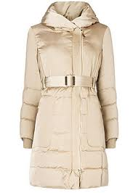
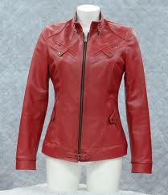
JACKETS
This is a light brown long-sleeved jacket.
This is a plain red leather jacked. It is long-sleeved.

Slide 5
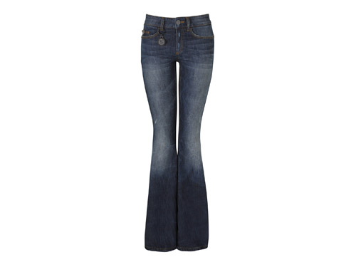
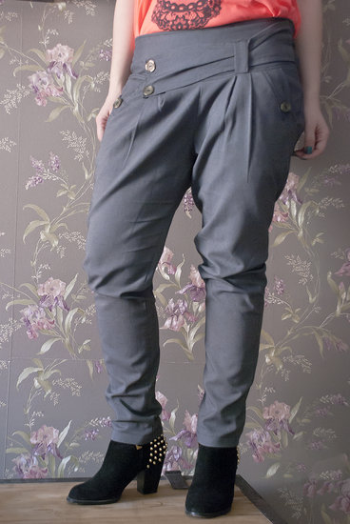
Trousers
These are baggy grey silk trousers.
These are denim flare jeans.

Slide 6
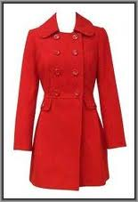
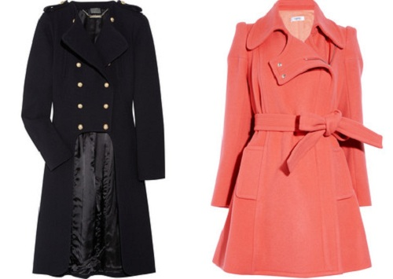
COATS
This is a plain red coat with long-sleeves.
These are black and pink long-sleeved coats. On the second coat is a belt.

Slide 7
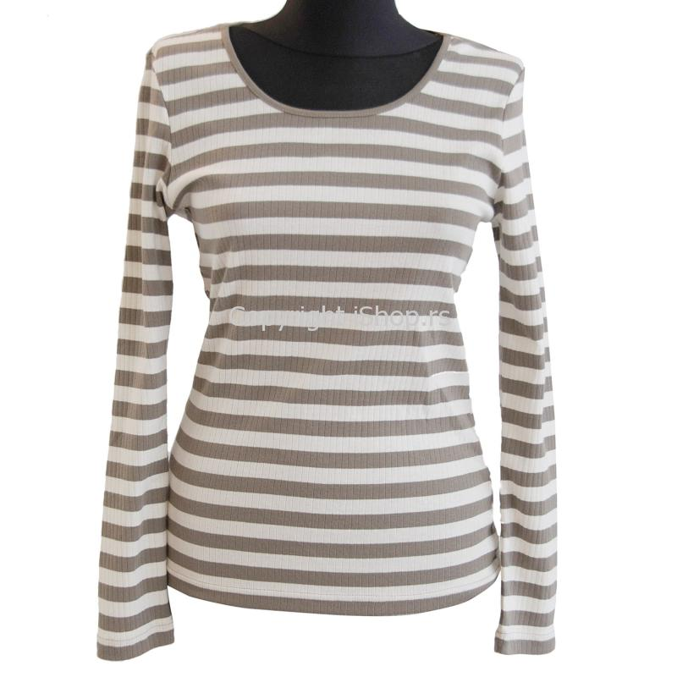
SWEATSHIRTS
This is a plain blue sweatshirt with long-sleeves.
This is a striped brown and white sweatshirt . It is long-sleeved.

Slide 8
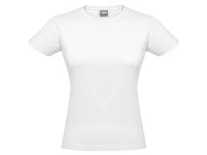
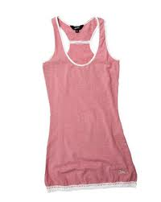
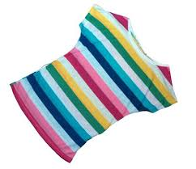
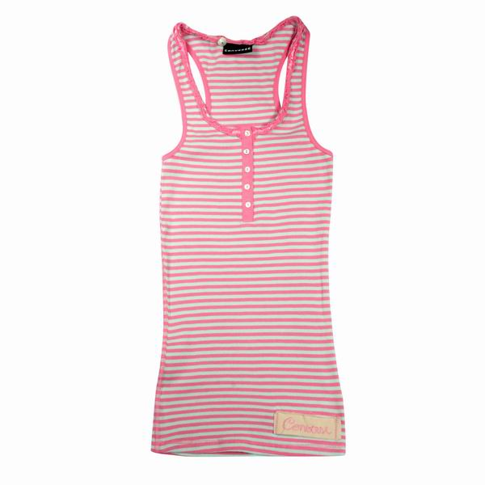
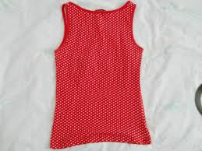
T-SHIRTS
These are plain,polka dot white,pink and red T-shirts. T-shirts are short-sleeved.
These are striped pink and colorful T-shirts.

Slide 9
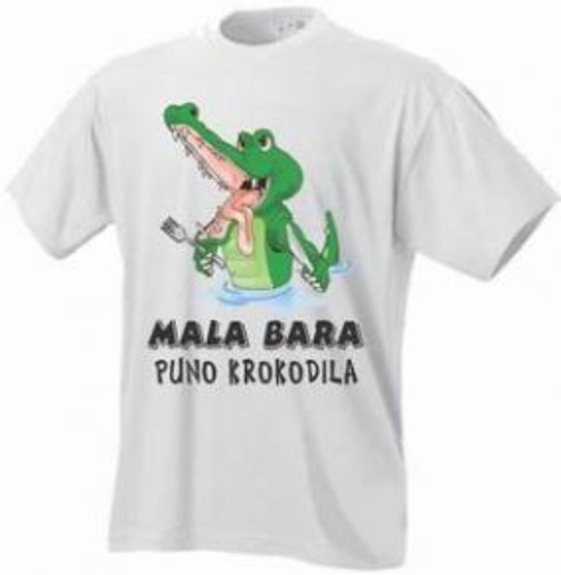
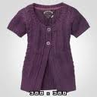
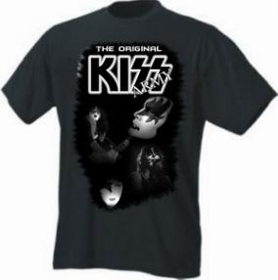
T-SHIRTS
Thess are print black and white T-shirts with short-sleeves .
This is a plain purple woolen T-shirt. It’s short-sleeved.

Slide 10
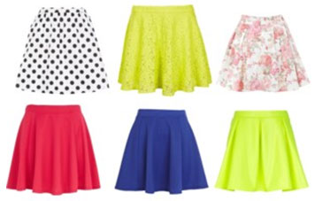
SKIRTS
These are polka dot and plain white-black, yellow, blue, pink and red skirts.
This is a long purple skirt.

Slide 11
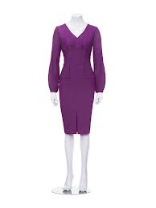
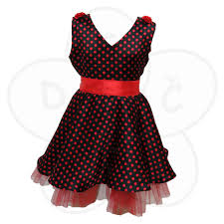
Dress
This is a plain purple dress with long-sleeves.
This is a polka dot red and black short-sleeved dress.

Slide 12
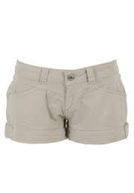
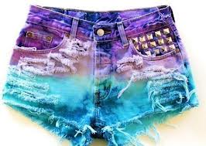
SHORTS
These are purple and blue short shorts.
These are plain grey shorts.

Slide 13
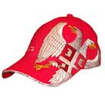
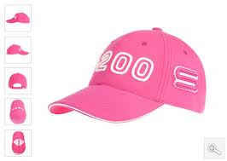
HATS
This is a print pink hat.
This is a print red hat.

Slide 14
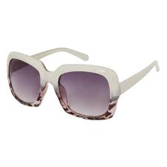
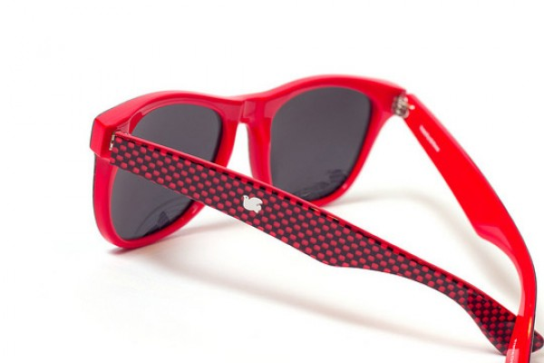
SUNGLASSES
These are white sunglasses.
These are checked red sunglasses.

Slide 15
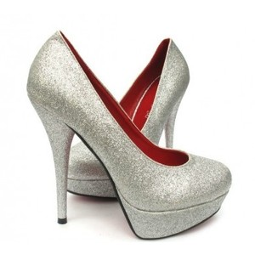
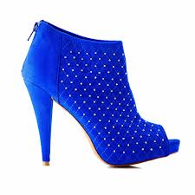
Shoes
These are plain grey high-heeled shoes.
This is a polka dot blue high-heeled shoe.

Slide 16
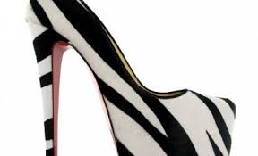
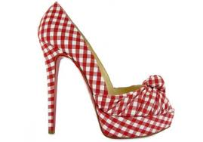
SHOES
This is a striped black and white high-heeled shoe.
This is a checked red and white high-heeled shoe.

Slide 17
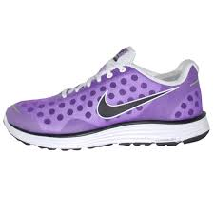
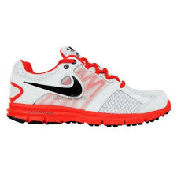
Trainers
This is a polka dot purple flat trainer.
This is a red and white flat trainer.

Slide 18
Tanja is wearing a checked black and white T-shirt. She is wearing tight black jeans .Tanja is wearing high-heeled black shoes. Marija is wearing a plain short-sleeved yellow dress. It is short. She is wearing black high-heeled shoes. Sara is wearing a white T-shirt and long sleeved black coat. She is wearing black tight trousers and a hat. Mira is wearing a striped black and white dress.
Tanja
Marija
Sara
Mira

Slide 19
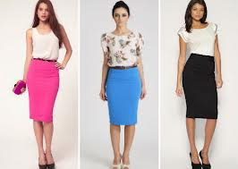
Kaca is wearing a short-sleeved, white T-shirt. She is wearing a leather belt. Kaca is wearing a long, pink skirt. Ana is wearing a long, blue skirt and a white print T-shirt. Tina is wearing a short-sleeved , white T-shirt and a brown belt. Tina is wearing a long, black skirt and black shoes.
Kaca
Ana
Tina

Slide 20
The end

