Slide 1
CLOTHES Miljana Đorđević VII 1 November, 2013

Slide 2
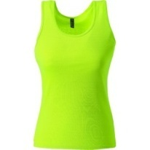
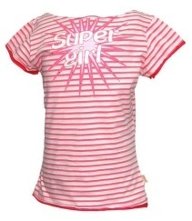
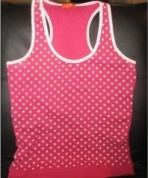
T-shirts
This is a plain green T-shirt with short-sleeves.
This is a striped pink T-shirt with short-sleeves.
This is a polka dot pink and white T-shirt with short-sleeves.

Slide 3
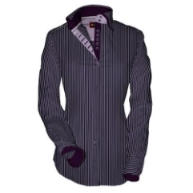
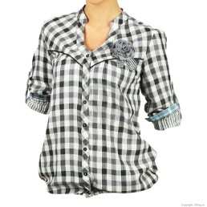
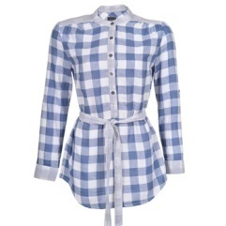
Shirt
This is a striped purple shirt with long-sleeves.
This is a checked black and white shirt with short-sleeves.
This is a checked blue and white shirt with long-sleeves.

Slide 4
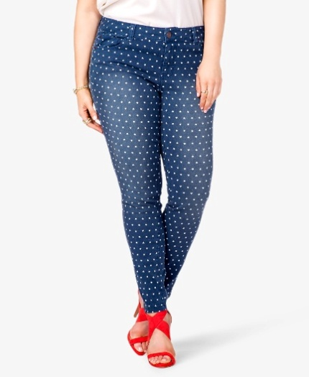
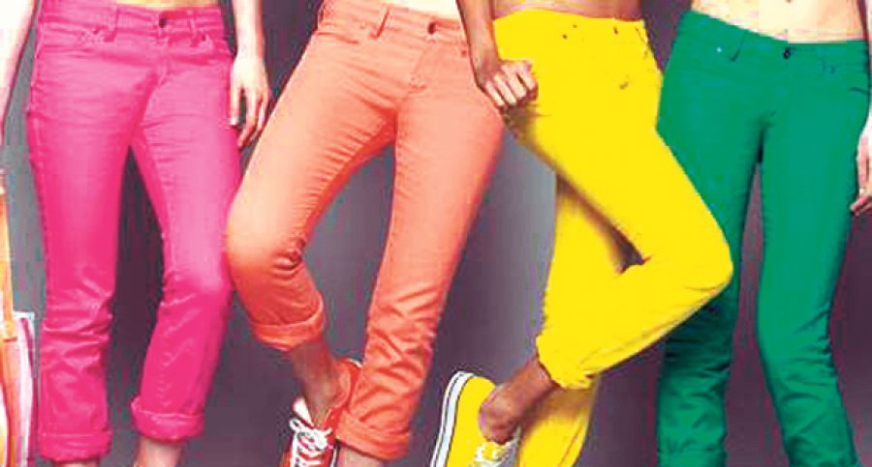
Trousers
These are tight polka dot blue trousers. These are tight pink, orange, yellow and green trousers.

Slide 5
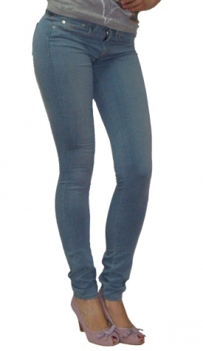
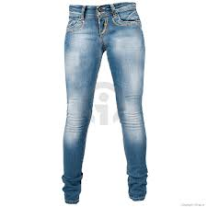
JEANS
These are tight denim blue jeans. These are tight light blue jeans.

Slide 6
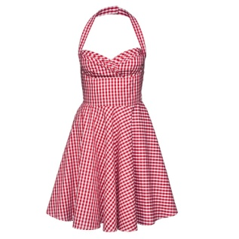
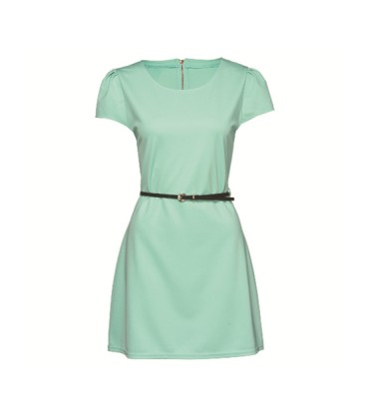
Dress
This is a loose, checked, pink dress.
This is a plain tight green dress.

Slide 7
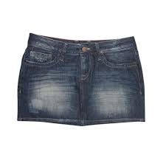
Skirts
This is a short, tight denim skirt.

Slide 8
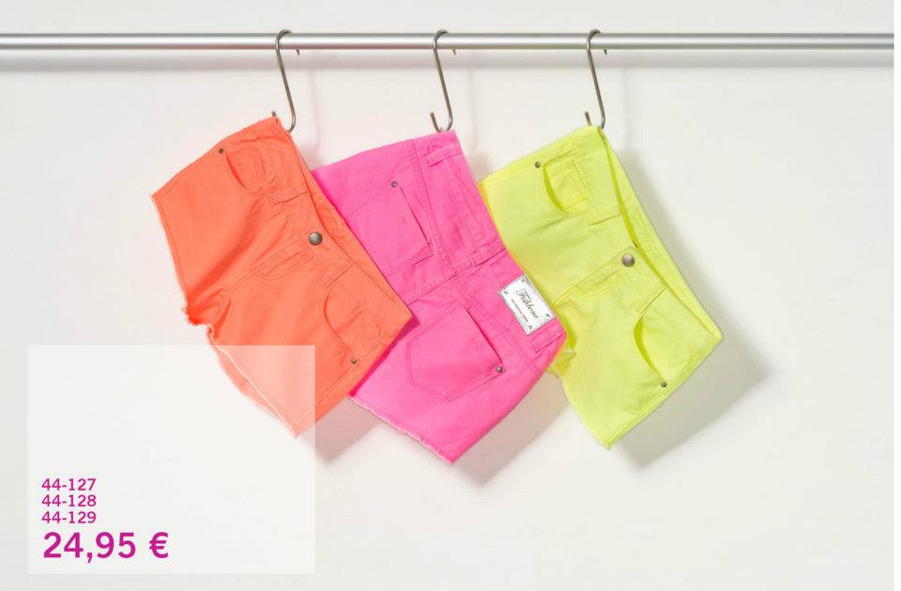
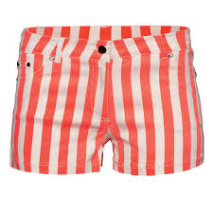
Shorts
These are tight orange, pink and yellow shorts. These are striped, tight, red shorts.

Slide 9
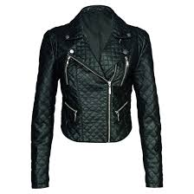
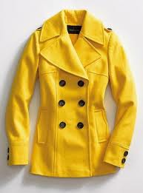
Jacket
This is a tight black, leather, jacket.
This is a tight yellow, leather jacket.

Slide 10
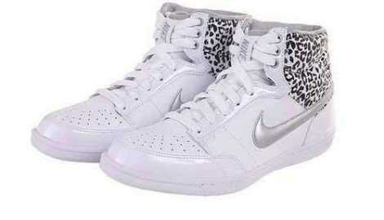
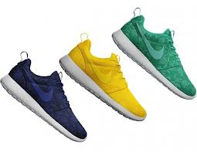
Trainers
These are plain white leather trainers. These are green, yellow and blue trainers.

Slide 11
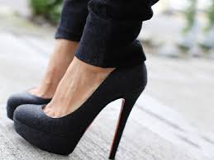
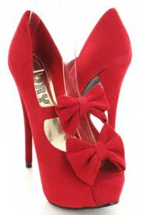
High-heeled shoes
These are black high-heeled shoes. These are red high-heeled shoes with ribbons.

Slide 12
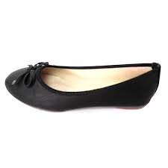
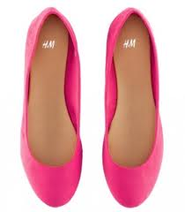
Flat shoes
These are black flat shoes.
These are plain pink flat shoes.

Slide 13
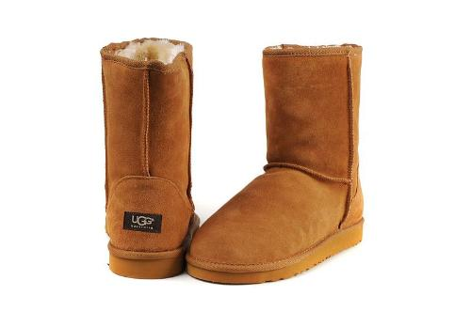
Boots
These are flat brown UGG boots.

Slide 14
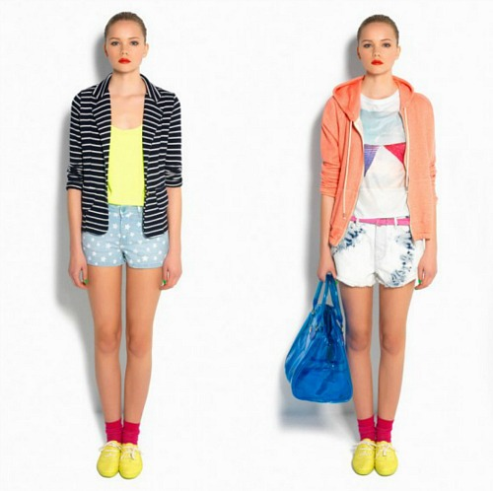
Ema is wearing a striped jacket, a yellow T-shirt, polka dot blue shorts ,red socks and yellow trainers but yesterday she was wearing an orange track suit, a white T-shirt, blue and white shorts, red socks and yellow trainers.

Slide 15
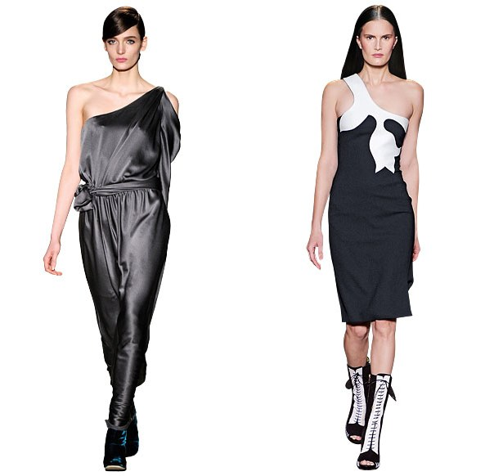
Miley is wearing black, silk trousers and a T-shirt. She is wearing a black and blue trainers. Elena is wearing a long black and white dress with short-sleeves. She is wearing a black and white boots.
Miley
Elena

Slide 16
THE END.☺

