Slide 1
HEALTH PROBLEMS & TREATMENT JANUARY, 2014
PROJECT 4/ UNIT 3

Slide 2
Illnesses
What’s the matter?
What’s wrong?

Slide 3
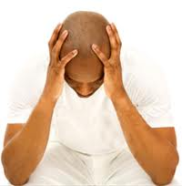
headache
I’ve got a headache.
He’s got a headache.

Slide 4
toothache
I’ve got a toothache.
He’s got a toothache.

Slide 5
earache
I’ve got an earache.
He’s got an earache.

Slide 6
stomachache
I’ve got a stomachache.
She’s got a stomachache.

Slide 7
backache
I’ve got a backache.
He’s got a backache.

Slide 8
sore thorat
I’ve got a sore throat.
He’s got a sore throat.

Slide 9
cold
I’ve got a cold.
She’s got a cold.

Slide 10
temperature/ fever
I’ve got a temperature/ fever.
He’s got a temperature/ fever.

Slide 11
cough
I’ve got a cough.
He’s got a cough.

Slide 12
flu
I’ve got flu.
He’s got flu.

Slide 13
runny nose
I’ve got a runny nose.
He’s got a runny nose.

Slide 14
bleeding nose
I’ve got a bleeding nose.
She’s got a bleeding nose.
Her nose is bleeding.

Slide 15
measles
I’ve got measles.
He’s got measles.

Slide 16
broken leg
I’ve got a broken leg.
He’s got a broken leg.
My leg is broken.
His leg is broken.

Slide 17
broken arm
I’ve got a broken arm.
He’s got a broken arm.
My arm is broken.
His arm is broken.

Slide 18
cut
I’ve got a cut.
He’s got a cut.
I cut my palm/ hand.

Slide 19
eye infection
I’ve got an eye infection.
He’s got an eye infection.

Slide 20
sunburn
I’ve got a sunburn.
He’s got a sunburn.

Slide 21
hiccups
I’ve got hiccups.
He’s got hiccups.

Slide 22
I’ve/ She’s/ He’s got
a headache
a toothache
an earache
a stomachache
a backache
a sore throat
a cold
a temperature/ fever
a cough
the flu
a runny nose
a bleeding nose
the measles
a broken leg/ arm
a cut
an eye infection
a sunburn
the hiccups

Slide 24
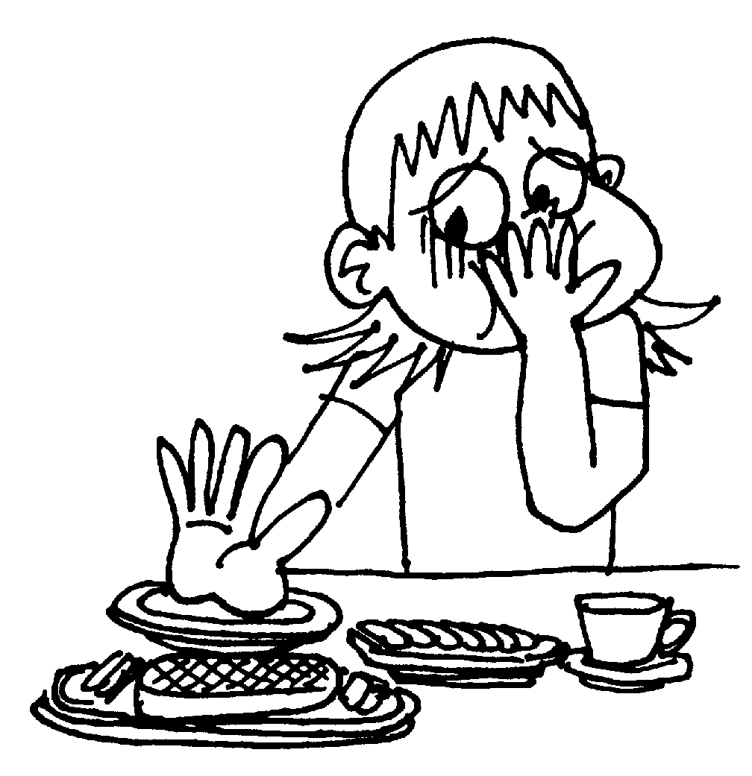
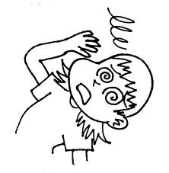
feel
sick
dizzy

Slide 25
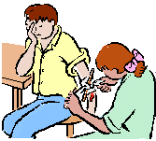
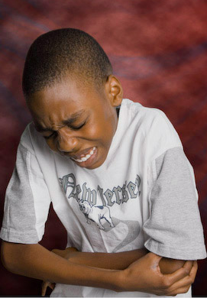
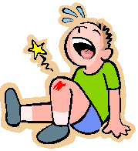
hurt
an arm
a leg
It’s bleeding.
It’s painful.
It’s swollen.

Slide 26
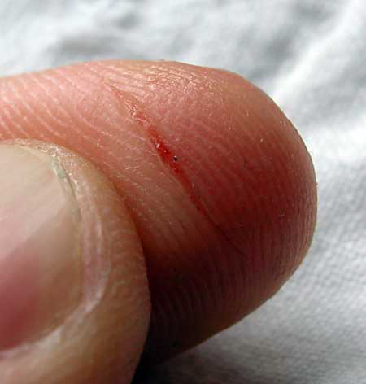
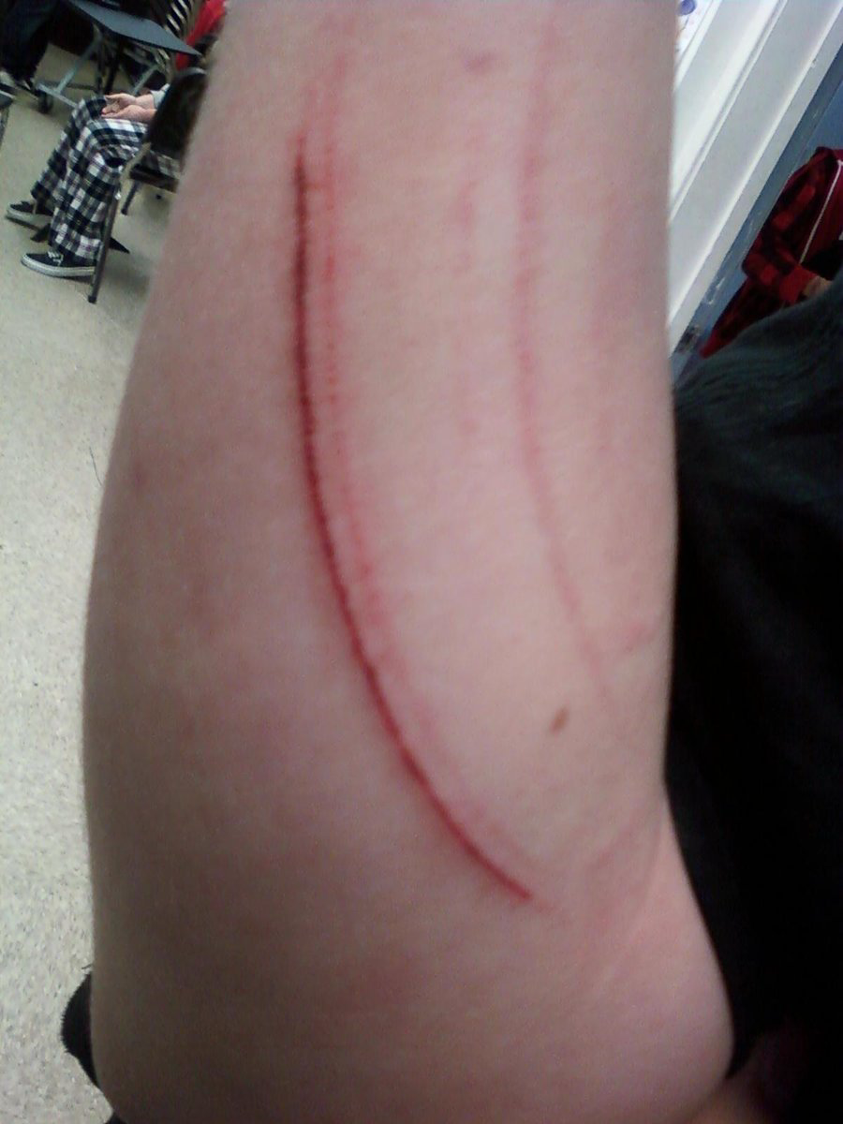
cut
a finger
an arm
It’s bleeding.
It’s painful.

Slide 27
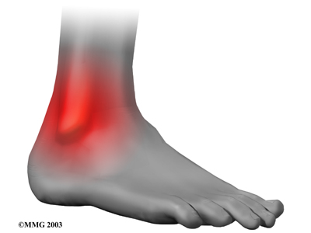
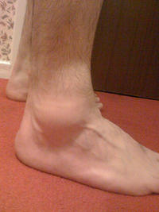
sprain
ankle
It’s painful.
It's swollen.

Slide 28
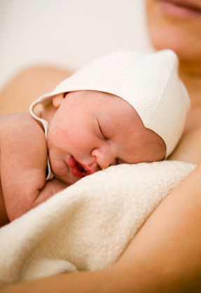
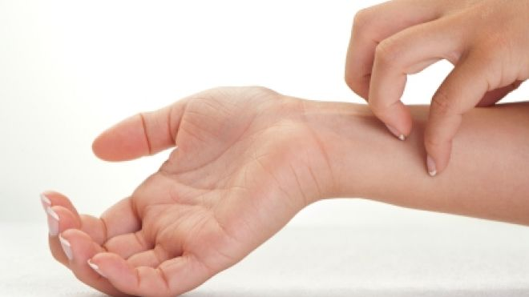
rash
It’s (a bit) red.
It’s painful.
It’s itchy.

Slide 29
Look at the picture. What’s the problem?
Tito has a broken leg.
Steve has a stomachache.
Joanne has a a sore throat.
Tam has a sprained ankle.
Dana has an earache.

Slide 30
I feel/ He feels sick/ dizzy.
I hurt my arm/leg.
I cut my finger/arm.
I sprained my ankle.
I’ve got a skin rash.
It’s painful.
It’s bleeding.
It’s swollen.
It’s a bit red.
It’s itchy.

Slide 31
Match the sentences with the correct picture
It's bleeding.
It's painful.
It's a bit red.
It's swollen
It's itchy.
It's sore.

Slide 32
Going to the doctor’s
1 make an appointment
2 tell your symptoms/ problems
3 the doctor examines you
4 diagnosis
5 treatment: -write a prescription
-medicine
6 get better-> check up

Slide 33
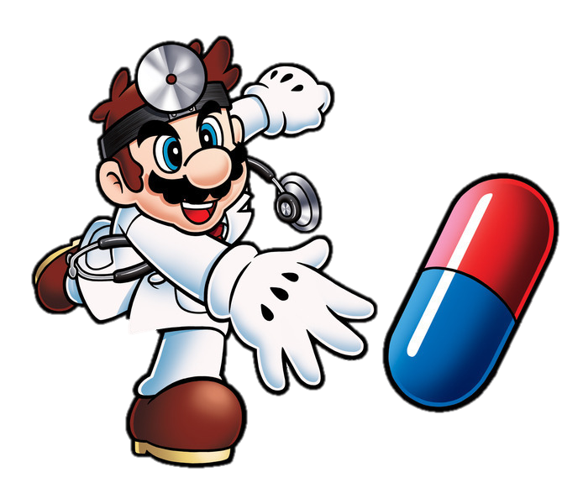
treatment

Slide 34
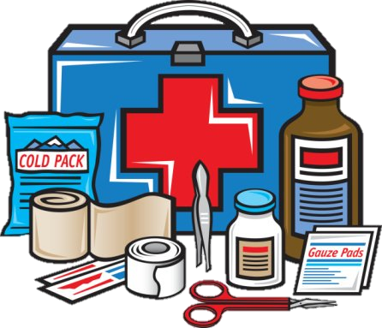
first aid kit

Slide 35
stethoscope

Slide 36
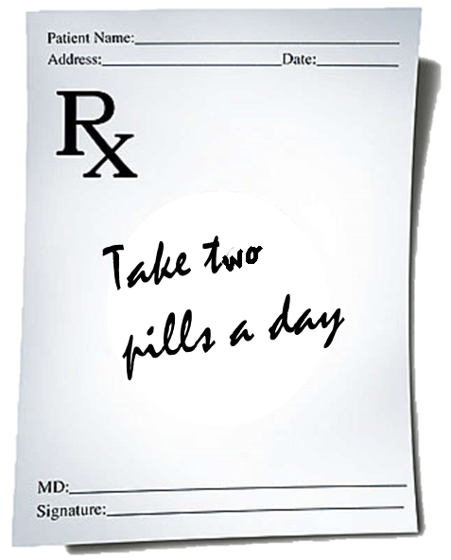
prescription

Slide 37
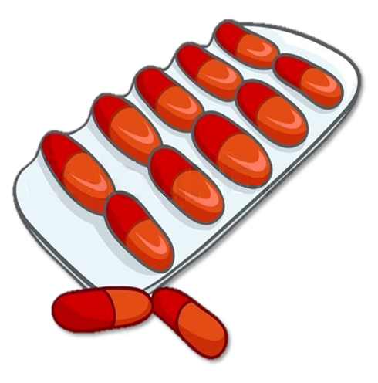
tablets/pills/ capsules

Slide 38
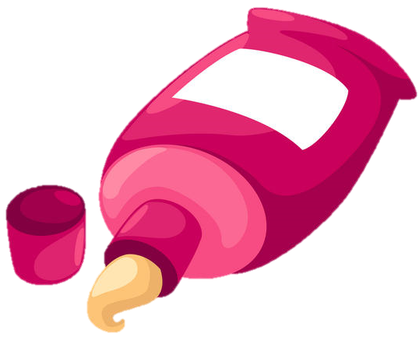
ointment

Slide 39
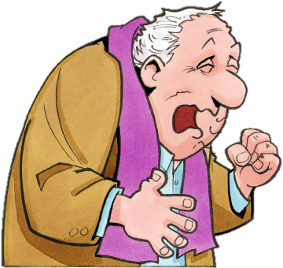
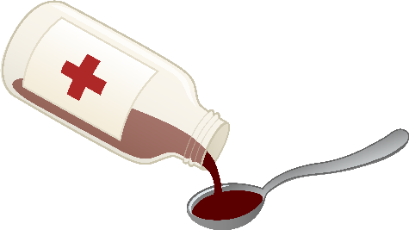
syrup

Slide 40
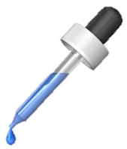
drops

Slide 41
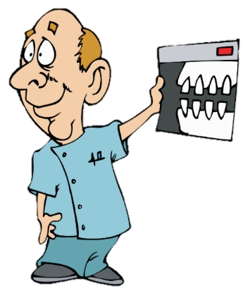
X-ray

Slide 42
band aid

Slide 43
plaster

Slide 44
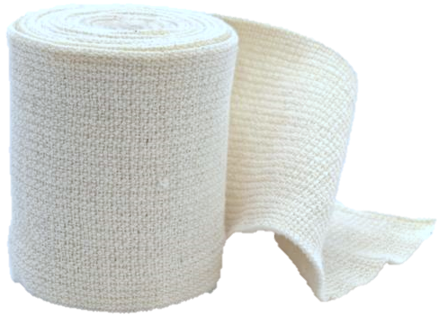
bandage

Slide 45
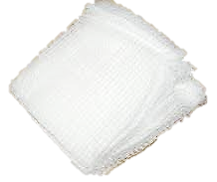
gauze

Slide 46
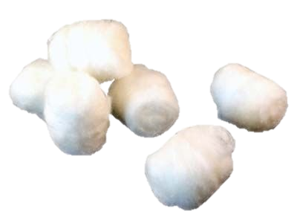
cotton

Slide 47
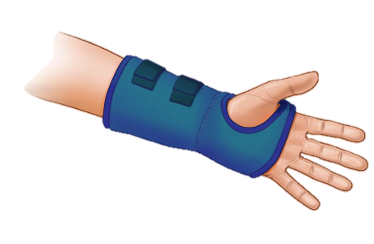
splint

Slide 48
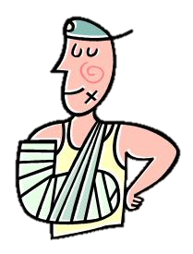
sling

Slide 49
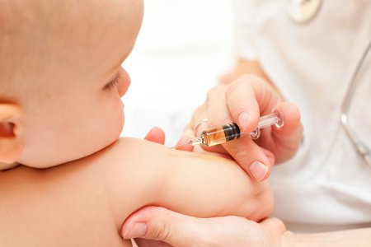
vaccine

Slide 50
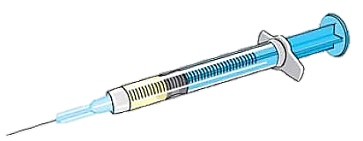
injection

Slide 51
crutch

Slide 52
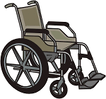
wheelchair

Slide 53
Treatment
prescription
tablets/ pills
ointment
syrup
drops
x-ray
plaster
bandage
gauze
cotton
splint
sling
vaccine
injection
crutch
wheelchair

Slide 54
Label these things
What problems do you use these treatments for?
tablets
bandage
plaster
drops
injection
x-ray
sling

Slide 55
complete the card for each patient
Patient 1
Problem: ____________________
Diagnosis: ___________________
Treatment: ___________________

Slide 56
complete the card for each patient
Patient 2
Problem: ____________________
Diagnosis: ___________________
Treatment: ___________________

Slide 57
complete the card for each patient
Patient 3
Problem: ____________________
Diagnosis: ___________________
Treatment: ___________________

Slide 58
Fill in the gaps with suitable words.
1.If you want to find out someone’s temperature, use a____________
2. I’ve got a _______________ nose. I suppose it’s a cold coming on.
3. It was quite a bad cut and it was bleeding, so I put on a_________ .
4. I think he’s broken his leg. Quick, someone call an____________ .
5.He was ten kilos overweight and was advised to go on a________ .
6. If you want some pills, you’ll have to ask the doctor for a_______ .
7. If you’ve got measles, your skin is covered in ________________.
8. I think you take too many sleeping __________________.
pills
thermometre
diet
prescription
runny
ambulance
spots
plaster

