Slide 1
My town
Nataša Stojanović, VI 1
October, 2013

Slide 2
My town
The name of my town is Kraljevo.
Kraljevo is a big town. I like my town.

Slide 3
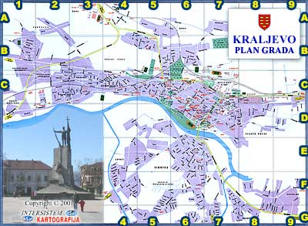
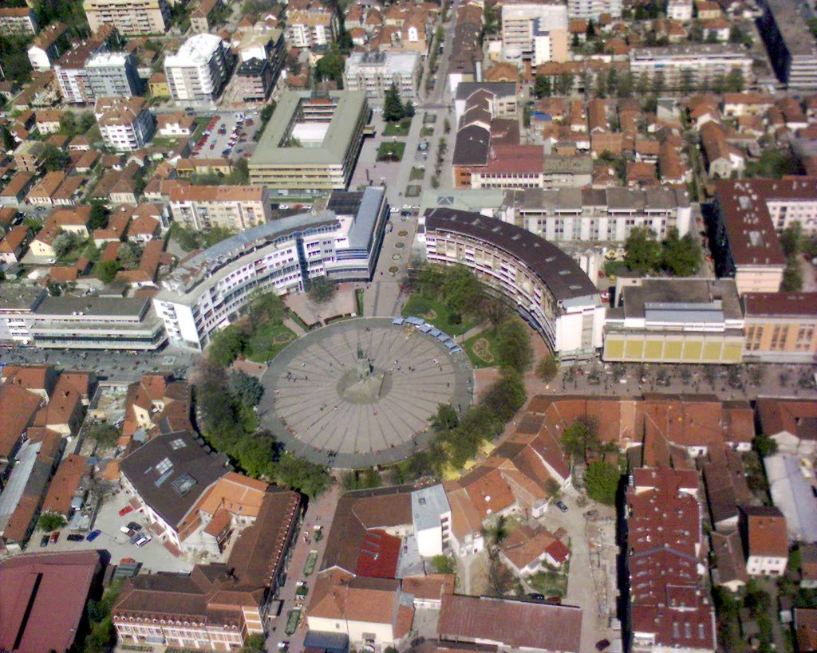
Kraljevo
Map of Kraljevo
Town Centre Square with the famous Monument dedicated to all Serbian victims
in the World War I.
It is called Milutin

Slide 4
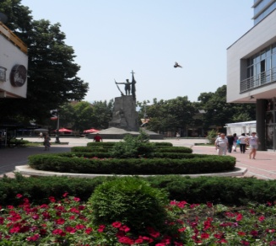
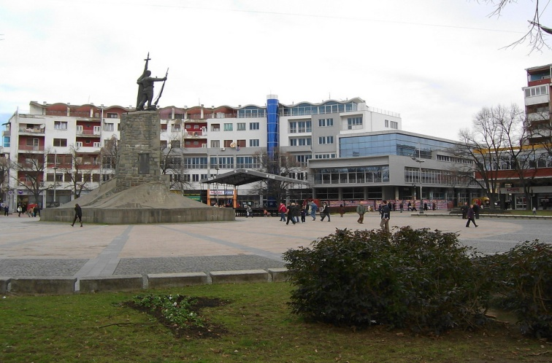
Kraljevo
Kraljevo is in central Serbia on the river Ibar.
Kraljevo has changed several names. They are: Ruda Polja,Janok,Rudopolje Karanovac,Kraljevo.
Town’s surface is 1530km2.
Kraljevo and environment of Kraljevo has 124.544 people.

Slide 5
Kraljevo is famous about…
Its name “SRCE ŠUMADIJE”
Monastery Žiča
Monastery Studenica
Town Square SRPSKIH RATNIKA
Famous Spas : Vrnjačka ,Mataruška, etc
Straight streets
Jolly rafting in June
Old town Maglič
Notes:
Č

Slide 6
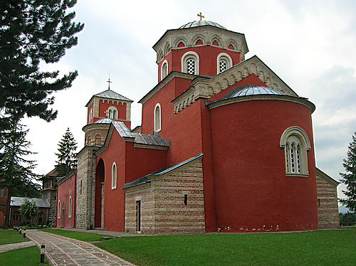
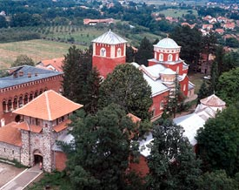
Monastery Žiča
Monastery Žiča is a very big monastery near Kraljevo.
Monastery Žiča was built in XIII century.
Stefan Prvovenčani built this monastery
Seven Serbian kings were crowned in this monastery.

Slide 7
Kraljevo in pictures
Coat of arms
Old town Maglič

Slide 8
Kraljevo in pictures
Jolly rafting
Monastery Studenica

Slide 9
Kraljevo in pictures
“Milutin”
Town Museum

Slide 10
Kraljevo in pictures
River Ibar
Omladinska Street

Slide 11
Kraljevo in pictures
Memorial park “14th October
View from the mountain Stolovi

Slide 12
That’ s my town. Isn’t it beautiful?

