Slide 1
The Future
NATASA STOJANOVIC,
December 2013

Slide 2
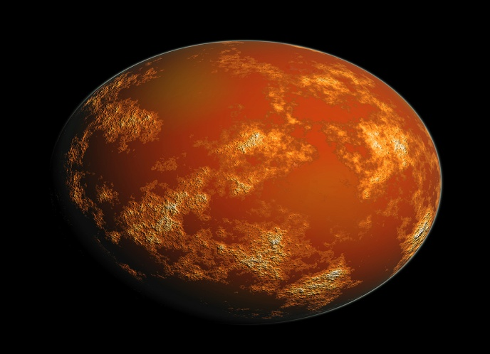
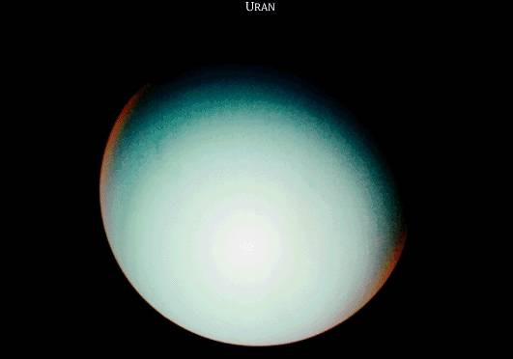
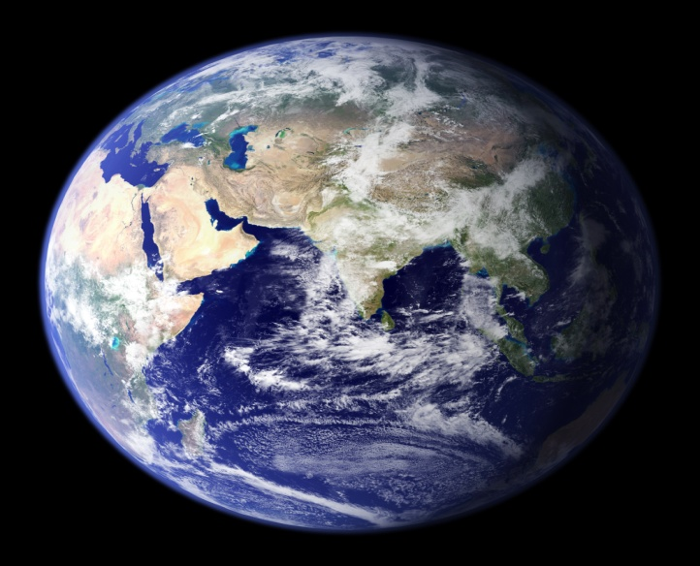
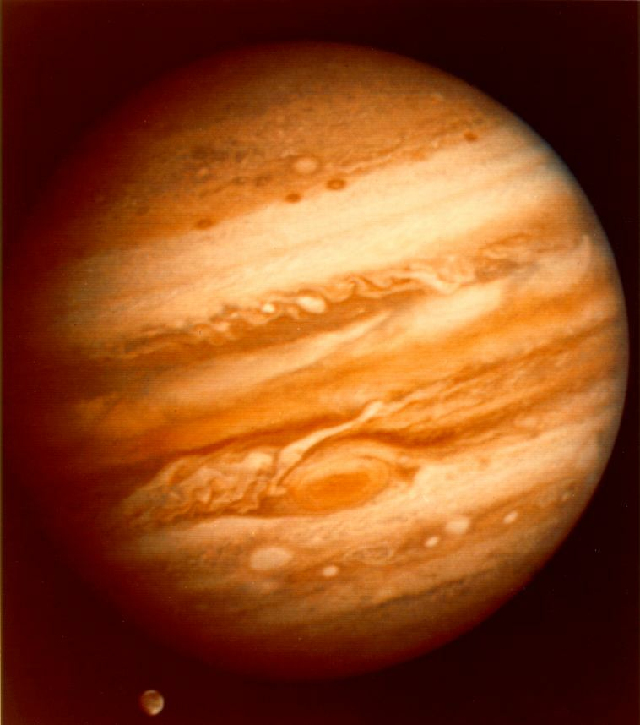
The solar system
Solar system consists of 8 planets.
These are:
The Earth
Jupiter
Venus
Mercury
Mars
Saturn
Uranus
Neptune

Slide 3
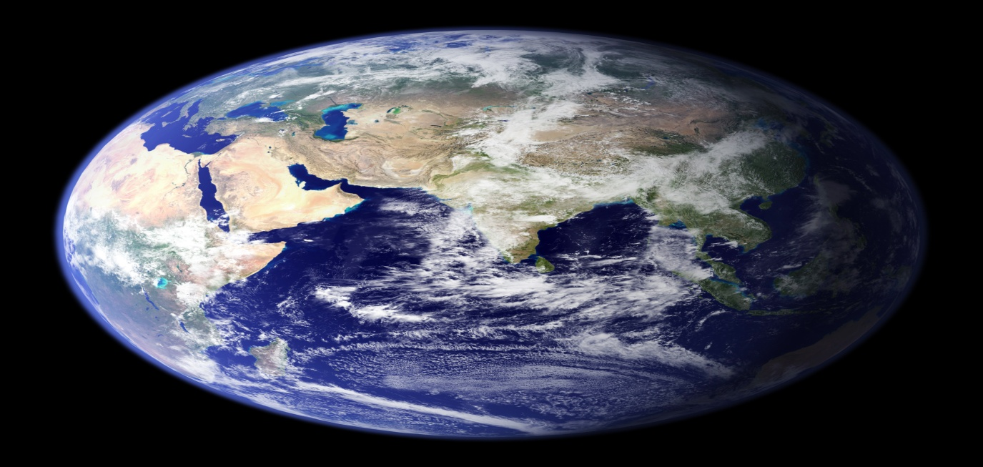
The Earth
The Earth is unique because water covers most of its surface.
70 PERCENT WATER,AND LAND 30 PERCENT
other planets are without water.
Scientist have not seen a single living being on other planets.

Slide 4
Uranus
Seasons on Uranus lasts for 21 years.
One trip around the Sun lasts for 84 years.

Slide 5
Jupiter
The largest planet in the solar system is Jupiter.
IT is as big as all other planets together.

Slide 6
Mars
Mars is red because of the red sand.
Red sand covers the entire planet.
On Mars are often strong winds and storms.

Slide 7
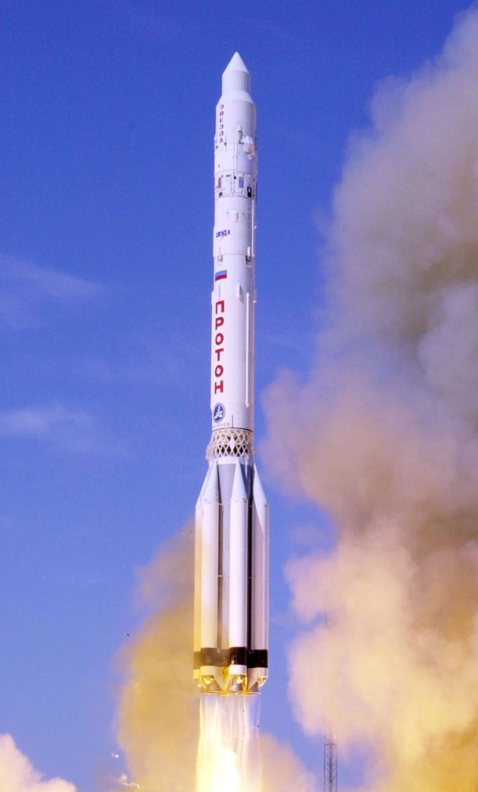
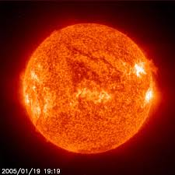
Journey into space
Space consists of:
Stars
The Sun
Planets
The Moon
Spaceships
Astronauts
Rockets
Satellites
Space stations

Slide 8
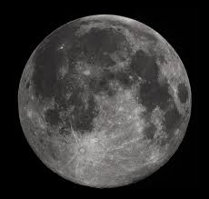
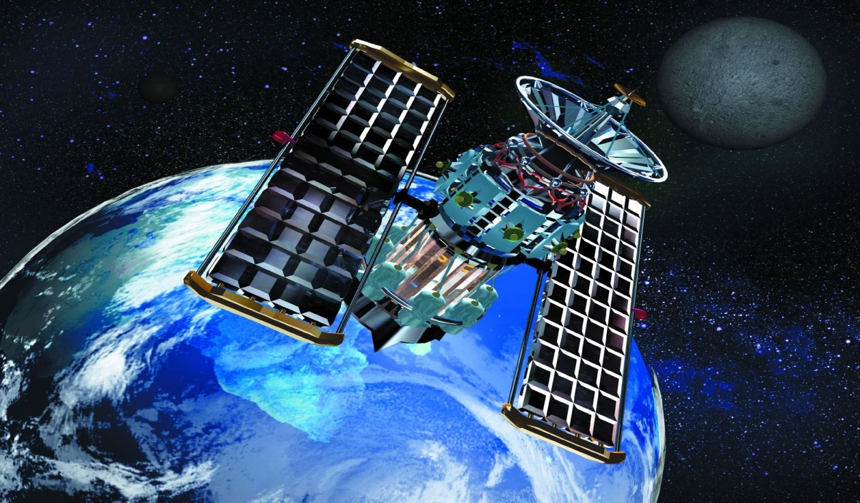
Satellites
Satellites are heavenly bodies that attracts the planet’s gravity.
The Moon is natural satellite of the Earth.
Artificial satellites are made by people.

Slide 9
Stars
Stars are heated celestial bodies.
They naturally produce light and heat.
They form constellations.
Our constellation called the “milky way” or “godfathers straw”.
Famous constellations are: Big bear , small bear , Orion , Cassiopeia , swan , etc.

Slide 10
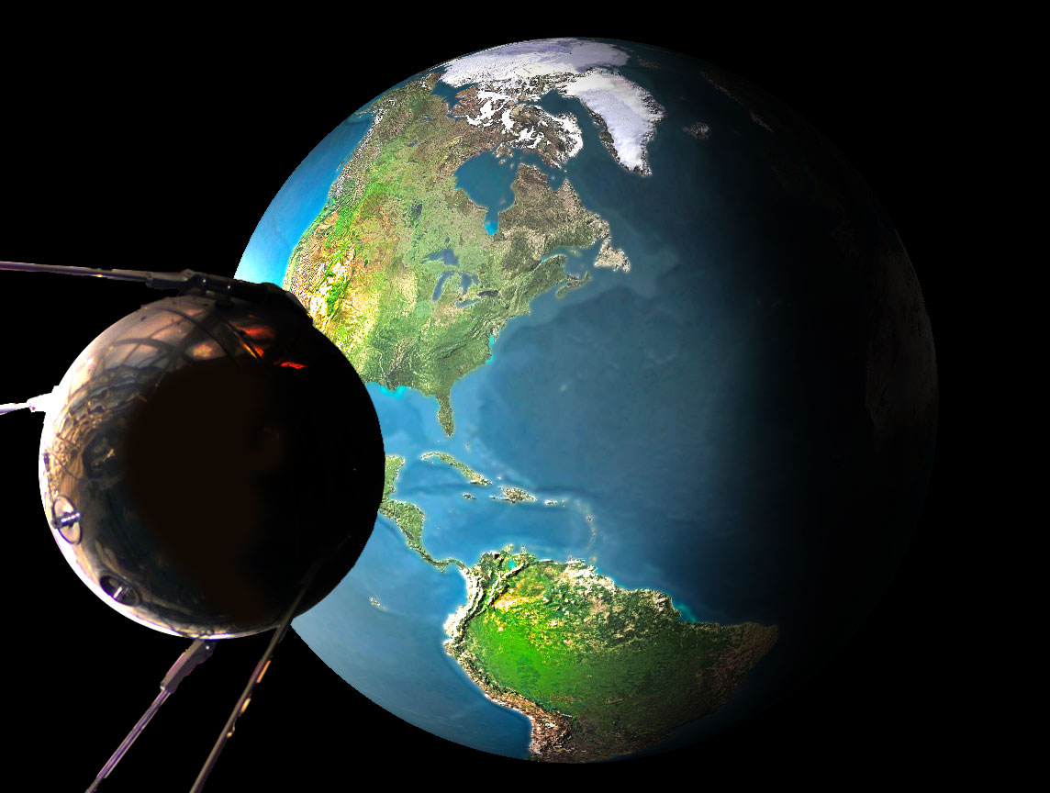
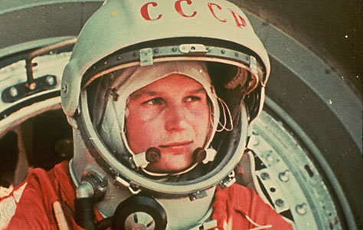
Interesting thing
Name planet comes from Greek word “planets” which means wanderer.
First artificial satellite was created in Russia in 1957 year s. It Was called sputnjik1.
In 1961 years the first man flew into outer space by a spaceship
Юрий Гагарин

Slide 11
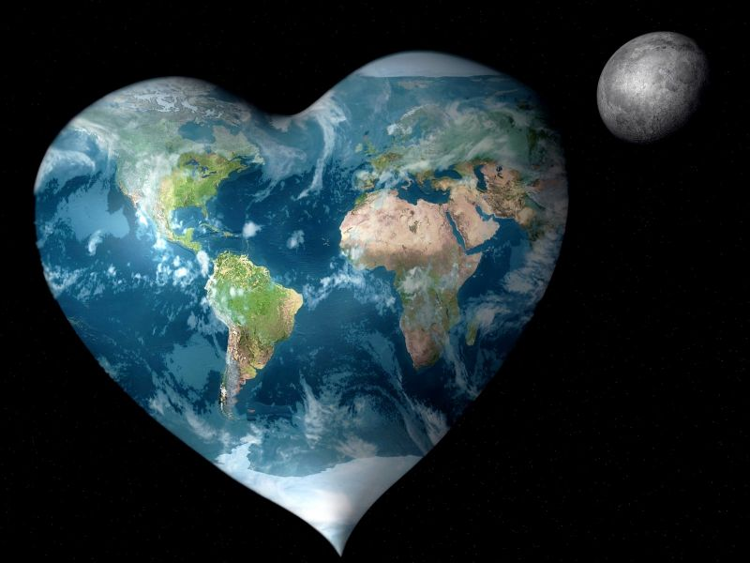
This is our planet on which we live!

