Slide 1
The Military
Aleksa Rafailović | VIII1

Slide 2
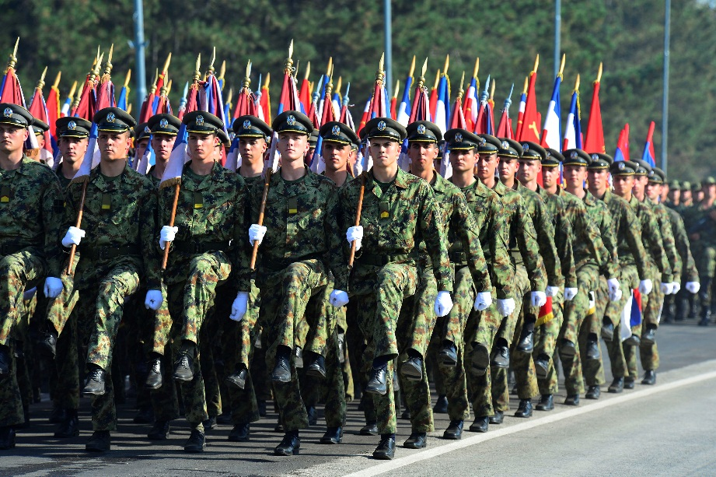
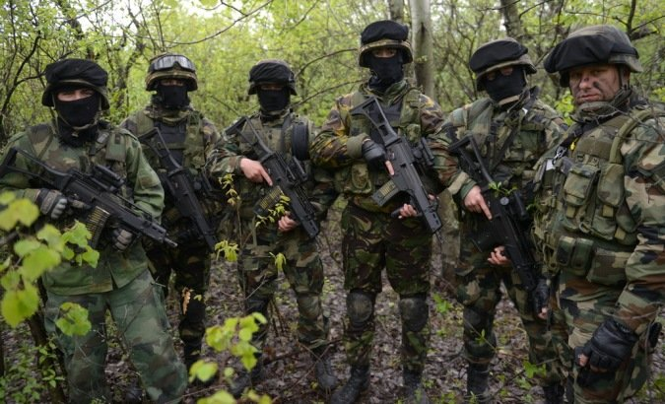
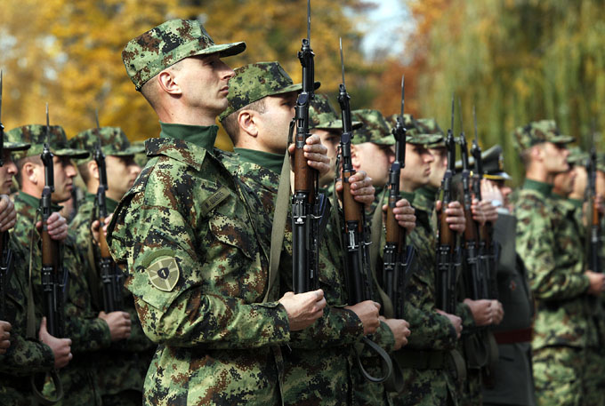
The Military
› The military is an armed force of defense. Organizational structure and numerical size of military are determined by the competent authorities and it depends on the risk, resources, missions and tasks. And it is also organized according to the strategy.

Slide 3
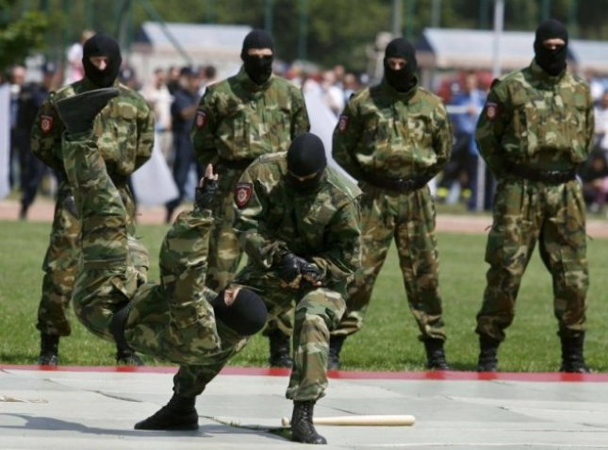
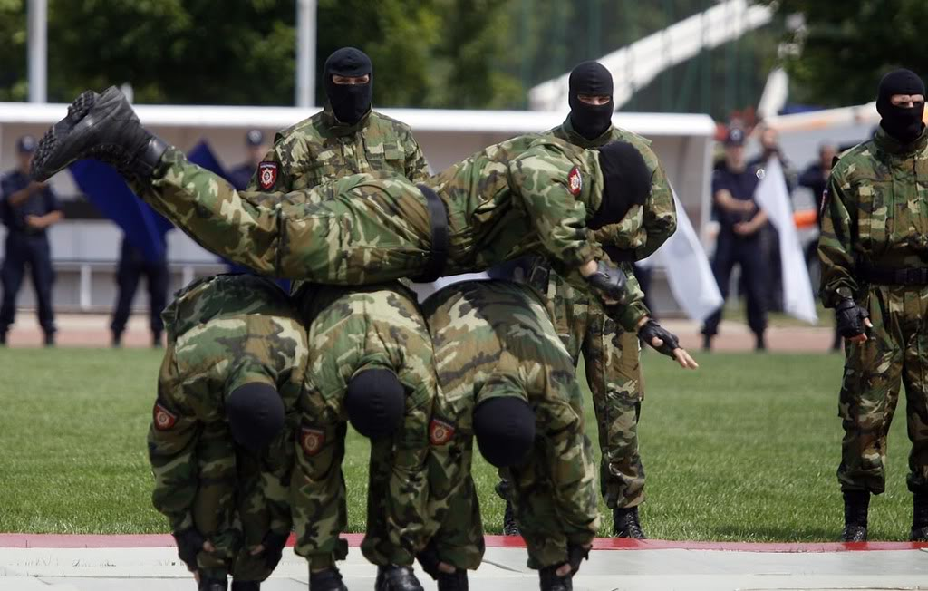
› The military is divided into species and genres. Also it develops its own system of training and logistic, and it relies on the resources of the state.

Slide 4
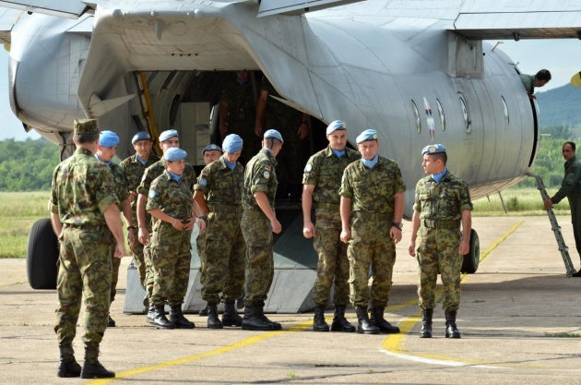
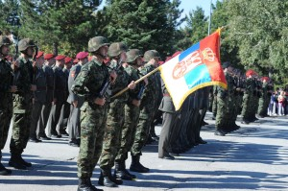
› Missions and tasks of the military are defined by the Assembly.
Missions of military are: defending the country from enemies, the participation of the peace in the country and the world, support after some natural disasters.
Tasks of military are: prevention of armed attacks, the defence of the territory, training soldiers, etc.

Slide 5
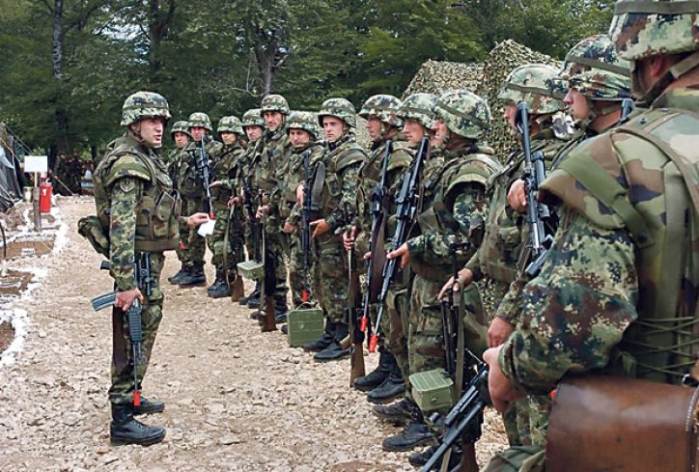
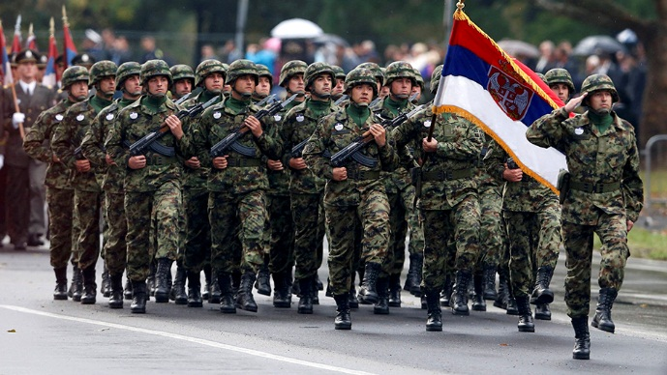
The Military of Serbia
» The Serbian Army is armed formations of the Republic of Serbia. It was officially created on June 8, 2006, by decree of the National Assembly of the Republic of Serbia. It was created after the declaration of independence of Montenegro from those parts of the Army of Serbia and Montenegro that were on the territory of Serbia.
» Some of ranks in Serbian military are: commander, captain, major, general, sergeant, corporal, etc.

Slide 6
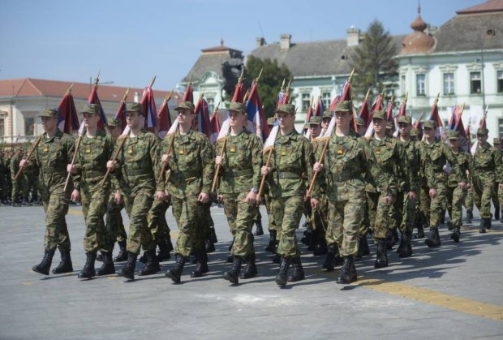
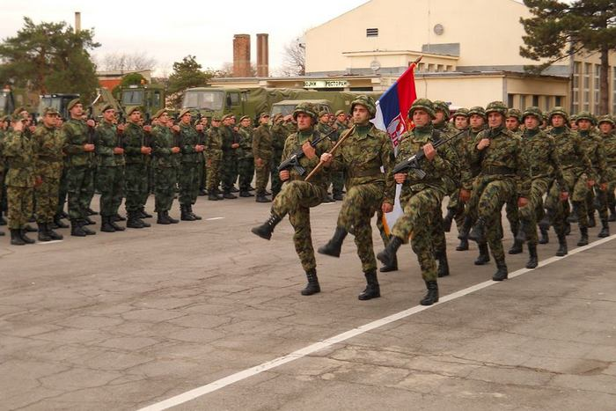
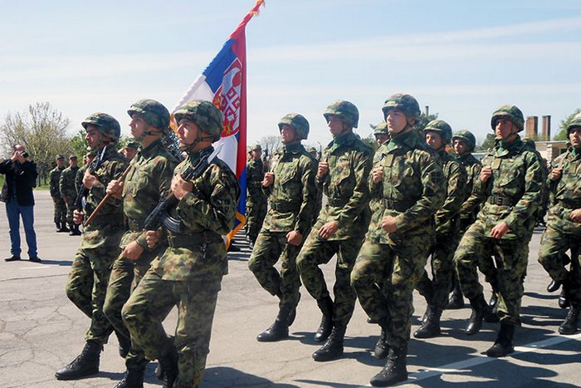
»The Army of Serbia celebrates 23rd April, because on that day in 1815 the Second Serbian Uprising was raised .

Slide 7
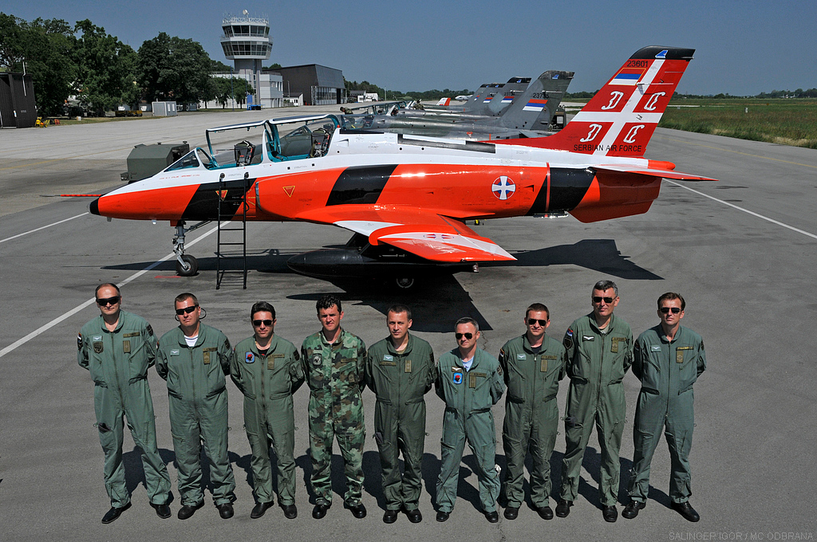
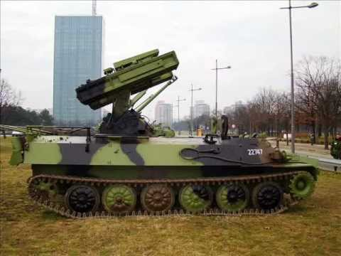
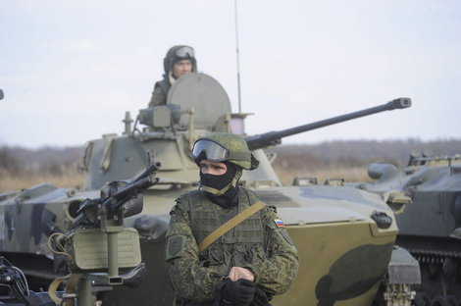
› Types of military in Serbia are: army, Air Force, air defense.
Some of the genres are: infantry, artillery, aviation, etc.

Slide 8
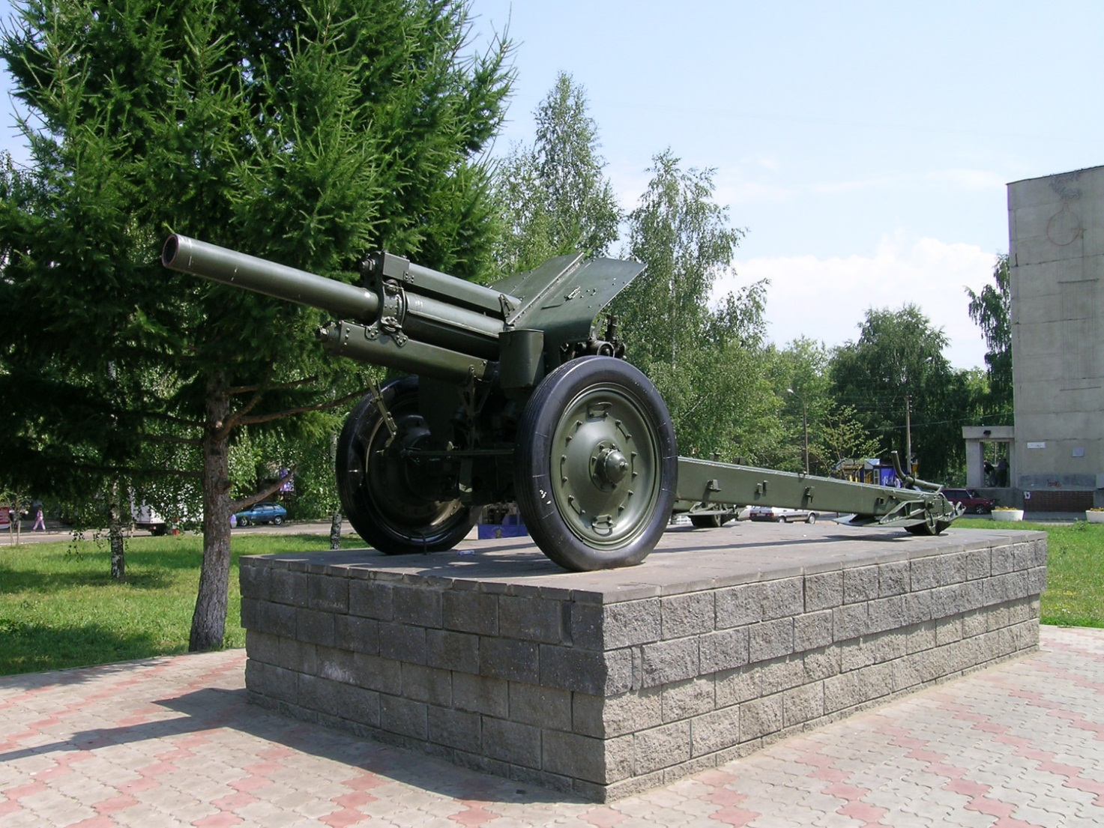
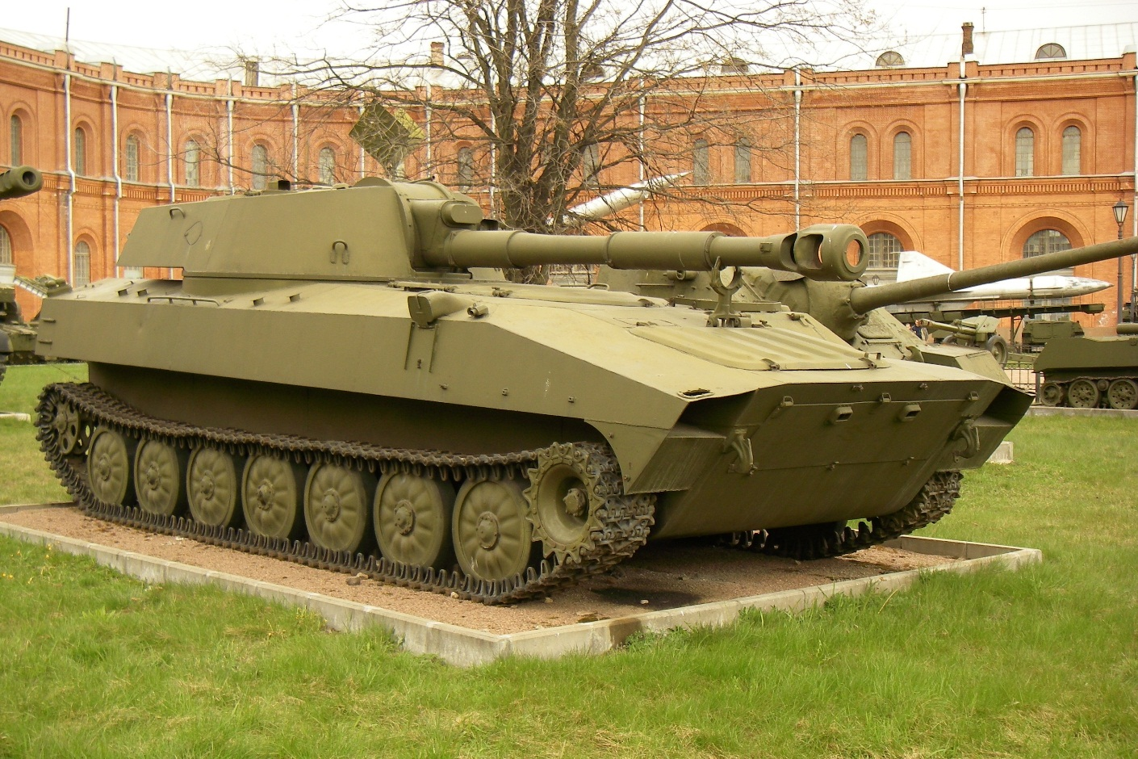
» Artillery: 122mm howitzers 230
self-propelled howitzers 2S1 "Carnation"
self-propelled howitzers2S1 “Carnation”
122mm howitzers 230

Slide 9
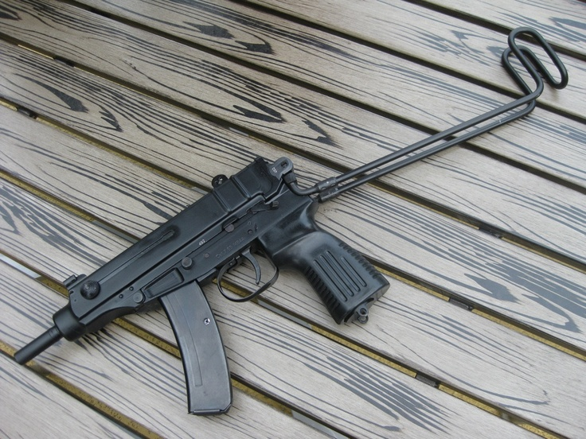
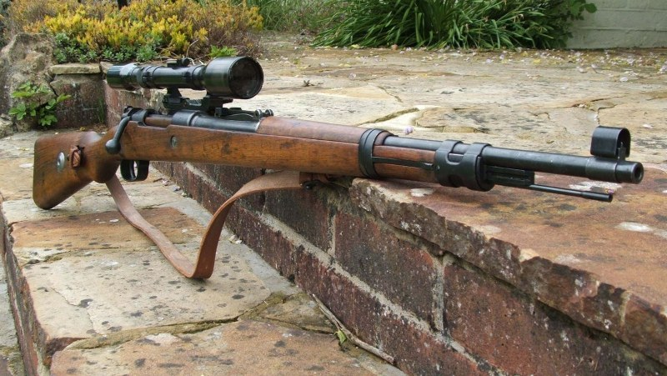
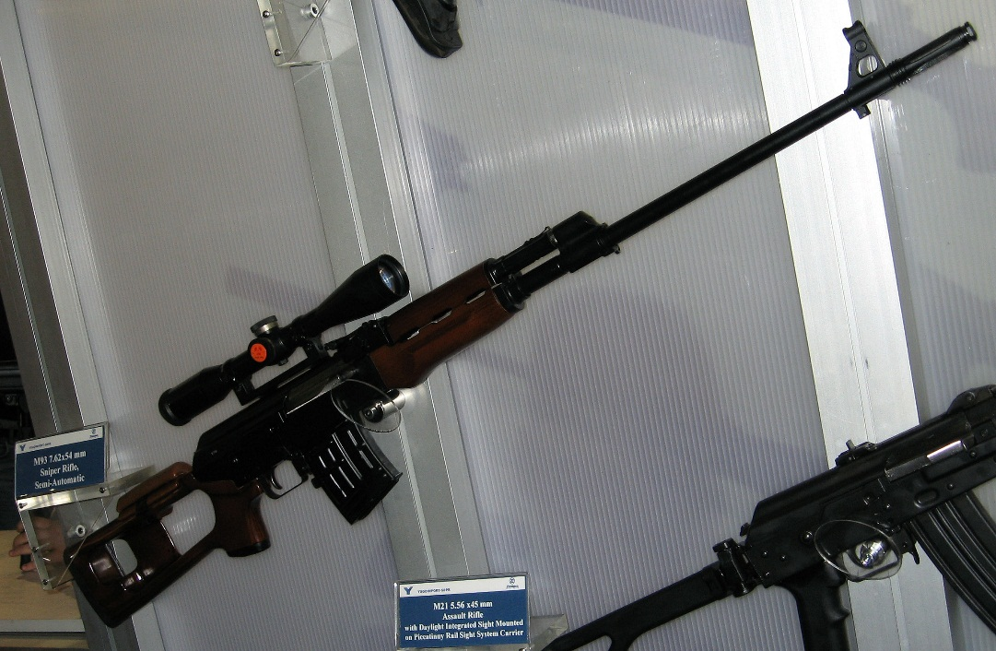
» Infantry weapons: automatic pistol "Scorpion"
Sniper M93 / M91 / M47
mortal M74 / M75
“Scorpion”
M47
M91

Slide 10
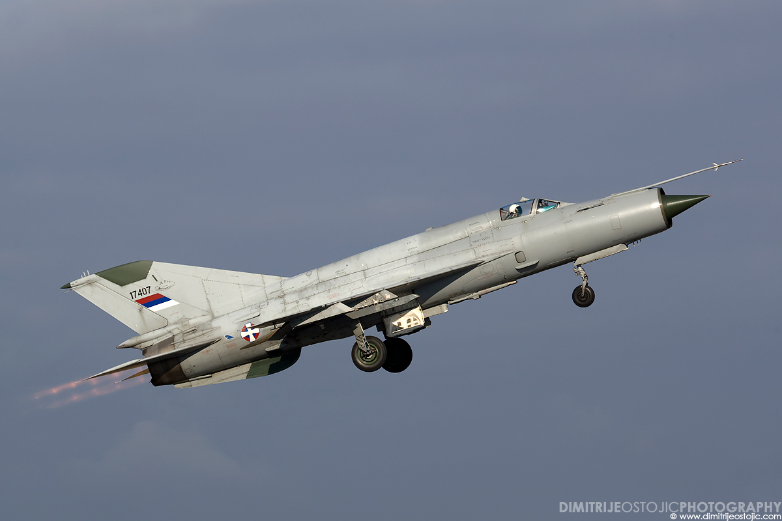
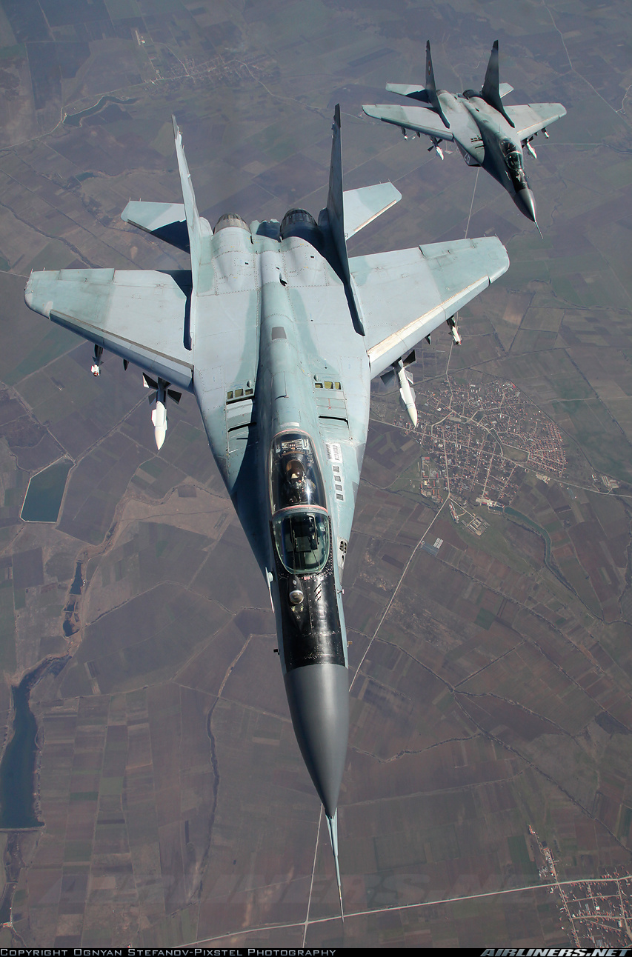
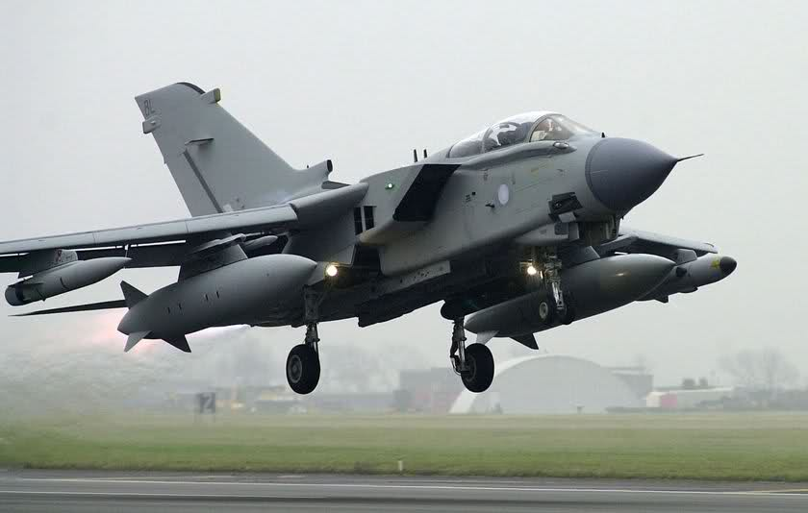
» Aircraft: hunter Mig 29 / Mig 21
hunter bomber "Eagle"
Mig 21
Mig 29
“Eagle”

Slide 11
» Thank you for listening.. «
THE END

