Slide 1
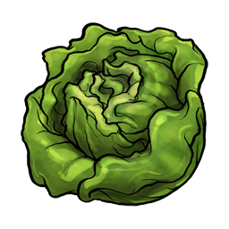
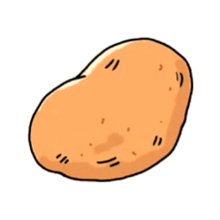

Slide 2
Spin the wheel and click the right word

Slide 3
Spin the wheel and click the right word
tomato
pepper
potato
carrot
pumpkin
beans
corn
artichoke
garlic
cauliflower
onion
lettuce

Slide 4
Spin the wheel and click the right word
tomato
pepper
potato
carrot
pumpkin
beans
corn
artichoke
garlic
cauliflower
onion
lettuce

Slide 5
Spin the wheel and click the right word
tomato
pepper
potato
carrot
pumpkin
beans
corn
artichoke
garlic
cauliflower
onion
lettuce

Slide 6
Spin the wheel and click the right word
tomato
pepper
potato
carrot
pumpkin
beans
corn
artichoke
garlic
cauliflower
onion
lettuce

Slide 7
Spin the wheel and click the right word
tomato
pepper
potato
carrot
pumpkin
beans
corn
artichoke
garlic
cauliflower
onion
lettuce

Slide 8
Spin the wheel and click the right word
tomato
pepper
potato
carrot
pumpkin
beans
corn
artichoke
garlic
cauliflower
onion
lettuce

Slide 9
Spin the wheel and click the right word
tomato
pepper
potato
carrot
pumpkin
beans
corn
artichoke
garlic
cauliflower
onion
lettuce

Slide 10
Spin the wheel and click the right word
tomato
pepper
potato
carrot
pumpkin
beans
corn
artichoke
garlic
cauliflower
onion
lettuce

Slide 11
Spin the wheel and click the right word
tomato
pepper
potato
carrot
pumpkin
beans
corn
artichoke
garlic
cauliflower
onion
lettuce

Slide 12
Spin the wheel and click the right word
tomato
pepper
potato
carrot
pumpkin
beans
corn
artichoke
garlic
cauliflower
onion
lettuce

Slide 13
Spin the wheel and click the right word
tomato
pepper
potato
carrot
pumpkin
beans
corn
artichoke
garlic
cauliflower
onion
lettuce

Slide 14
Spin the wheel and click the right word
tomato
pepper
potato
carrot
pumpkin
beans
corn
artichoke
garlic
cauliflower
onion
lettuce
EXIT

