Slide 1
Forensic science
Marta Milenkovic | VIII1

Slide 2
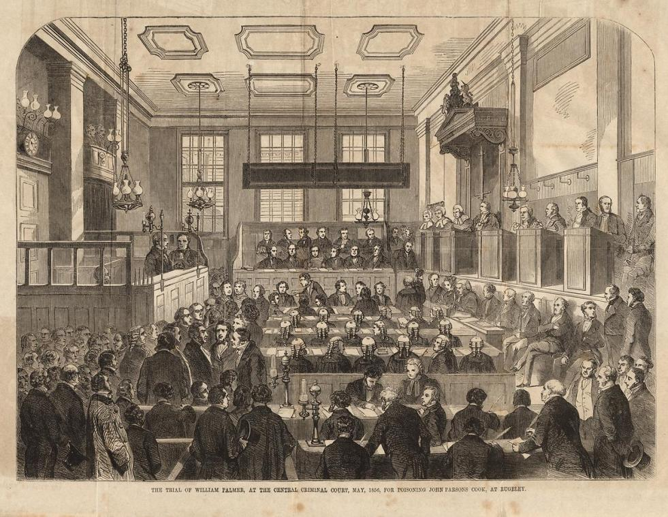
Forensic science
» Forensic is a science that studies the physical evidence in order to solve crimes. Forensic was created in the mid-nineteenth century. In the beginning, due to shortage of development of sciences such as biology, chemistry and medicine, research was hardly carried out which led to the concerns during the trials.
» In the beginning for the identification were used photo documentation and technique of fingerprints. After that the fingerprint technique was combined with the analysis of physical evidences such as hair, biological stains, soil and other materials from the crime scene.

Slide 3
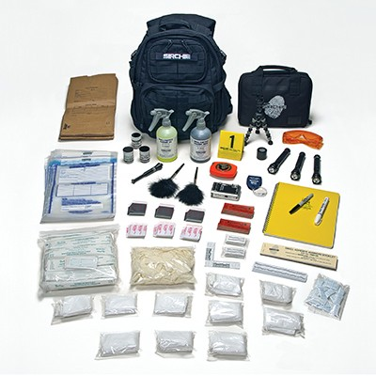
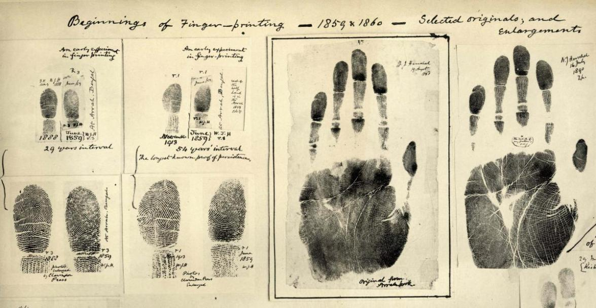
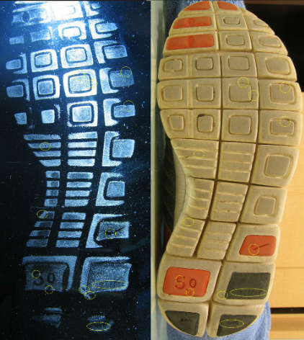
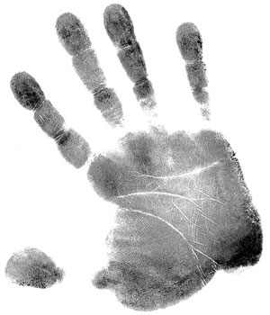
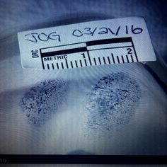

Slide 4
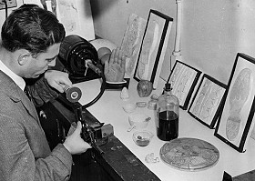
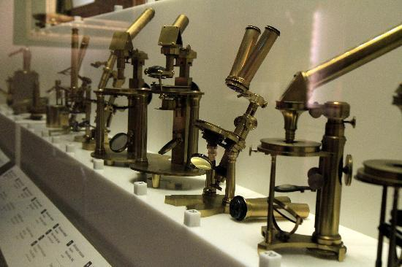
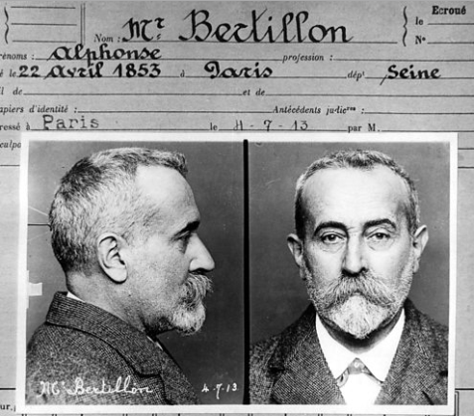
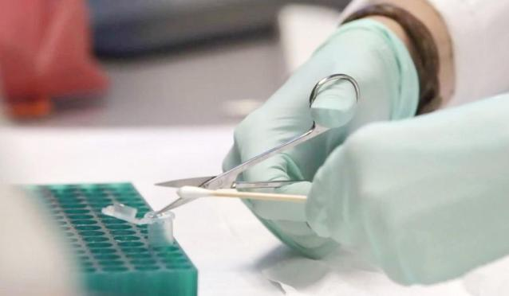
Development of forensic
» Forensic development was slow :
Development of photography and documentation
Development of chemistry and instruments for analysis of the evidences and development of other sciences
Development and use of microscopes to study tissues and evidences from the crime scene
Progress of pathology and possibility of taking samples

Slide 5
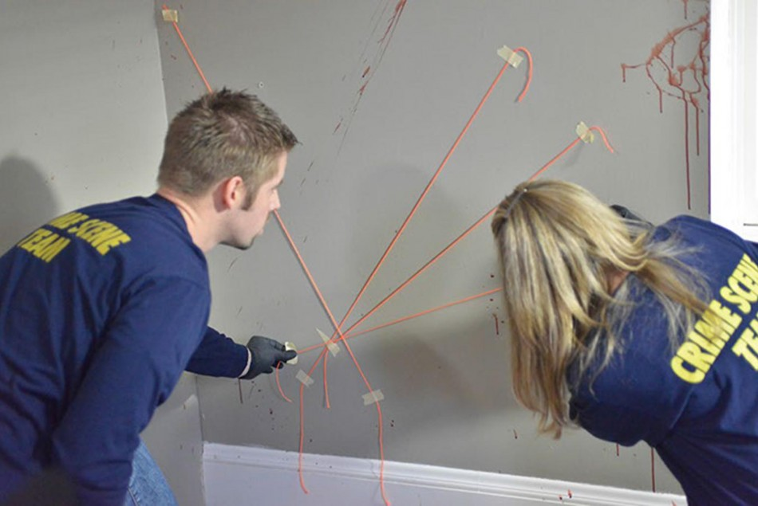
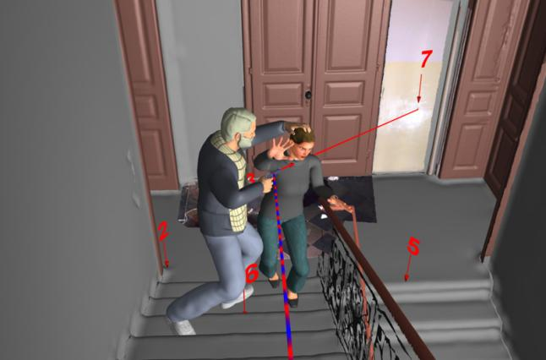
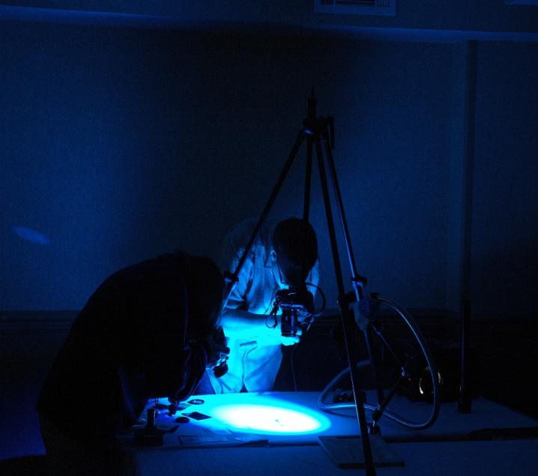
» Forensic is also a science that is connected with other science such as: criminalistics, pathology, biology, medicine, chemistry, toxicology, forensic anthropology, computer forensic, ballistic, etc.
» Together with reconstruction of the crime scene , interrogations of suspects, witness’s statements and other evidences, forensic find it easy to find out what really happened at the scene.

Slide 6
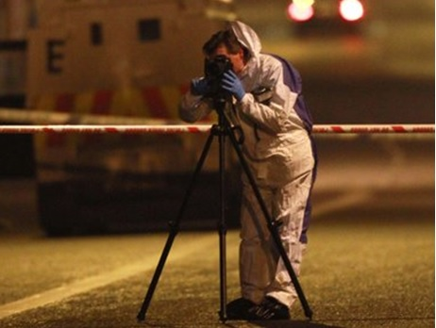
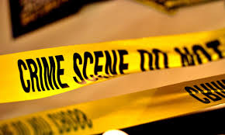
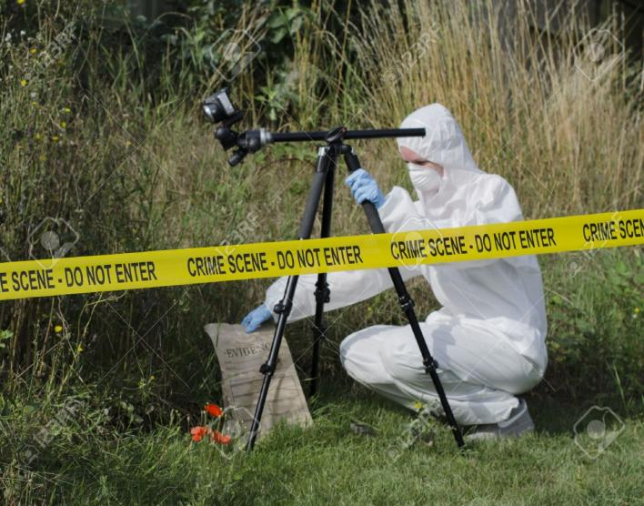
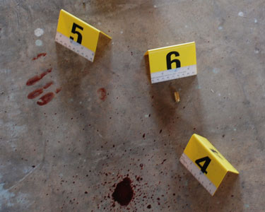
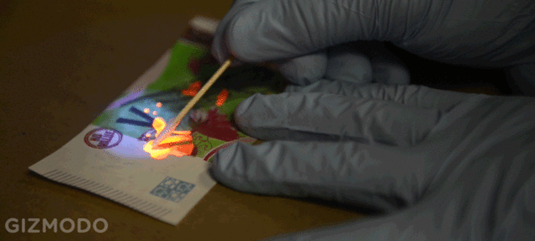

Slide 7
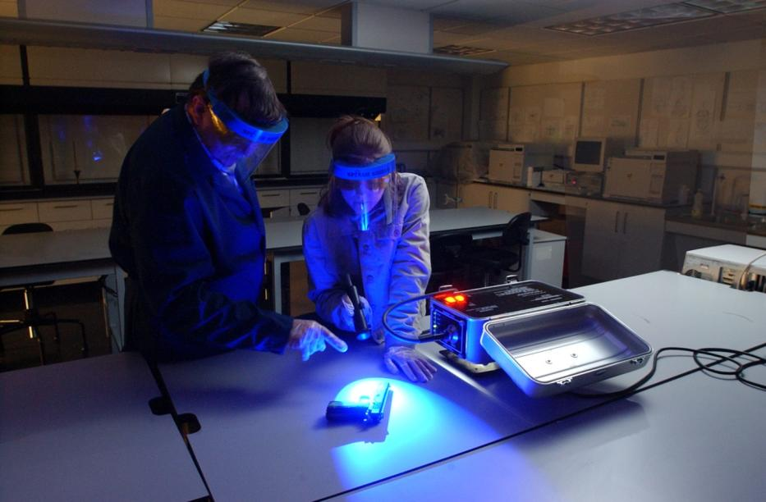
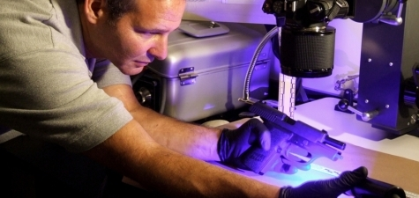
Criminalistics (criminal science)
» Criminalistics is a science that involves working in small laboratories that have departments for analyzing traces of explosives and firearm (weapons).

Slide 8
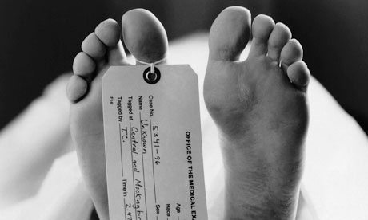
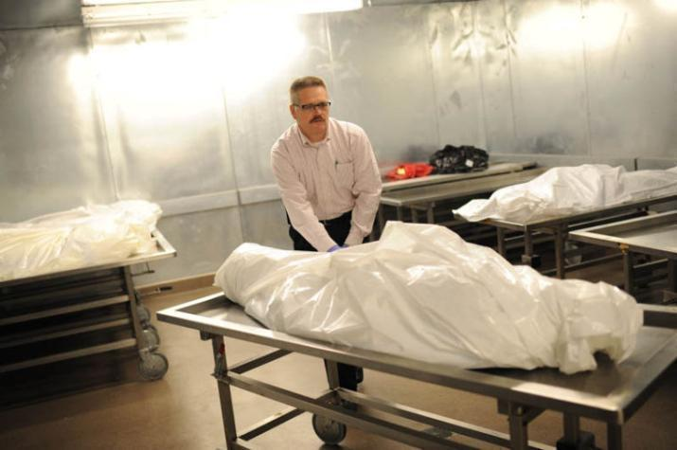
Forensic pathology
» Forensic pathology is the science that examines samples of unnatural death. A pathology is also a science where doctors do autopsies of unnatural, suspicious, violent and unexpected deaths.

Slide 9
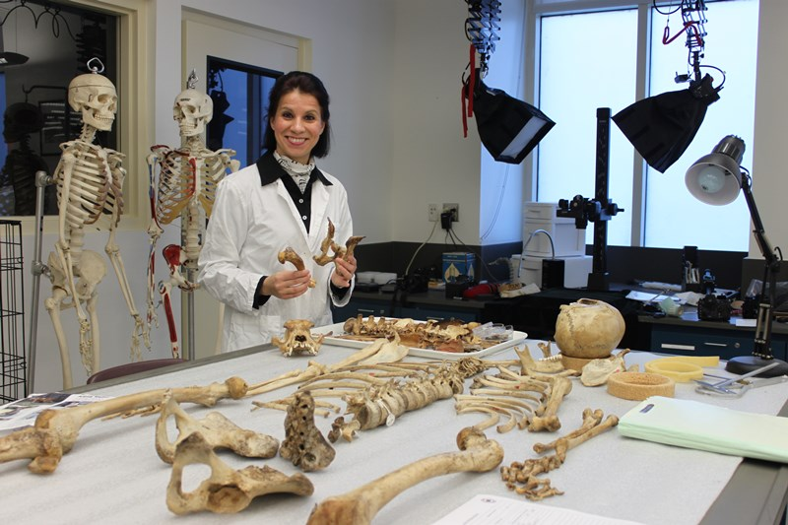
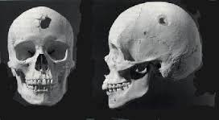
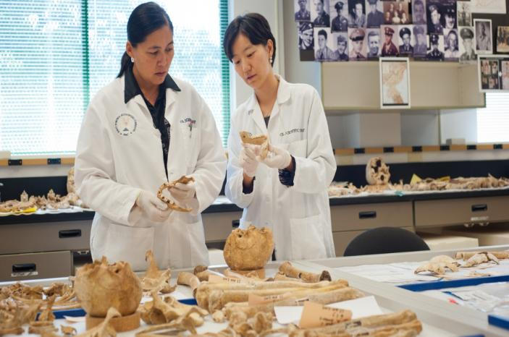
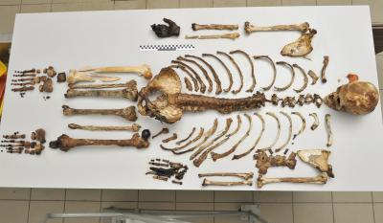
Forensic anthropology
» Forensic anthropology is a science that involves identification of victims using their bones and skeletal remains. Their research gives information about the victim’s age, gender, race and time of death.

Slide 10
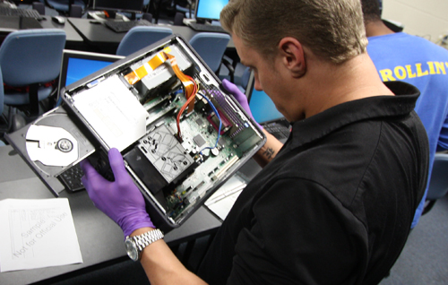
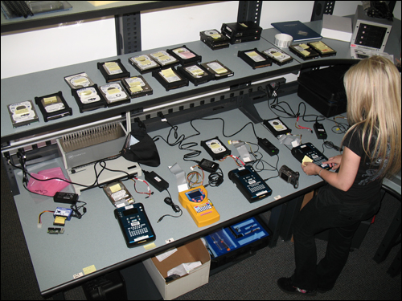
Computer forensic
» Computer forensic is a science that collects and completes the research of digital proofs from specific device. Also this science uses the method of stenographic analysis, collection of deleted data and stochastic analysis, etc.

Slide 11
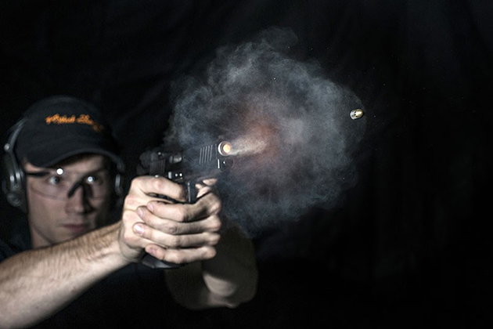
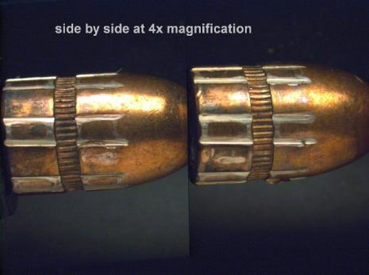
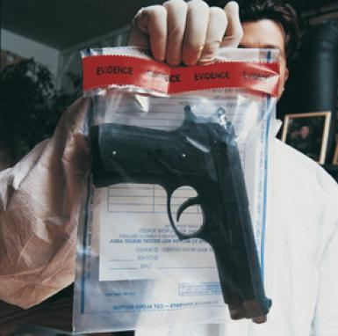
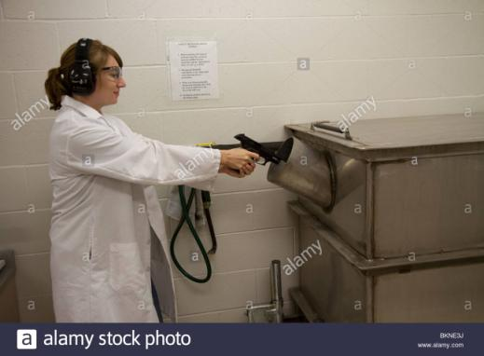
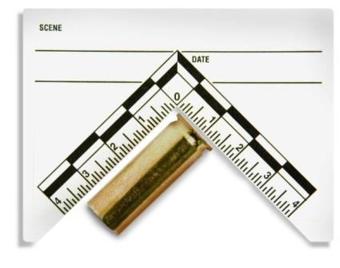
Ballistic
» Ballistic is a science that studies the movements of the bullets before and after shots. Ballistic is divided into internal, external and target ballistic, and the first problems of ballistic were solved by Leonardo da Vinci.

Slide 12
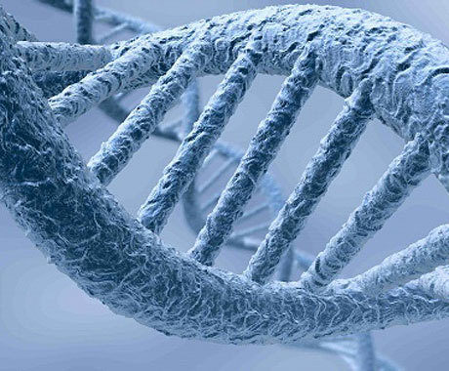
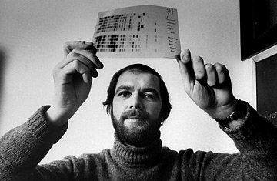
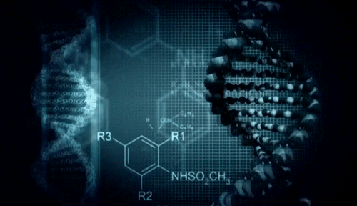
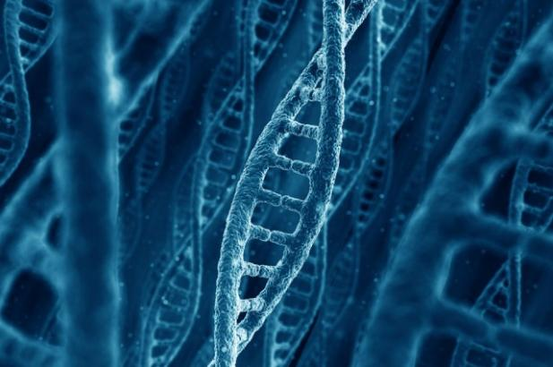
DNA
» DNA are nucleic genes in the form of double spiral. Forensics use DNA from blood, hair and skin which are found on crime scene or victim for the identification of suspects. And this method was developed by English geneticist Alec Jeffreys.

Slide 13
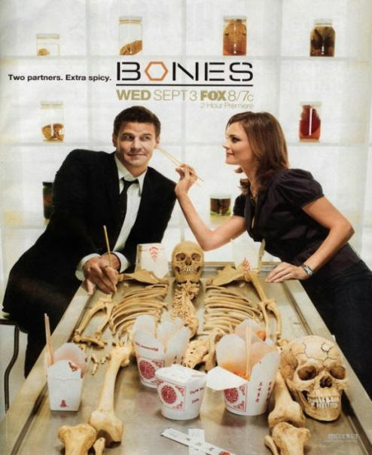
Forensic science in TV series

Slide 14
Forensic Science Day
» This is a short film about the Forensic Science Day.

