Slide 1
Greece
Strahinja BelosevicVI1
Luka Djuric VI1

Slide 2
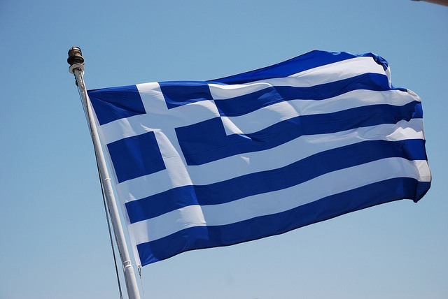
Greek flag

Slide 3
Capital city: Athens
Official language: Greek
Currency: euro

Slide 4
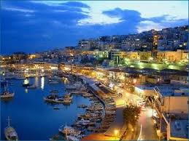
Greek capital

Slide 5
boundaries
Greek exits to the Aegean and lonian and Mediterranean seas.
It borders with Macedonia, Turkey, Bulgaria and Albania.

Slide 6
climate
Greece has a Mediterranean climate with a wet, mild winters and hot, dry summers.
Northern Greece has moderate climate.

Slide 7
Natural features
Greece is mostly mountainous country with a lot of islands.
Mountains: three old mountain massives are:
Olympus, Parnassus, Rhodope mountains.
Rivers: Marica, Vardar and Struma
Lakes: Janjinsko, Prespansko and Dojransko

Slide 8
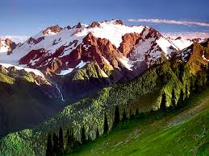
Mountain olYmpus

Slide 9
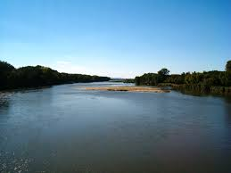
River marica

Slide 10
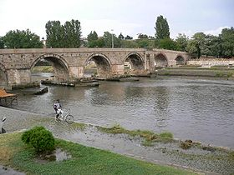
Vardar river

Slide 11
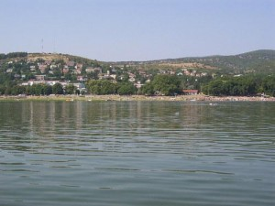
Dojransko lake

Slide 12
Social characteristics
Greece is one of the most homogeneous national countries in Europe.
Greeks make up about 98 % of the population.
They are descendants of the ancient Helena.

Slide 13
Interesting
Greece is a manufacturer of marine water sponges.
Olympic games originated in ancient Greece.
Football is the national sport in Greece.

Slide 14
Thank you for listening

