Slide 1
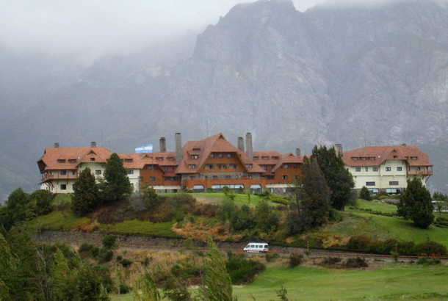
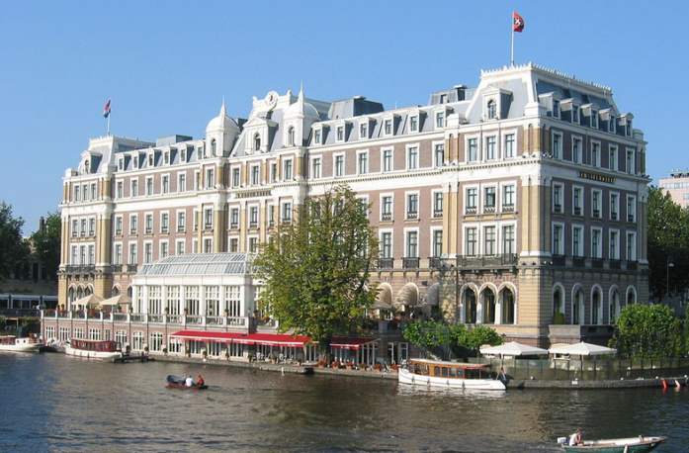
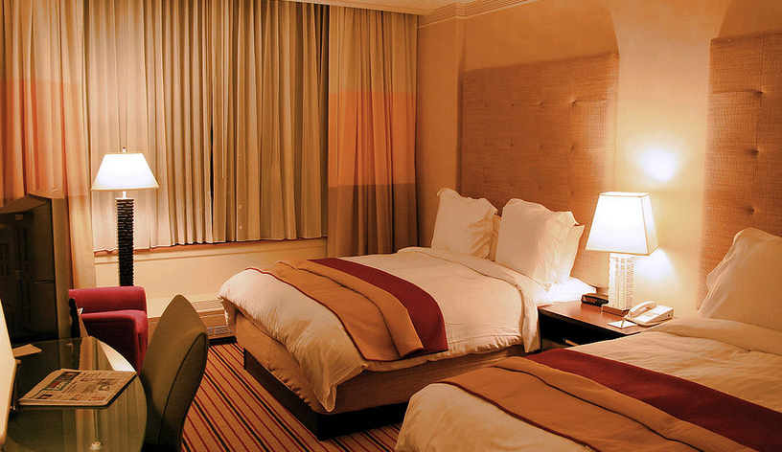
HOTELS
Marijana Milić, VIII 2

Slide 2
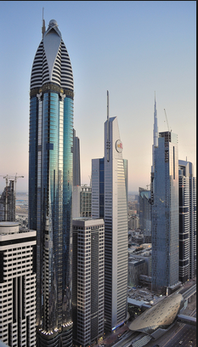
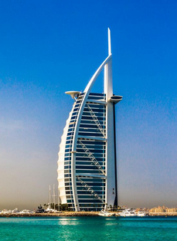
A hotel is an establishment that provides lodging paid on a short-term basis.
The tallest hotel in the world is the Rose Rotana Suites Hotel in Dubai, which is as high as 333 meters, so it surpass the previous record holder Burj-Al-Arab high 321 meters, which is also located in Dubai.
Rose Rotana Suites Hotel
Burj-Al-Arab

Slide 3
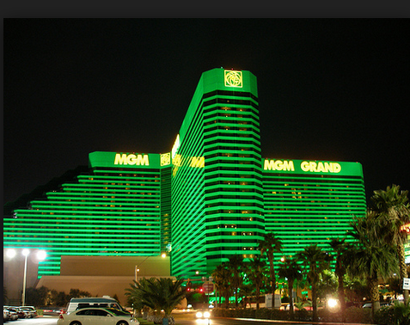
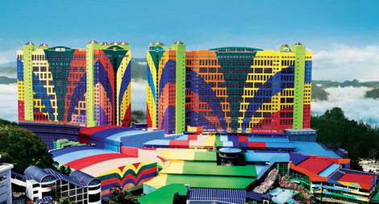
The world's largest hotel is the MGM Grand in Las Vegas, whose accommodation has 6276 rooms, which in December 2006 surpassed the previous recorder First World Hotel in Genting Highlands in Malaysia whose total capacity amounts 6118 rooms.
MGM Grand
First World Hotel

Slide 4
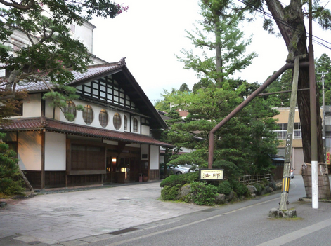
The world's oldest hotel is the Hoshi Ryokan, in Awazu, Japan, which was opened 717 years ago.

Slide 5
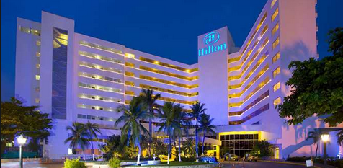
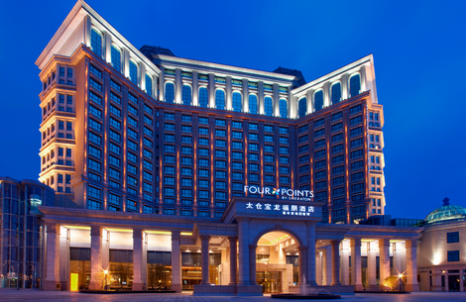
FAMOUS HOTELS ARE:
Hilton
Sheraton

Slide 6
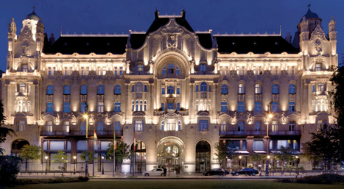
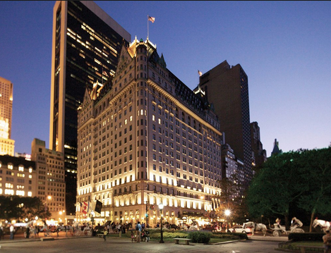
FAMOUS HOTELS ARE:
Grand hotel Royal
Plaza

Slide 7
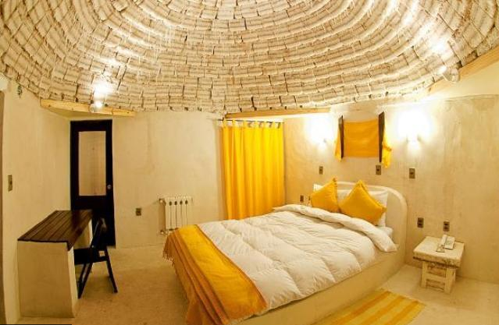
Some of the unusual hotel are:
Palacio de Sal means "Palace of salt" and it looks just like that. It is located a few hundred kilometers south of La Paz and everything in this hotel, from the ceiling to the furniture, is made of salt.
Licking items is strictly prohibited.

Slide 8
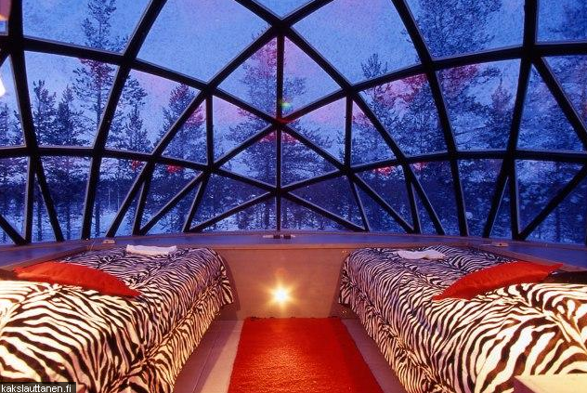
Hotel Kakslauttanen
Rooms are made of special thermal glass, and because of it, the cold air won't get in. The glass allows one to enjoy the wonderful view of Aurora Borealis from one’s bed.
Tourists can also stay in a snow igloo, in which the temperatures vary from -3 to -6 degrees Celsius.

Slide 9
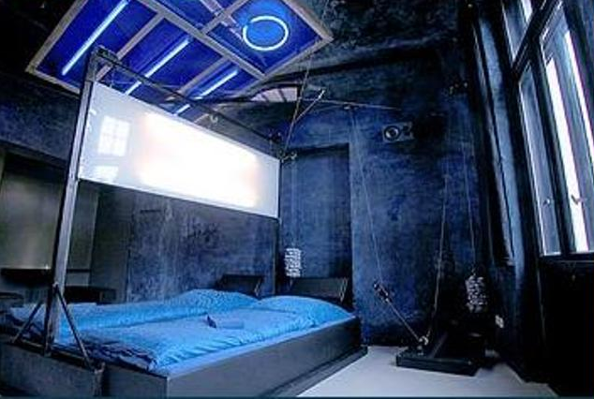
Propeller Island City Lodge in Berlin
In the hotel there aren't two same rooms. Tourists can stay in a variety of interiors - from the pentagonal room decorated with mirrors, to the replica of a prison cell.

Slide 10
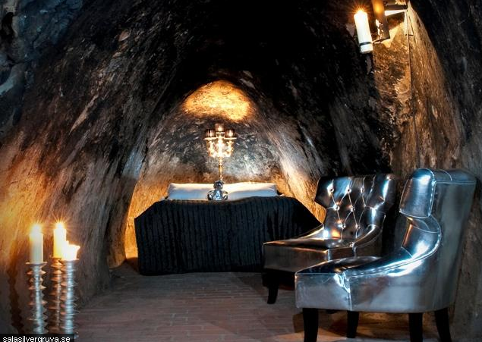
Sala Silvermine, Sala
At 155 meters below the surface ground there is a room inspired by the mine.

Slide 11
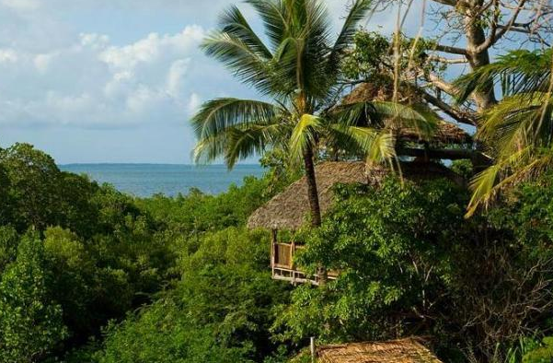
Chole Mjini is located in a park in the east of Africa and consists of seven unique tree houses.

Slide 12
Hotel in the future
Marijana Milic VIII2

