Slide 1
Monica selesh
Nataša Stojanović VII 1

Slide 2
Monica Selesh was born on 2nd December 1973 in Novi Sad.
She is a former Yugoslav and later an American professional tennis player (Hungarian origin), ex-best player in the world.
During her tennis career she has won 9 Grand Slam tournaments.
She is the youngest tennis player who’s won Roland Garros.

Slide 3
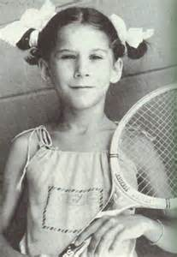
Selesh started playing tennis when she was 6 years old. The coach was her father Karoly. She won her first tournament when she was 9, although she didn’t understand the scoring in tennis and during the match she didn’t know who’s running the game.
In 1985, with only 11, she won the prestigious Orange Bowl tournament in Miami, USA. Next year Monica moved to Nick Bollettieri tennis academy, where she trained for two years.

Slide 4
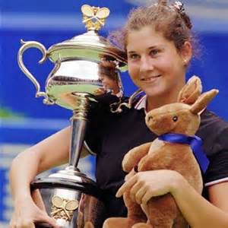
She won her first Grand Slam title at the Franch Open in 1990 . In the final, she faced Steffi Graf. Winning the tournament, she became the youngest tennis player who won the Franch Open with only 16 and a half years.
In1991, Selesh had a dominant position in women’s tennis. She started that season by winning the Australian Open in January, bating Jana Novotna in the final.Two months later, on 11th March she took place No.1 on the WTA list from Steffi Graf.

Slide 5
In 1993, Selesh strongly started her tennis year. In January, she won the Australian Open, beating Steffi Graf the 3rd consecutive time... However….

Slide 6
Everything has changed because of an incident that has shocked the tennis world on 30th April 1993.
In the quarterfinals during the match between Selesh and Magdalena Malajeva at a tournament in Hamburg, a 38-year-old man, Ginter Parhe stabbed Monica Selesh in the spine between the shoulder blades. He was an obsessive fan of Steffi Graf.
Soon she was taken to the hospital.

Slide 7
Physically, Monica recovered in a few weeks, but the attack has left great psychological consequences.
She didn’t return to the professional tennis for the next two years.
The attacker didn’t go to prison because of his mental state.
Because of this incident security measures have intensified at tennis tournaments.

Slide 8
Selesh returned to professional tennis in August 1995 and won her first comeback tournament, the Open Championship of Canada.
That same month, she came to the final of the Open Championship of America, where she lost from Steffi Graf.
In January 1996 she won the Australian Open.

Slide 9
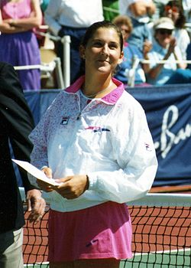
After winning 53 tournaments until 2003, Selesh had to leave professional tennis because of a leg injury. In February 2005, she played two matches against Martina Navratilova and she lost booth times.

