Slide 1
Unusual hotels
Milos Bozic VIII2

Slide 2
Unusual hotels of the World is the online guide for travellers interested in staying somewhere truly different.
Some unusual hotels in the world can be :
In the ice,
In the plane,
Under water,
On boat, etc.

Slide 3
The ice hotel:
An ice hotel is a temporary hotel made of snow and sculpted blocks of ice. They may be visited by adventurous travelers that are comfortable with the outdoors.
Ice hotels are promoted for adventurous travelers who are interested in novelties and unusual environments.
Temperature in the rooms is below zero Celsius, but much warmer than outside.
An ice bar, sometimes associated with an ice hotel, is a drinking establishment primarily made of ice.
Staying at an ice hotel is expensive as prices for a night are from around US $300 to $3,000. Some ice hotels may be destination hotels.

Slide 4
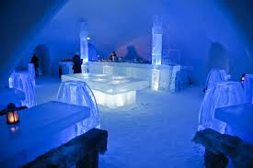
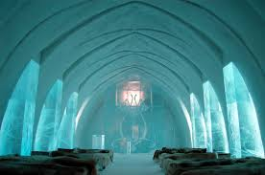

Slide 5
Tree hotel
Tree hotels have unforgettable view, and the best place for this is Tree House in Kerala, India.
The two tree houses have been built in the middle of the rain forest, 30 meters above the ground.
From the hotel you can lo0k out over the rain forest and watch beautiful birds and animals.
This hotel have got a sitting room, bedroom and shower.
The one night in this hotel cost 150€.

Slide 6
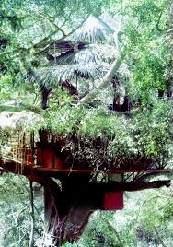
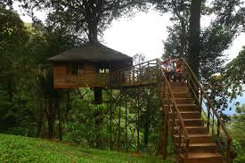
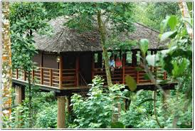

Slide 7
Underwater hotel:
Lot of people like to stay in hotel near the water but some stay under the water.
The Poseidon Mystery Island resort in Fiji has got 25 rooms that are 12 meters under the Pacific Ocean.
The fish can be fed by pushing a button.
Guests are taken down to the underwater rooms by elevator.
One week at the resort including two nights in an underwater room, costs 19.400 € .

Slide 8
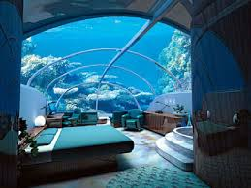
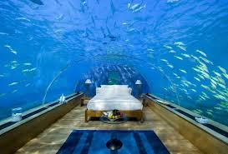
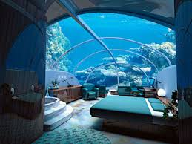
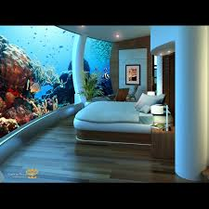
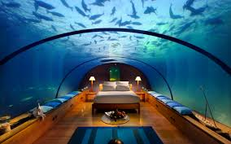

Slide 9
The end

