Slide 1
unit 2-animals Present Continuous Tense October, 2013

Slide 2
Present Continuous Tense
They ______________ on a school trip.
He ________________ on a coach.
I _________________ about a school trip.
are going
is getting
am writing
S
infinitivna osnova +
-ING
present TO BE
(am/ is/ are)

Slide 3
Present continuous Tense
S
infinitivna osnova +
-ING
present TO BE
(am/ is/ are)
play+ ing = playing, clean + ing =cleaning, watch + ing =watching,
come + ing = coming, dance + ing = dancing;
swim + ing = swimming, run + ing = running
play playing
watch watching
come + -ING coming
dance dancing
swim swimming
run running

Slide 4
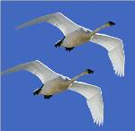
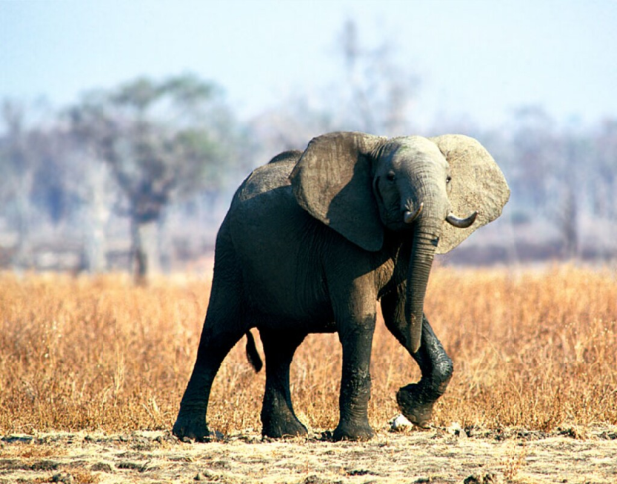
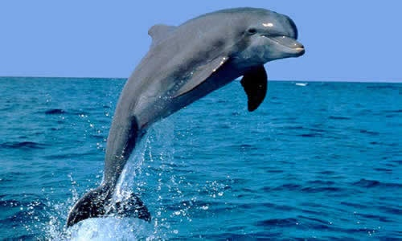
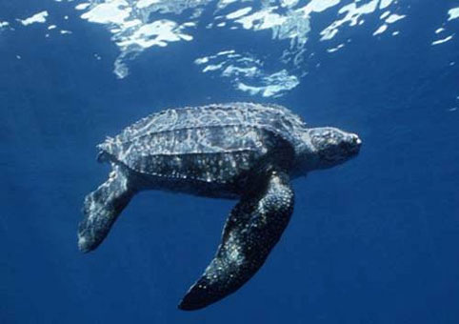
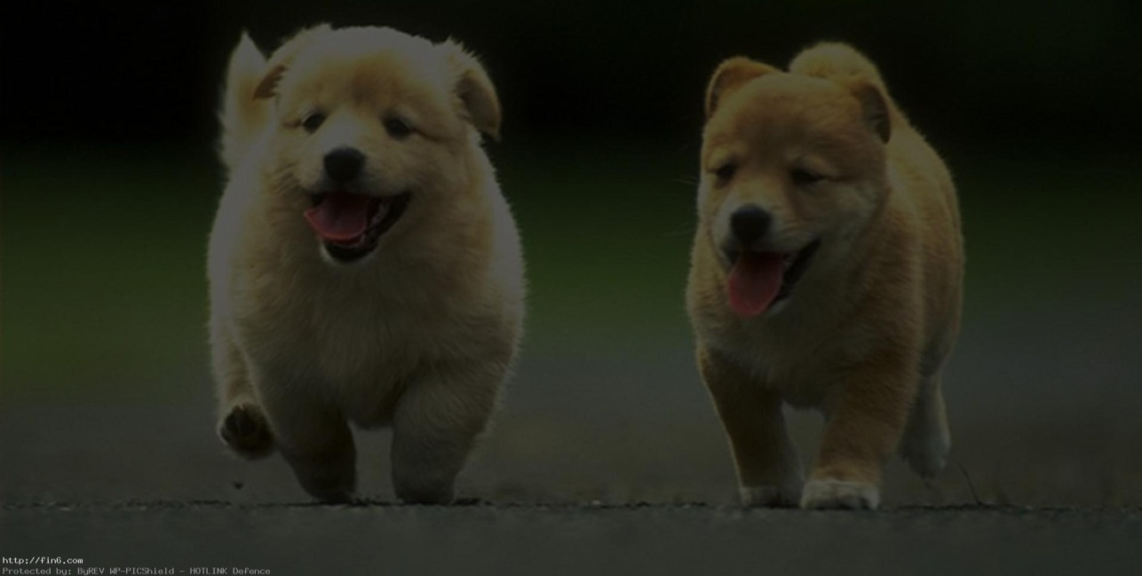
WHAT ARE THEY DOING?
The birds are flying.
The elephant is walking.
The dolphin is jumping.
The turtle is swimming.
The dogs are running.

Slide 5
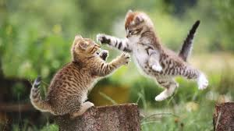
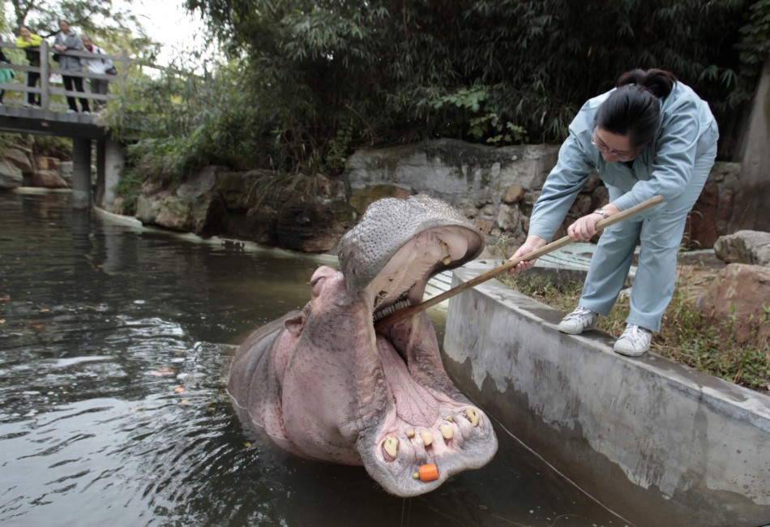
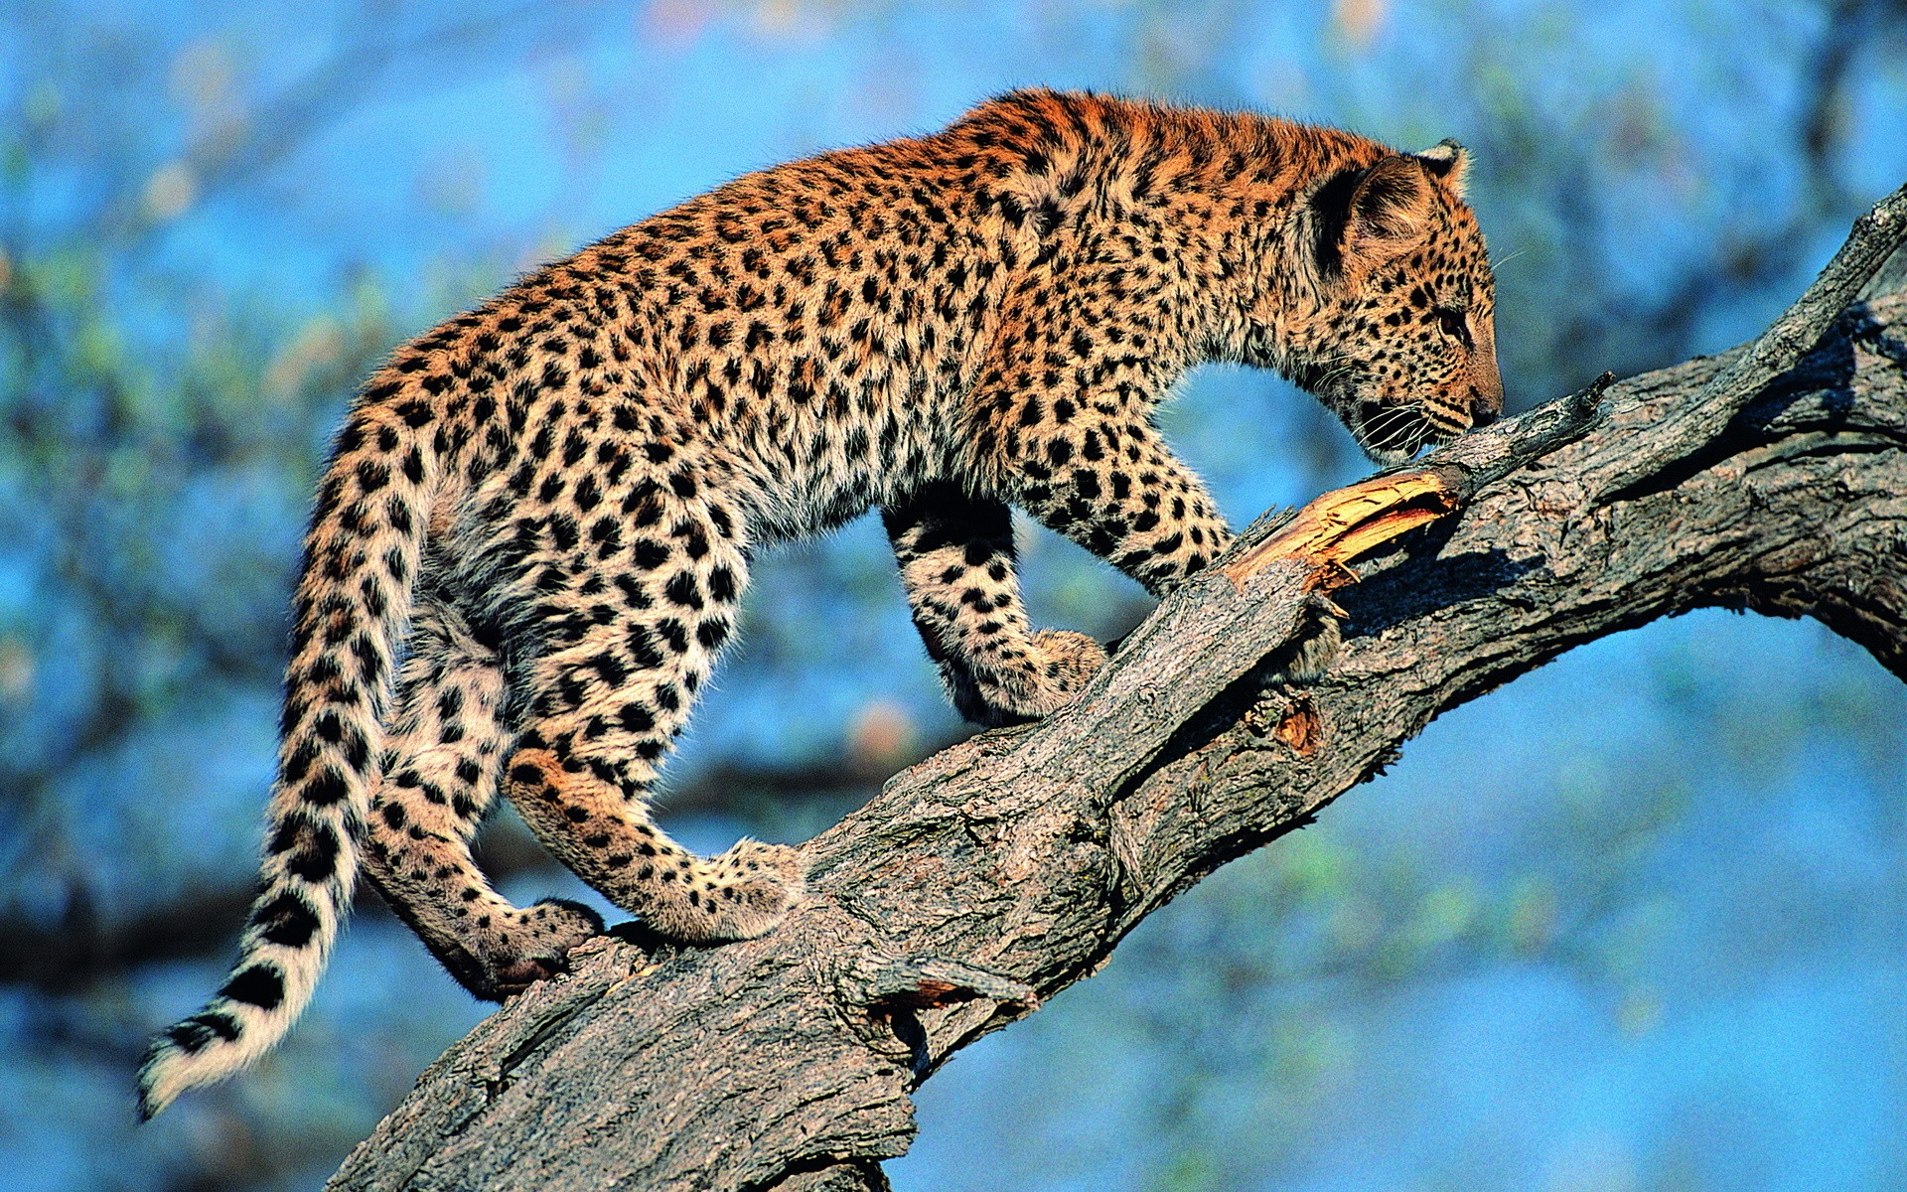
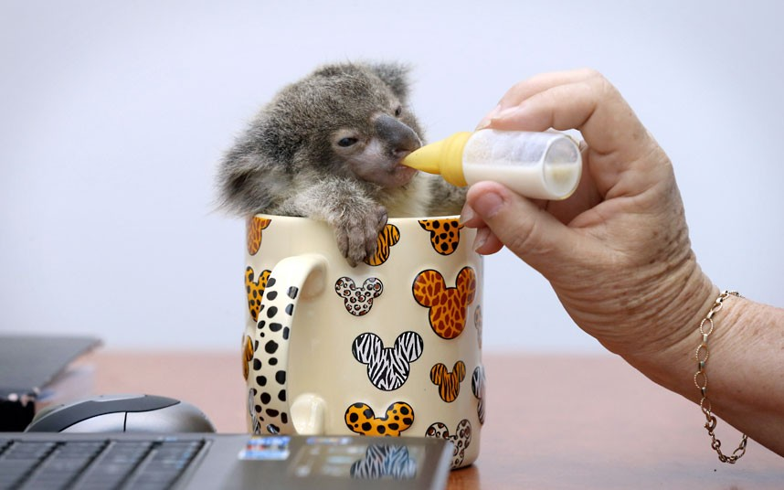
WHAT ARE THEY DOING?
The cats are playing.
The penguins are standing.
The keeper is cleaning hippo’s teeth.
The koala is drinking milk.
The cheetah is climbing a tree.

Slide 7
What animal is this?
It’s a lion.

Slide 8
What animal is this?
It’s a monkey.

Slide 9
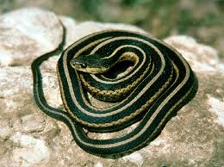
What animal is this?
It’s a snake.

Slide 10
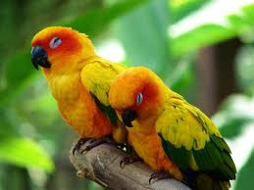
What animal is this?
It’s a bird/ parrot.

Slide 12
LISTEN AND WRITE:
1) THE NAME OF THE ANIMALS 2) WHAT ARE THEY DOING
Animal | Action
bats | They’re flying.
a lion
It’s eating.
a snake
It’s swimming.
elephants
They are drinking.
a crocodile
It’s running into the water.
monkeys
They are jumping.
a bear
It’s climbing a tree.
kangaroos
They are sleeping.

Slide 13
CORRECT THE SENTENCES.
are
They is sleeping.
The kangaroo are jumping.
Hippos are swiming in the river.
Birds flying.
The tiger is runing very fast.
is
swimming
are
running

Slide 14
Now, take your books and practise!

Slide 15
What
are they
doing?
Present continuous

